Slide 1

Getting paid

Slide 2
Contents
Chapter 1 - Income
01 How does money come in for me and my family?
02 Different models of work and their pros and cons
03 Work benefits that matter to me
04 Looking at more ways money can come in
Chapter 3 - Speaking up at work
09 Equal pay for equal work
10 Asking for a pay rise
11 Resolving problems at work
Chapter 2 - Deductions
05 Deductions on a pay slip
06 What do we mean by tax on income?
07 Calculating income tax using tax bands
08 Where does my tax money go?

Slide 3
What is FLIC?
The Financial Times news group has set up a charity (Financial Literacy and Inclusion Campaign) focused on building up the financial knowledge and skills of everyone in the UK, especially the people that don’t usually come across this information.

Slide 4
Learning Outcome: ‘I will learn about different forms of employment, about tax and other deductions that may be taken from my earnings, as well as how to speak up at work.’
By the end of the session, I will be able to:
Understand the advantages and disadvantages of different models
of paid work including employment vs. self-employment, and what’s important to me when choosing a job.
Understand the main salary deductions, focusing on national insurance and income tax.
Recognise my rights at work, confidently ask for a pay rise and know where I can turn for support when facing problems in the workplace.

Slide 5
Chapter 1:
Income

Slide 6



How does money come in for me and my family?

Slide 7

The world of work
Watch here: https://www.youtube.com/watch?v=P26wizs8I20
Notes:
The world of work video: https://www.youtube.com/watch?v=P26wizs8I20

Slide 8

Don’t forget you’ll need to set up a bank account to get paid!
You can set up a bank account through an application online, over the phone or, sometimes, in a branch. You’ll want to be careful and do your research to work out which bank you want to use. You can learn more here!

Slide 9
National minimum wage or Real living wage?
A minimum hourly rate of pay all employers must pay - it is legally-enforced.
There is a different minimum set depending on your age, of up to £9.50 per hour.
A wage that employers can choose to pay that is based on the standard cost of living. It is higher than the national minimum wage
This wage is different in London from other parts of the UK because the cost of living is higher in the capital.
NATIONAL MINIMUM WAGE
REAL LIVING WAGE
Why might employers decide to pay the real living wage, which is higher?

Slide 10
National minimum wage rates 2022
First job or already employed? Get to know the minimum you have a right to get paid!
Apprentice / Under 18
£4.81
Aged 23+
£9.50
Aged 18-20
£6.83
Aged 21-22
£9.18
For a full guide to national minimum and living wage rates see: https://www.gov.uk/national-minimum-wage-rates

Slide 11







What benefits are important to you when choosing a job?
Can you think of any others?
Child
care vouchers
Free stuff or food
Cycle to
work scheme
Company
discount
Company
car
Health
insurance

Slide 12
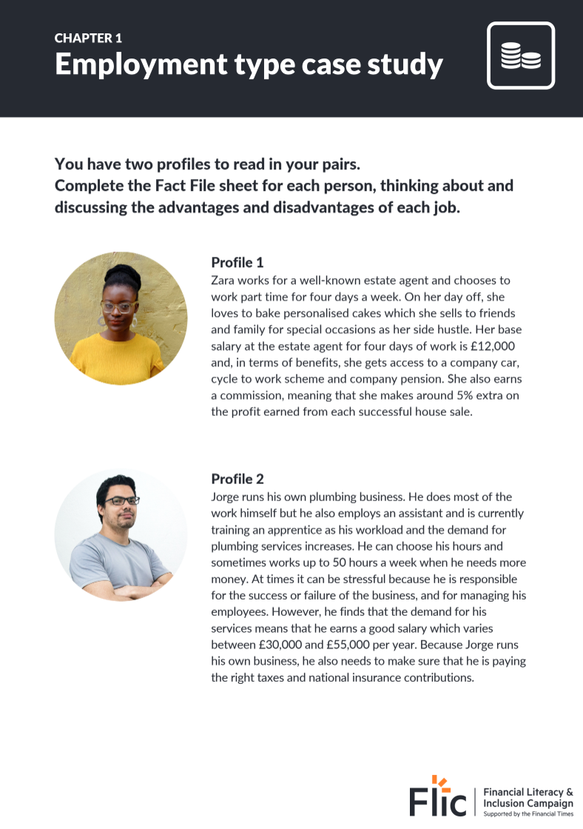
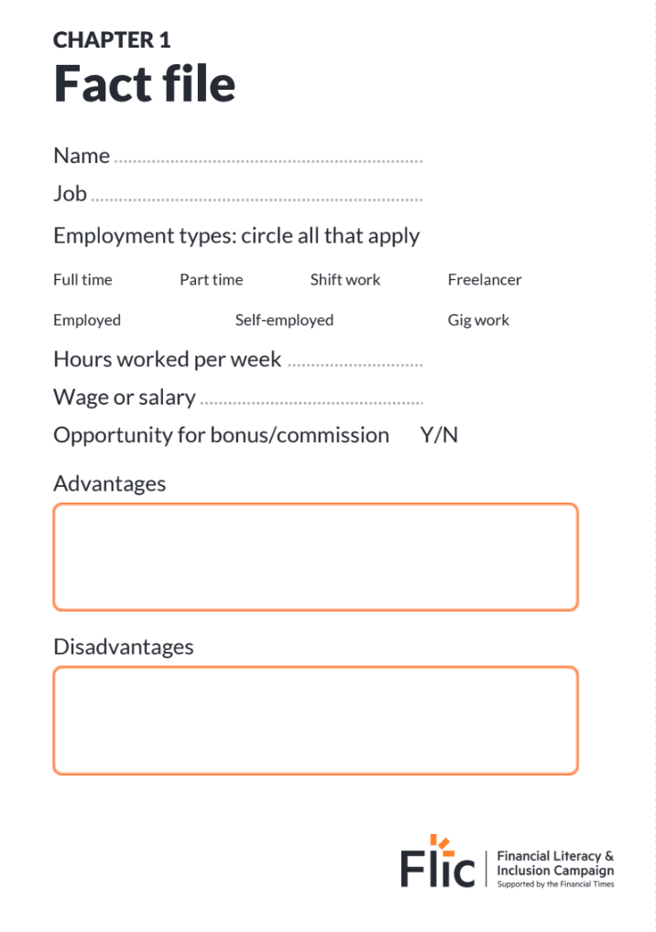
Different types of work
There are lots of ways people can earn money
Complete the Fact File for your 2 job profiles

Slide 13



Discuss the advantages and disadvantages of these jobs
Zara
Job Title: Estate agent
Type of Employment: Employed,
Part-time
Weekly hours/days worked:
4 days
Wage or salary: £12,000
Bonus/commission/tips?:
Yes, 5% commission on the profit of a home sold
Jorge
Job Title: Plumber
Type of Employment: Self-employed, Full-time
Weekly hours/days worked: Varies but at times 50 hours a week
Wage or salary: £30,000-£55,000
Bonus/commission/tips?: No
Lucy
Job Title: Barista
Type of Employment: Employed, Part-time, Shift work
Weekly hours/days worked:
Part time 15 hours/ week
Wage or salary: £9.50 per hour
Bonus/commission/tips?:
Yes, tips

Slide 14



Discuss the advantages and disadvantages of these jobs
What kind of job do you think you would like and why?
David
Job Title: Junior investment banker
Type of Employment: Employed, Full time
Weekly hours/days worked:
Full time contract but often works 80-100 hours a week
Wage or salary: £42,000
Bonus/commission/tips?:
Yes, bonus of up to 30% of his base salary
Shivaughn
Job Title: Food delivery courier
Type of Employment: Zero-hours, Part time
Weekly hours/days worked: Depends, roughly 3 days
Wage or salary: £11 per hour on average
Bonus/commission/tips?: No
Ken
Job Title: Graphic designer
Type of Employment: Self-employed, Freelancer
Weekly hours/days worked:
Day rates.
Wage or salary: £200 per day
Bonus/commission/tips?:
No

Slide 15


There are many ways to get money
9am-5pm
traditional job
Self-employment
Investment in stocks and shares, crypto or other assets
Side hustle / variable hours
Pensions
Rental income
Inheritance
Benefits
Using the above, can you think of somebody who makes money outside of their day job?
It could be a personal relation, a TV character or celebrity. Discuss how they get this money.

Slide 16


Lots of stars make money in more ways than you may think
Marcus Rashford
Main job: Professional footballer for Manchester United and the England national team
Passions and additional income streams: Marcus is passionate about child food poverty and literacy in the UK. He writes books and has a very well paid sponsorship with Nike.
Jessica Alba
Main job: Actress
Passions and additional income streams: Jessica is a successful businesswoman and co-founded the healthy household goods start-up, The Honest Company in 2011.
She also invests in start-ups like Headspace.
Notes:
Jessica Alba
In addition to founding her household product company, Honest Co., back in 2011, Alba has also made investments in startups like Headspace and Managed by Q.
https://financebuzz.com/celebrity-investors
Marcus Rashford
He is a campaigner against racism, homelessness and child hunger in the United Kingdom. Rashford has been praised for using his platform to be a political activist and philanthropist to drive societal change. For his efforts, he has received widespread praise, and has been recognised for his efforts from organisations both in and outside of sport. He’s also written a childrens book “You Are a Champion: How to Be the Best You Can Be …” which he earns from to inspire children to reach their full potential

Slide 17

By the end of the session, I will be able to:
Understand the advantages and disadvantages of different models of paid work including employment vs. self-employment, and what’s important to me when choosing a job.
Understand the main salary deductions, focusing on national insurance and income tax.
Recognise my rights at work, confidently ask for a pay rise and know where I can turn for support when issues arise in the workplace.

Slide 18
Chapter 2:
Deductions

Slide 19

Doubling your salary doesn’t mean doubling your take-home pay.
When you’re in employment, there will be some deductions which are taken away from your gross pay. These are the main ones, and we’ll then focus on National Insurance and Income tax:
National Insurance
Income
tax
Student loan
Pensions
Watch this video

Slide 20

Can you guess…
When was income tax first introduced?
Income tax was first introduced in 1799 to raise money to fight Napoleon in the French Revolutionary war

Slide 21
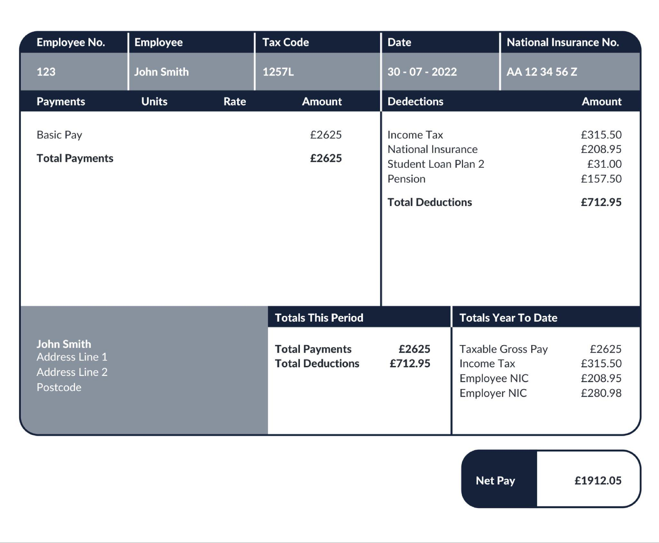
Understanding a payslip
Today we’re going to learn about DEDUCTIONS.
You will have to pay INCOME TAX and NATIONAL INSURANCE. You’ll also likely have a PENSION and may have to pay back a STUDENT LOAN.
Notes:
You will also have to pay a pension - more on that in wider FLIC modules.

Slide 22
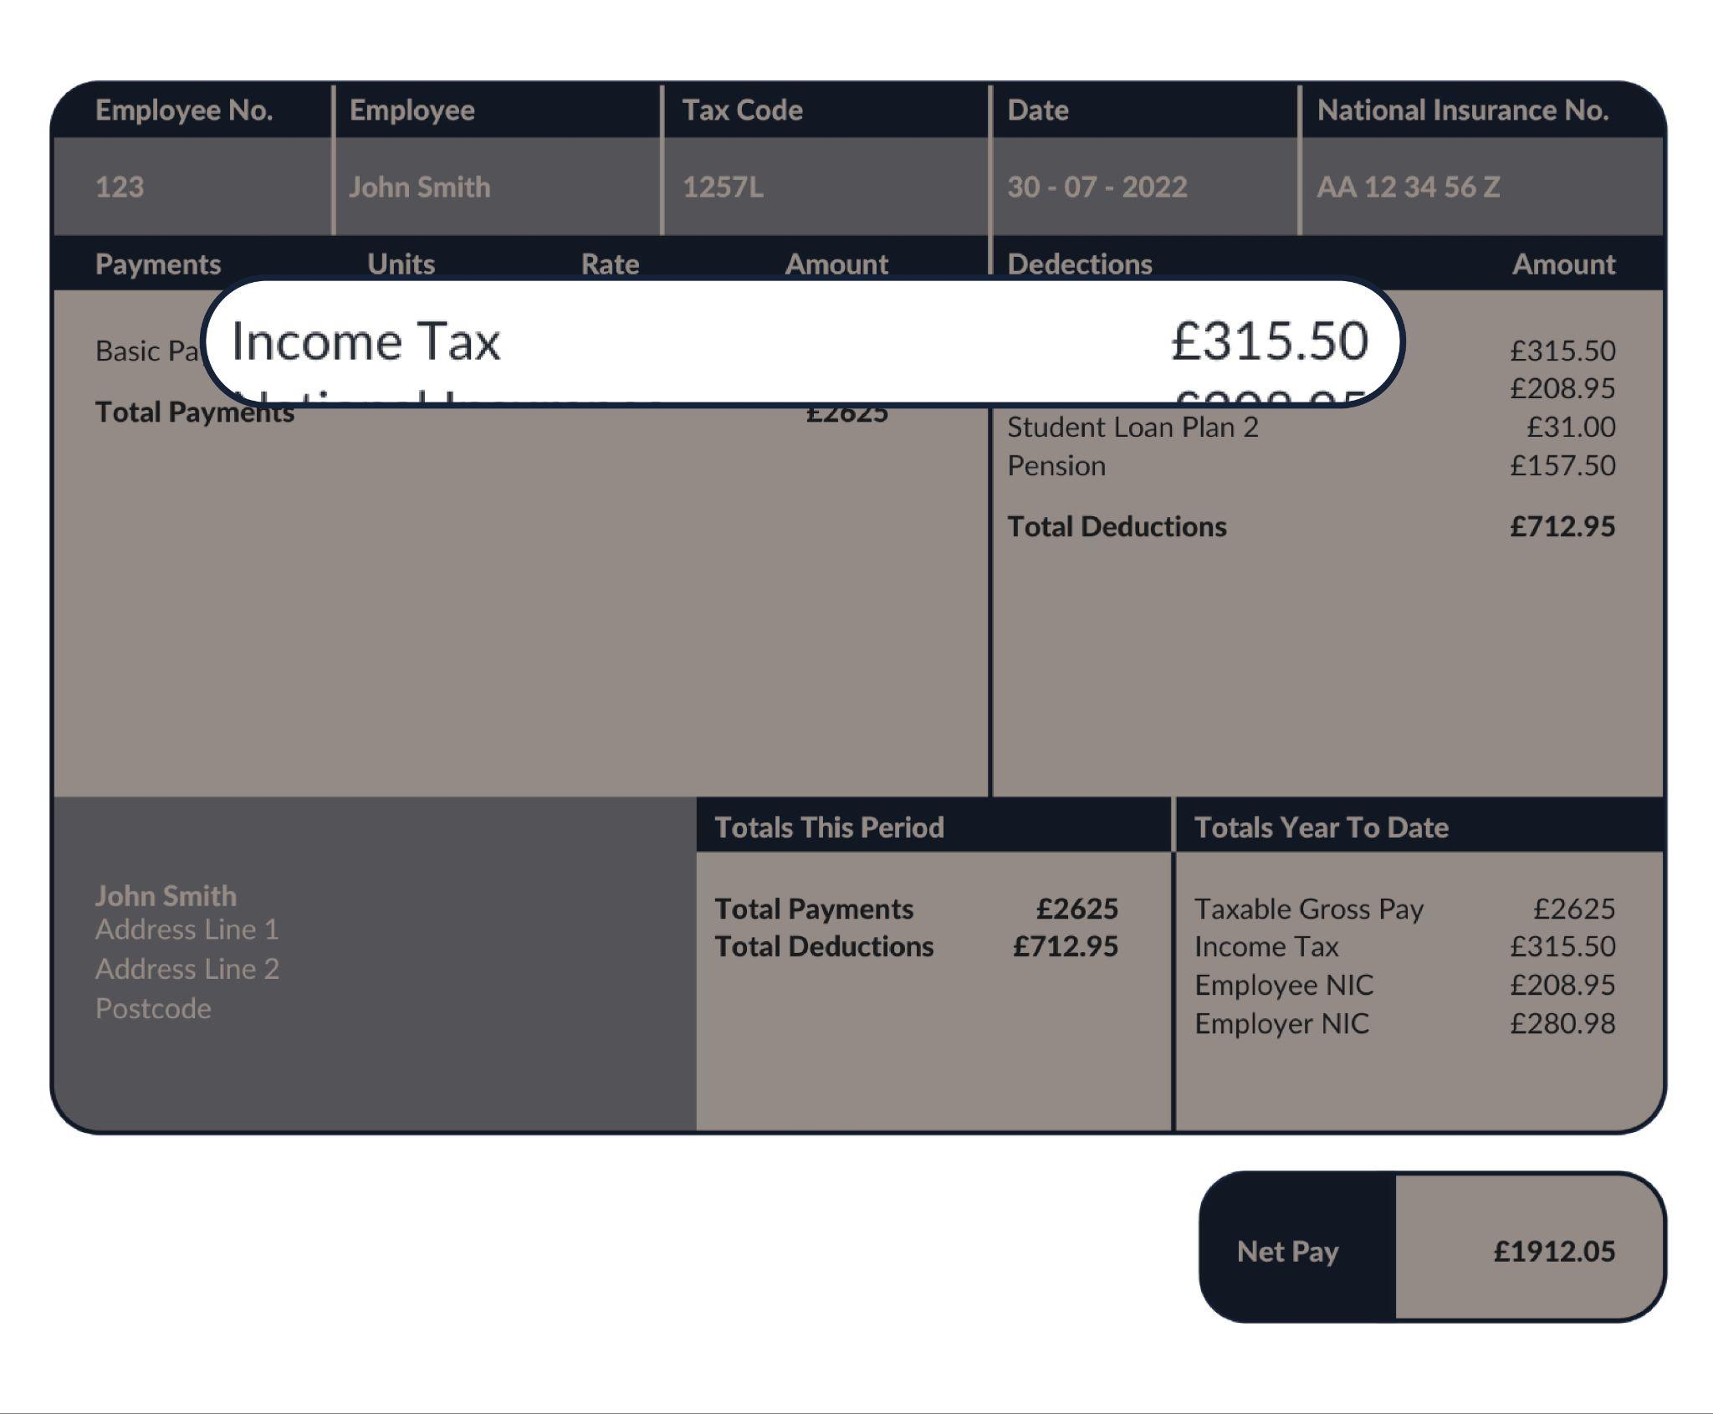
Starting with your taxes
Income Tax
Paid on earnings
Used for general public spending
The more you earn, the more you pay

Slide 23
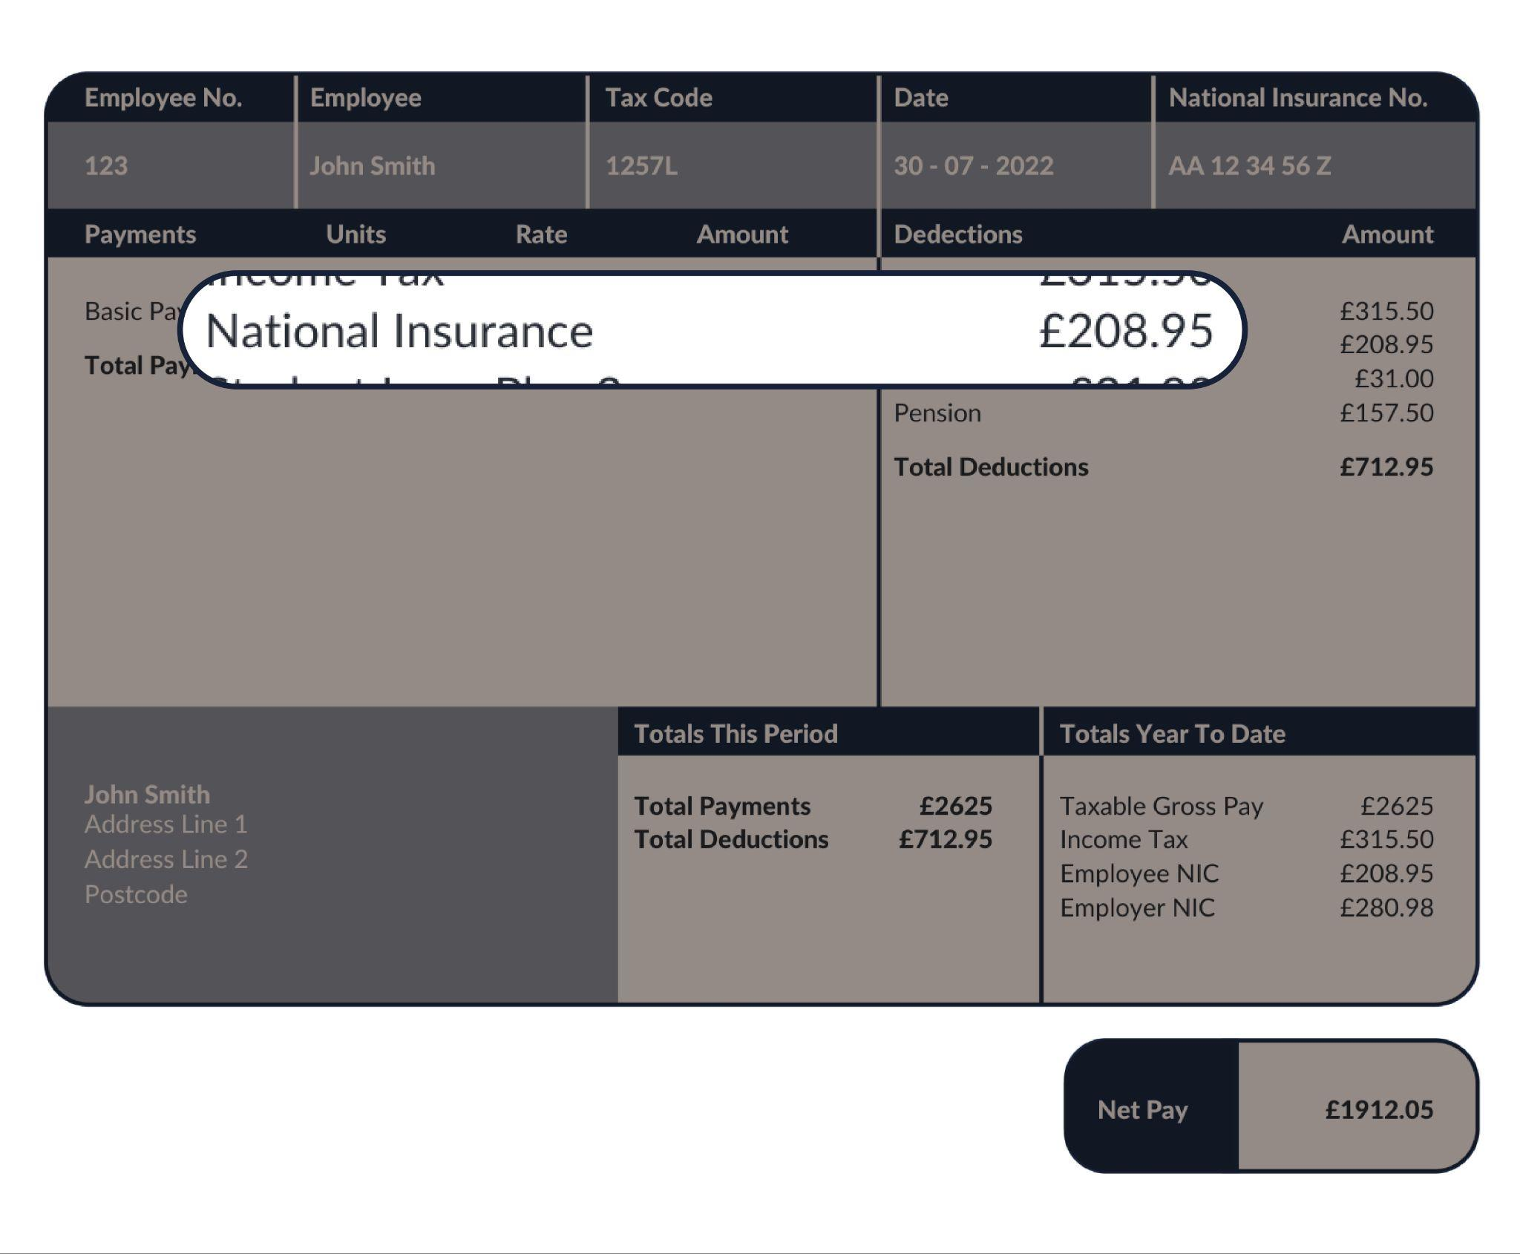
Starting with your taxes
National Insurance
Paid on earnings
Used for general public spending
The more you earn, the more you pay (to a point)
You need a minimum 35 years of paying this to qualify for a state pension

Slide 24
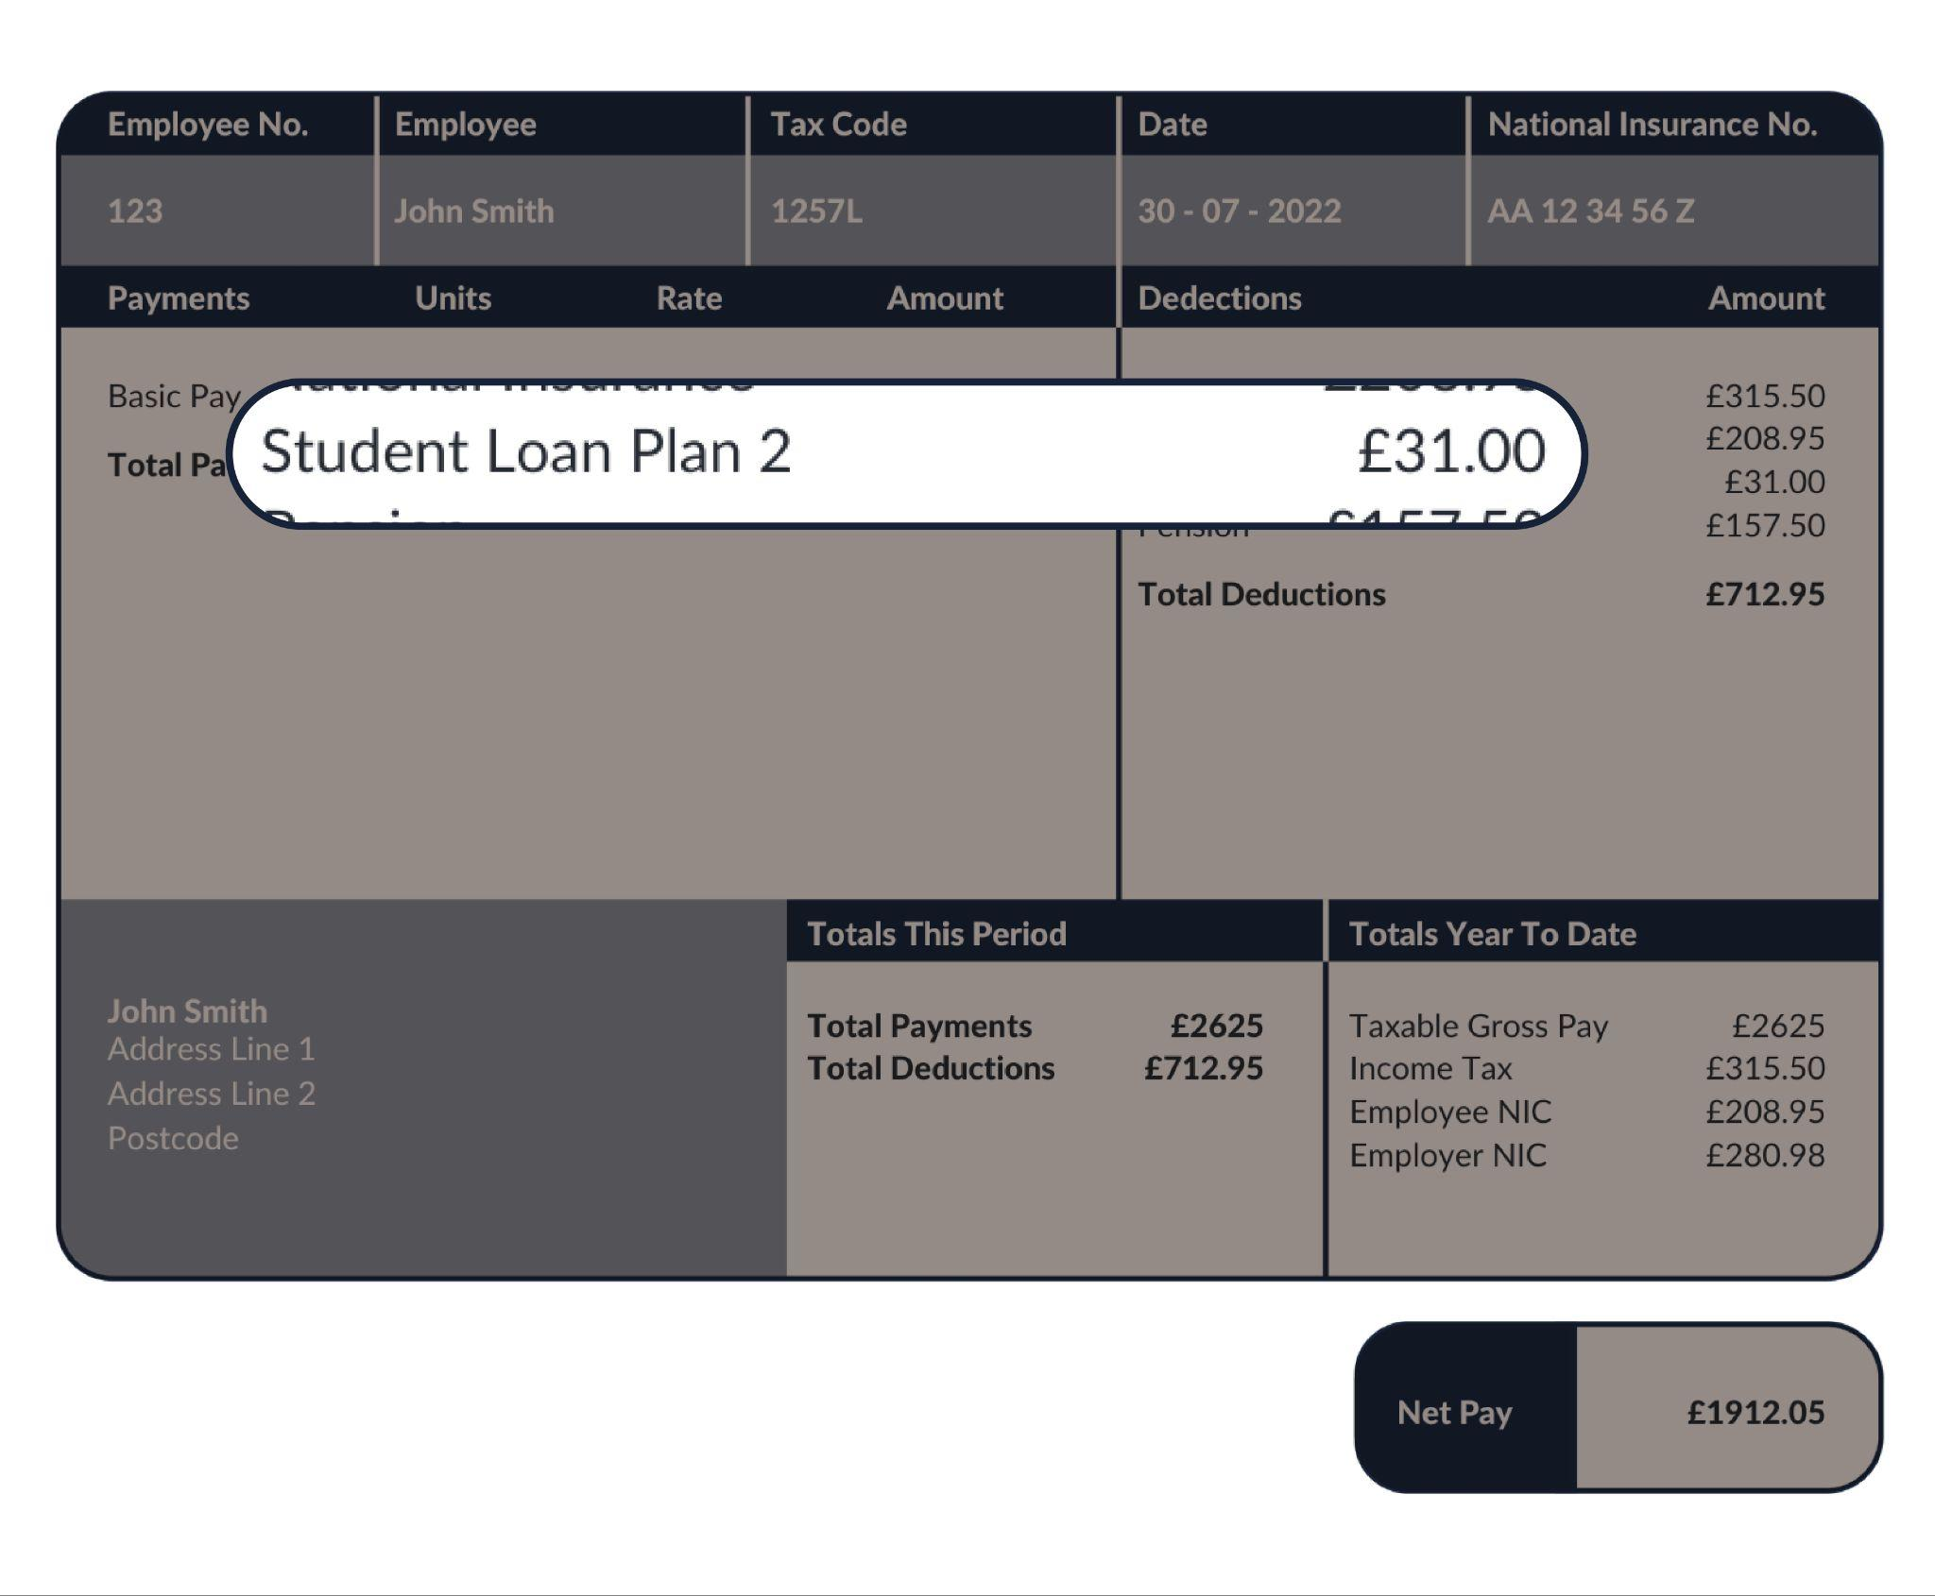
Starting with your taxes
Student Loan
Money borrowed to pay for university education
It is paid back through salary deductions.

Slide 25
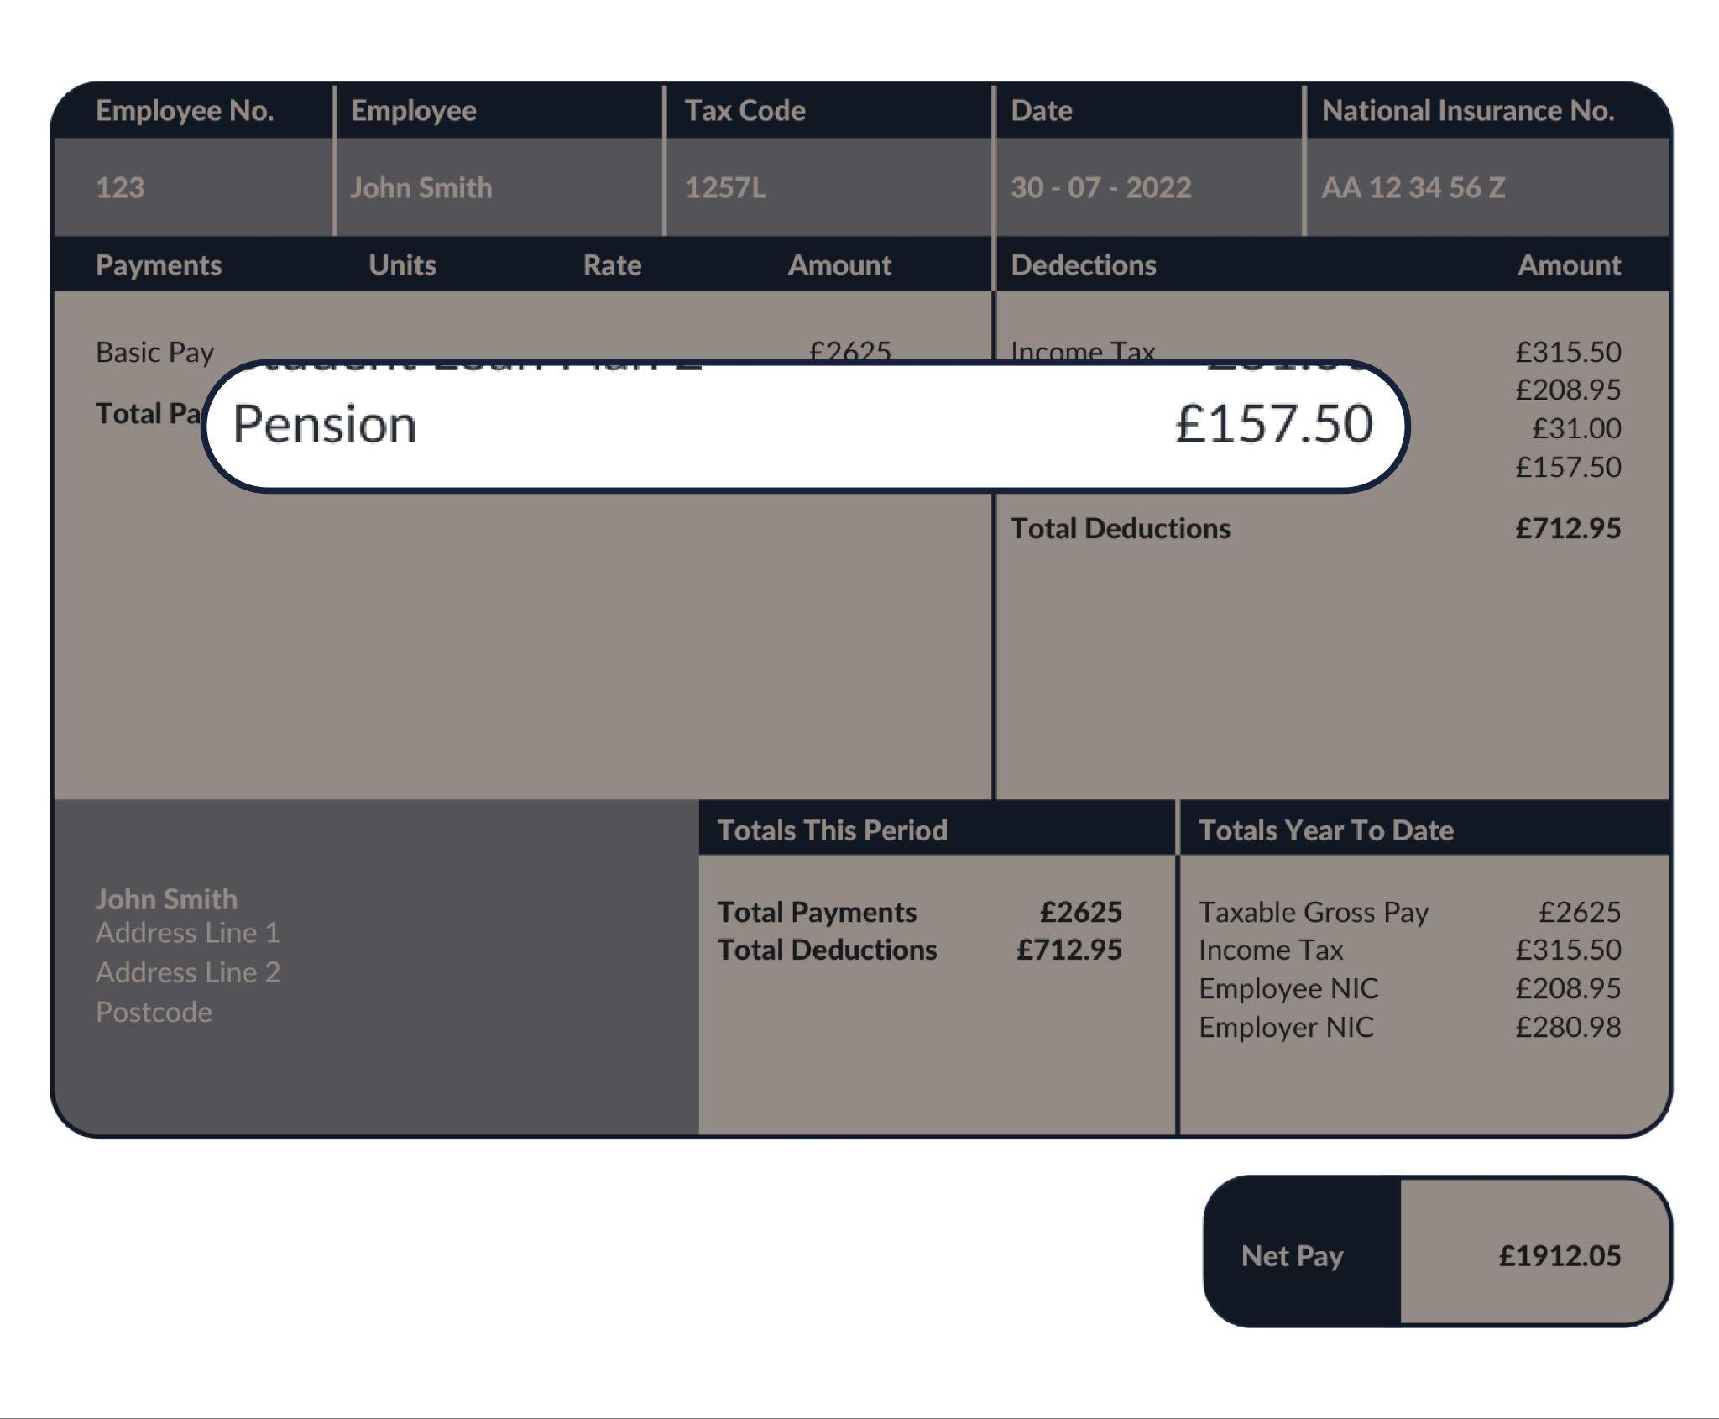
Starting with your taxes
Pensions
A way of saving money for later in life
It gets invested in the hope that it will grow
You can use it when you retire, from the age of 55 and moving to 57 from 2028.

Slide 26
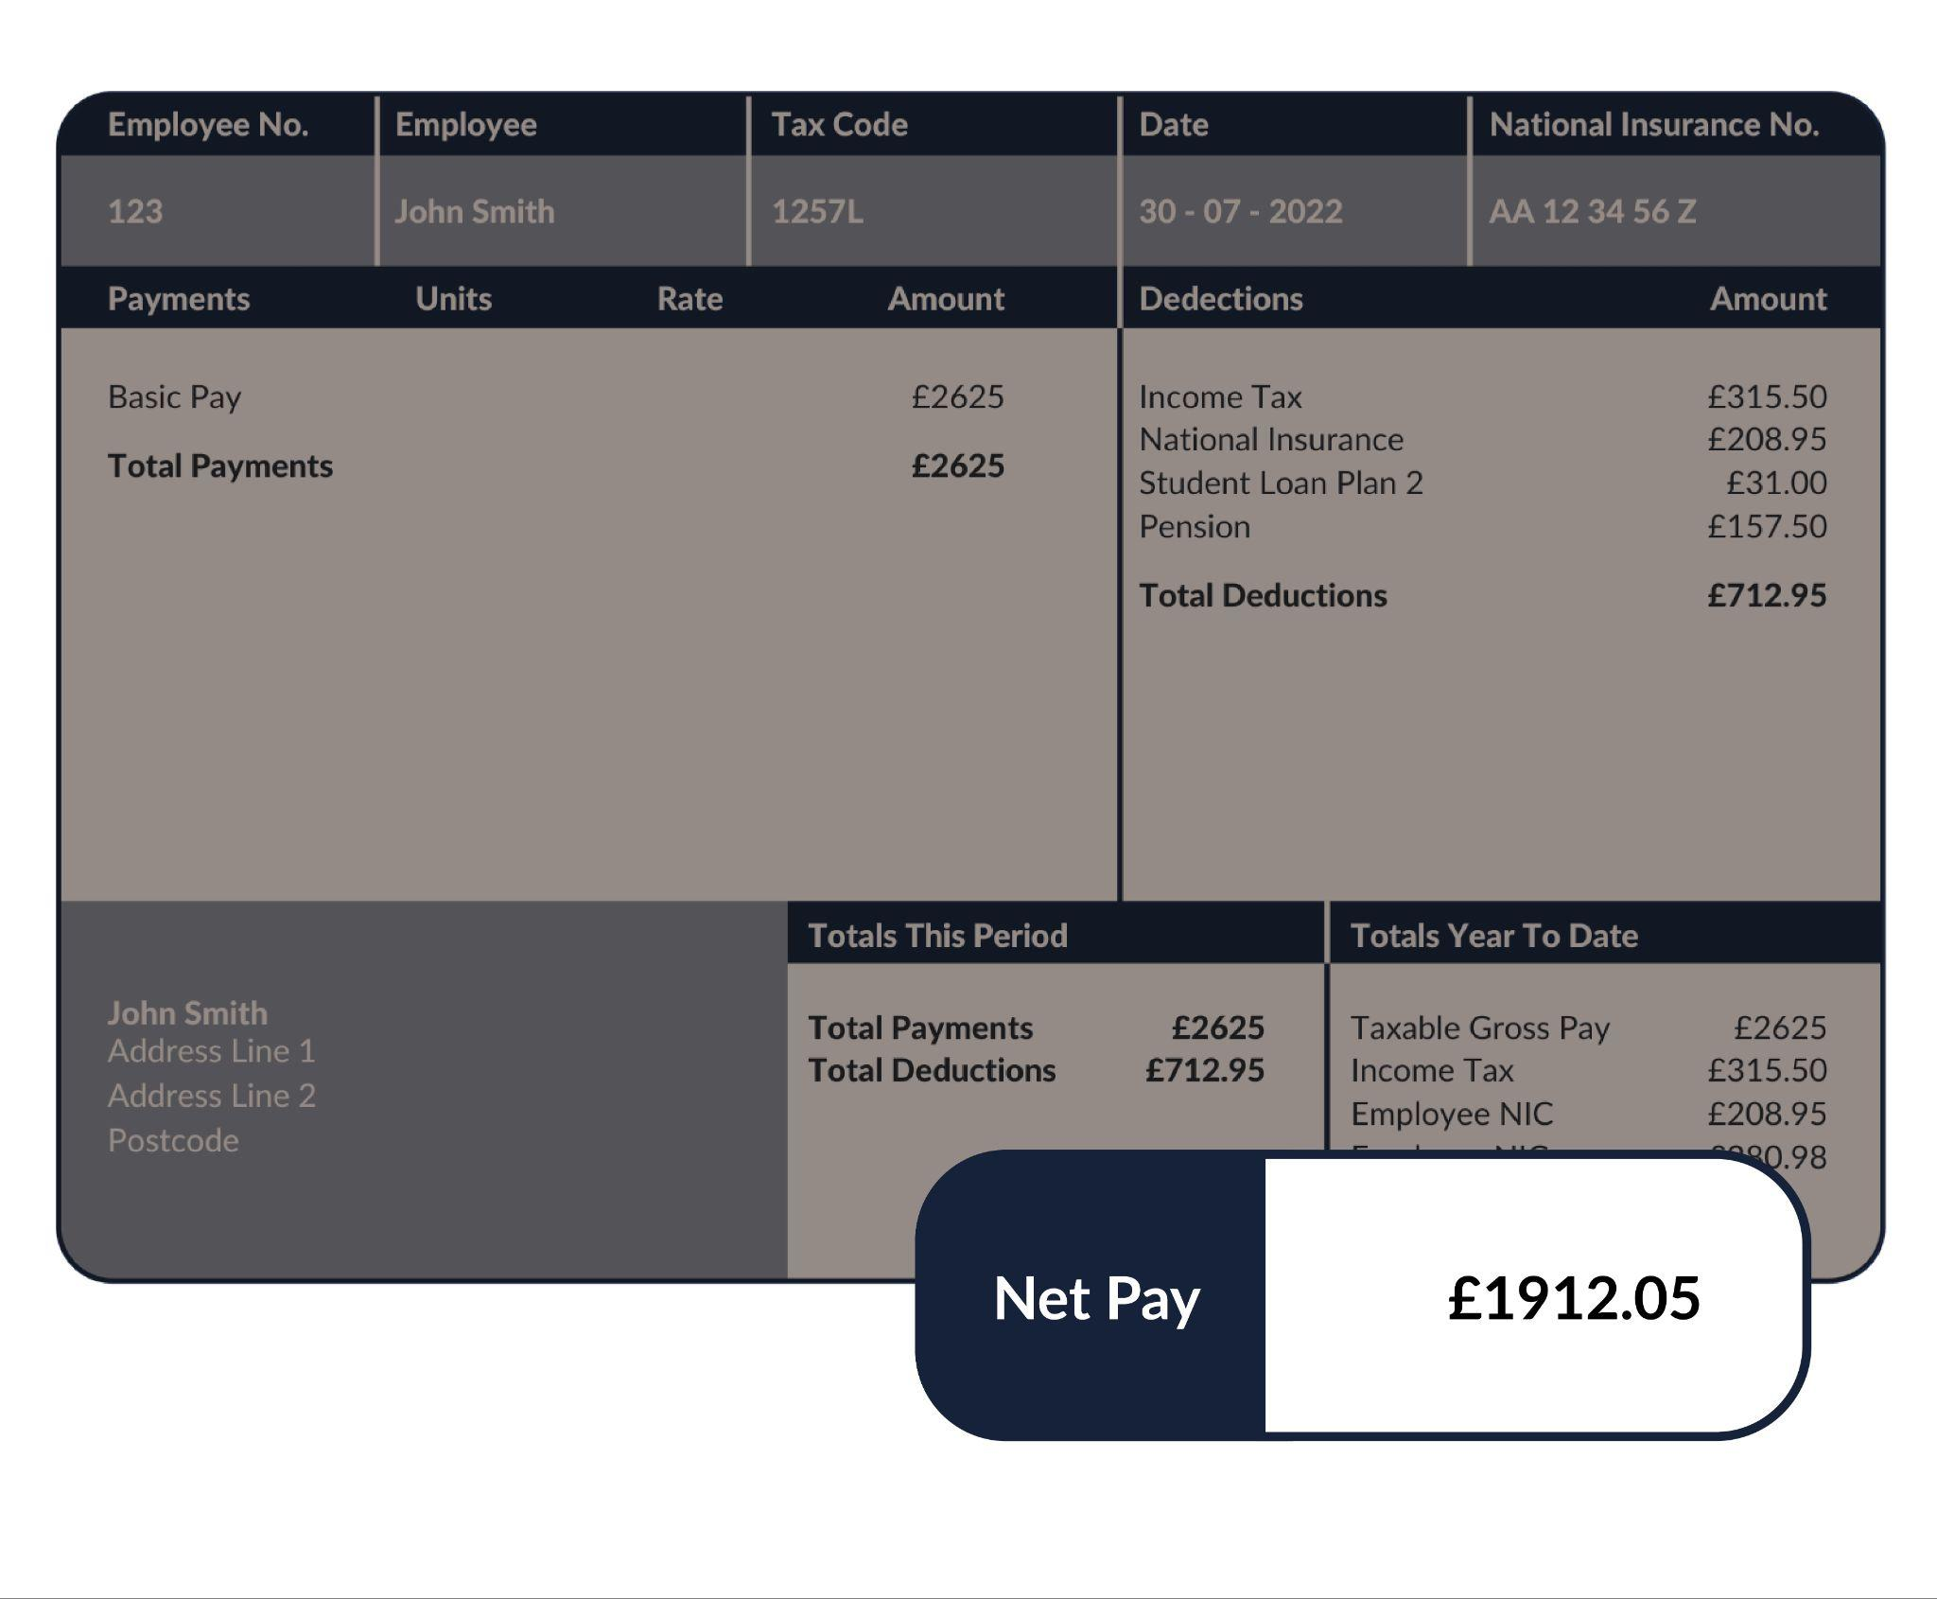
Starting with your taxes
Net Pay
What’s left after deductions have been made

Slide 27

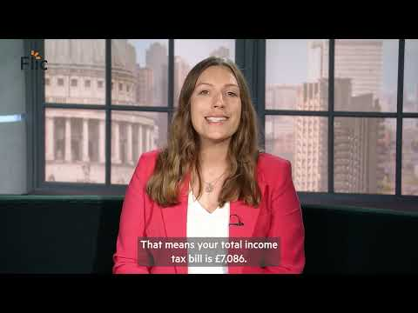
How does tax on my earnings really work?

Slide 28
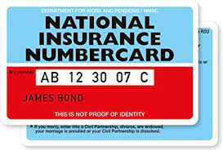
Top tip! Take a pic of your
National Insurance number
What is National Insurance (NI) all about?
Your NI number is like your own personal account number with the government and it NEVER changes
The number is needed at many points in your life e.g. when you start a job, if you claim benefits and take a mortgage out. The list goes on!
You have to pay it if you’re over 16 years old and earn or have self-employed profits over a certain amount, called a threshold.
Did you know? Until 2011 cards were issued. Now, you’ll get a letter in the post with your number to watch out for!

Slide 29
Progressive taxation
Looking at income tax bands
Tax rates and bands | What’s taxable?
Personal allowance 0% | £0 to £12,570
Basic rate 20% | £12,571 to £50,270
Higher rate 40% | £50,271 to £150,000
Additional rate 45% | Over £150,000
* People earning between £100,000 and £125,000 gradually lose their entitlement to their personal allowance. By the time they reach £125,000, the personal allowance is gone and everything they earn up to £50,270 is taxed at 20%

Slide 30


A deeper dive into a Man City female player’s income tax…
Each football player earns on average £75,000 per year
How much does a player pay in income tax on £75,000?
We’re going to explore this looking at tax bands.
Governments will change these rates and bands over time, so always check for yourself!
Notes:
https://www.bbc.co.uk/news/entertainment-arts-62133808

Slide 31

For a £75,000 salary, how do the tax bands work?
No tax is paid on the first £12,500!
Personal Allowance
* People earning between £100,000 and £125,000 gradually lose their entitlement to their personal allowance. By the time they reach £125,000, the personal allowance is gone and everything they earn up to £50,270 is taxed at 20%

Slide 32
How do the tax bands work?
No tax is paid on the first £12,500!
Personal Allowance
Basic Rate
20% tax is paid on income between £12,571 and £50,270.

Slide 33
Finally, we see that her salary lies in the Higher Rate tax band.
So 40% tax is paid on the difference between £50,271 and £75,000
How do the tax bands work?
No tax is paid on the first £12,500!
Personal Allowance
Basic Rate
Basic Rate
Higher Rate
20% tax is paid on income between £12,571 and £50,270

Slide 34

Own your income tax!
Worked example with annual salary of £75,000
Tax rates and bands | What’s taxable? | Tax to pay
Personal allowance at 0% £0 to £12,570 | £0 to £12,570 (for income less than £100,000) | 0 x £12,570 = £0

Slide 35
Own your income tax!
Worked example with annual salary of £75,000
Tax rates and bands | What’s taxable? | Tax to pay
Personal Allowance at 0% £0 to £12,570 | £0 to £12,570 (for income less than £100,000) | 0 x £12,570 = £0
Basic Rate at 20% £12,571 to £50,270 | £50,270 - £12,571 = £37,699 | 0.20 x £37,699 = £7,539.80

Slide 36
Own your income tax!
Worked example with annual salary of £75,000
Tax rates and bands | What’s taxable? | Tax to pay
Personal Allowance 0% £0 to £12,570 | £0 to £12,570 | 0 x £12,570 = £0
Basic Rate at 20% £12,571 to £50,270 | £50,270 - £12,571 = £37,699 | 0.20 x £37,699 = £7,539.80
Higher Rate at 40% £50,271 to £150,000 | £75,000 - 50,271 = £24,729 | 0.40 x £24,729 = £9,891.60
The salary falls in this tax band
* People earning between £100,000 and £125,000 gradually lose their entitlement to their personal allowance. By the time they reach £125,000, the personal allowance is gone and everything they earn up to £50,270 is taxed 20%

Slide 37
Own your income tax!
Worked example with annual salary of £75,000
Tax band | What’s taxable? | Tax to pay
Personal Allowance at 0% £0 to £12,570 | £0 to £12,570 (for income less than £100,000) | 0 x £12,570 = £0
Basic Rate at 20% £12,571 to £50,270 | £50,270 - £12,571 = £37,699 | 0.20 x £37,699 = £7,539.80
Higher Rate at 40% £50,271 to £150,000 | £75,000 - 50,271 = £24,729 | 0.40 x £24,729 = £9,891.60
Additional Rate at 45% Over £150,000 | No income tax paid at this rate | No income tax paid at this rate
The salary falls in this tax band

Slide 38
Own your income tax!
Worked example with annual salary of £75,000
Tax rates and bands | What’s taxable? | Tax to pay
Personal Allowance at 0% £0 to £12,570 | £0 to £12,570 (for income less than £100,000) | 0 x £12,570 = £0
Basic Rate at 20% £12,571 to £50,270 | £50,270 - £12,571 = £37,699 | 0.20 x £37,699 = £7,539.80
Higher Rate at 40% £50,271 to £150,000 | £75,000 - 50,271 = £24,729 | 0.40 x £24,729 = £9,891.60
Additional Rate at 45% Over £150,000 | No income tax paid at this rate | No income tax paid at this rate
Total income tax |  | £0 + £7,539.80 + £9,891.60 = £17,431.40
The salary falls in this tax band

Slide 39
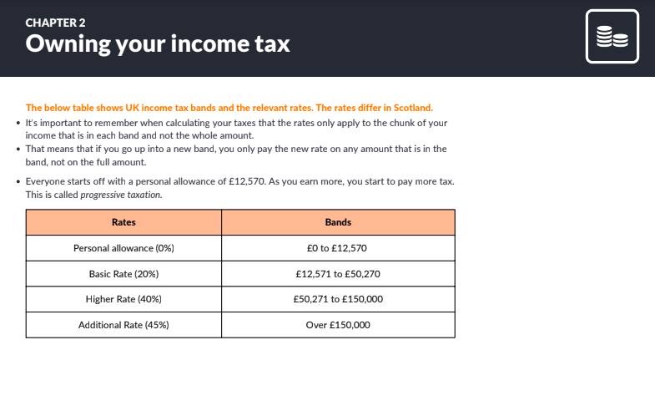
Own your income tax! Over to you!
INCOME TAX (UK, not Scotland)
Choose two jobs that you’re interested in from the worksheet and calculate the income tax.
Tax rates and bands | Threshold (from April 2022)
Personal Allowance 0% | £12,570
Basic Rate 20% | £12,571 to £50,270
Higher Rate 40% | £50,271 to £150,000
Additional Rate 45% | Over £150,000
Governments will change these rates and bands over time, so always check for yourself!

Slide 40
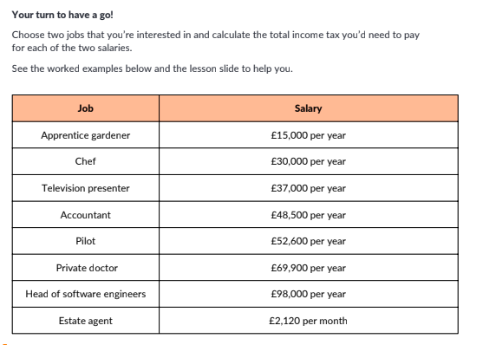
Discussion and answers
What have you noticed about the income tax you’ve calculated?
How does it change when the salary is just above or below the tax band?
Allow £1 above or below answers for rounding differences.

Slide 41
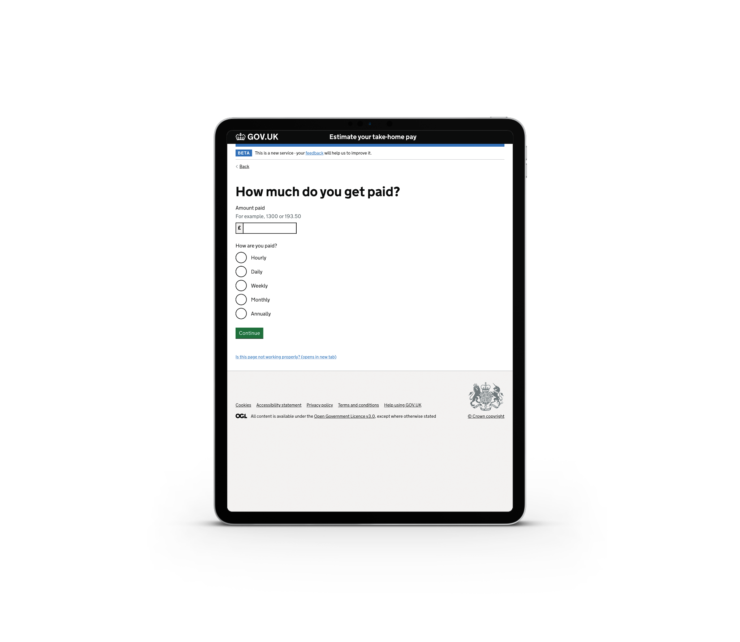
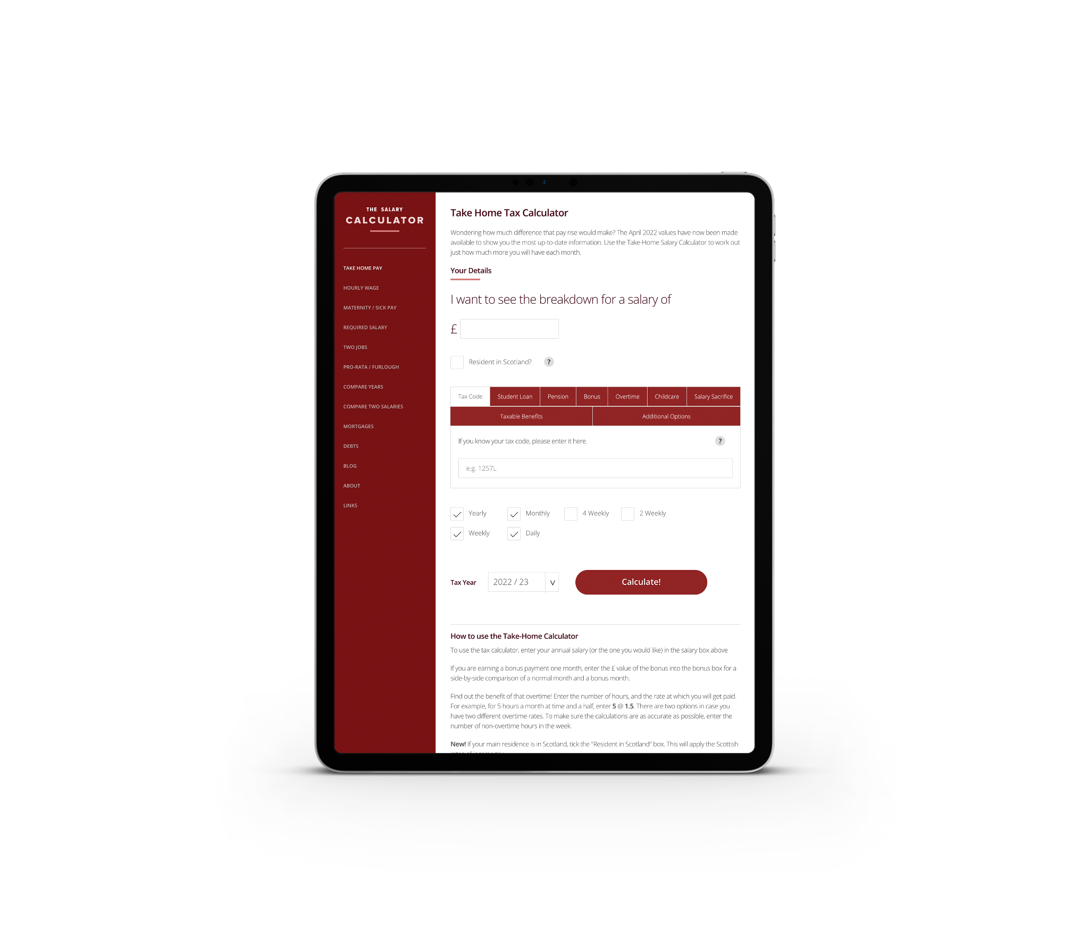
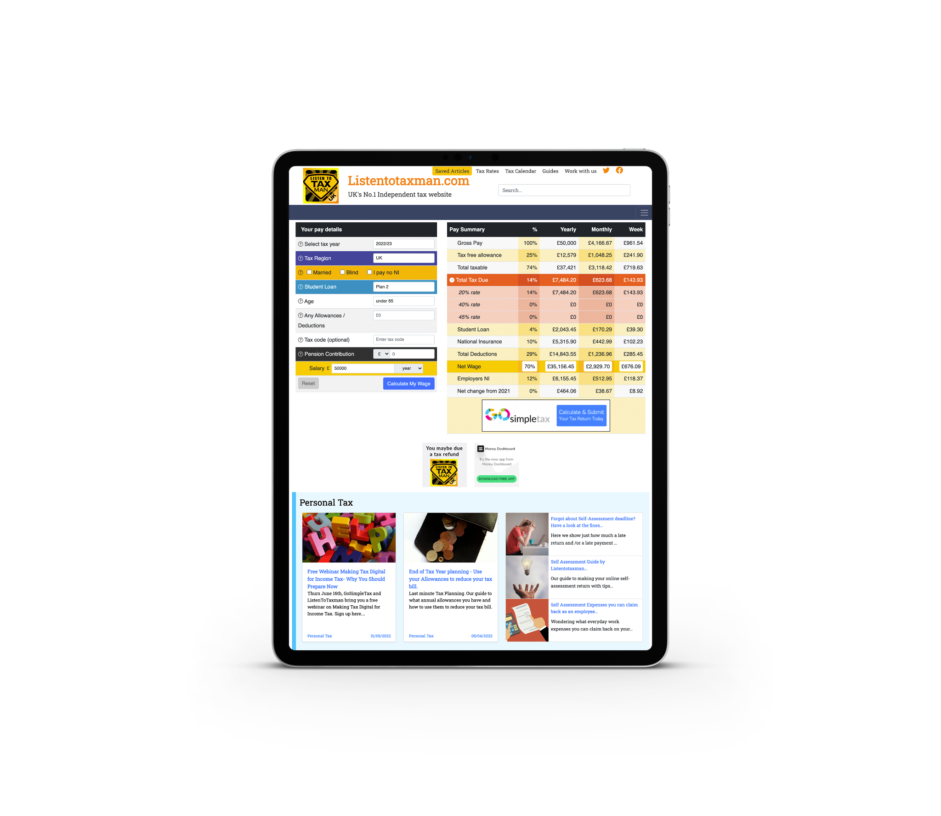
Where can I go for some online support working out my deductions?
Government website
The Salary Calculator
Listen to Tax Man

Slide 42
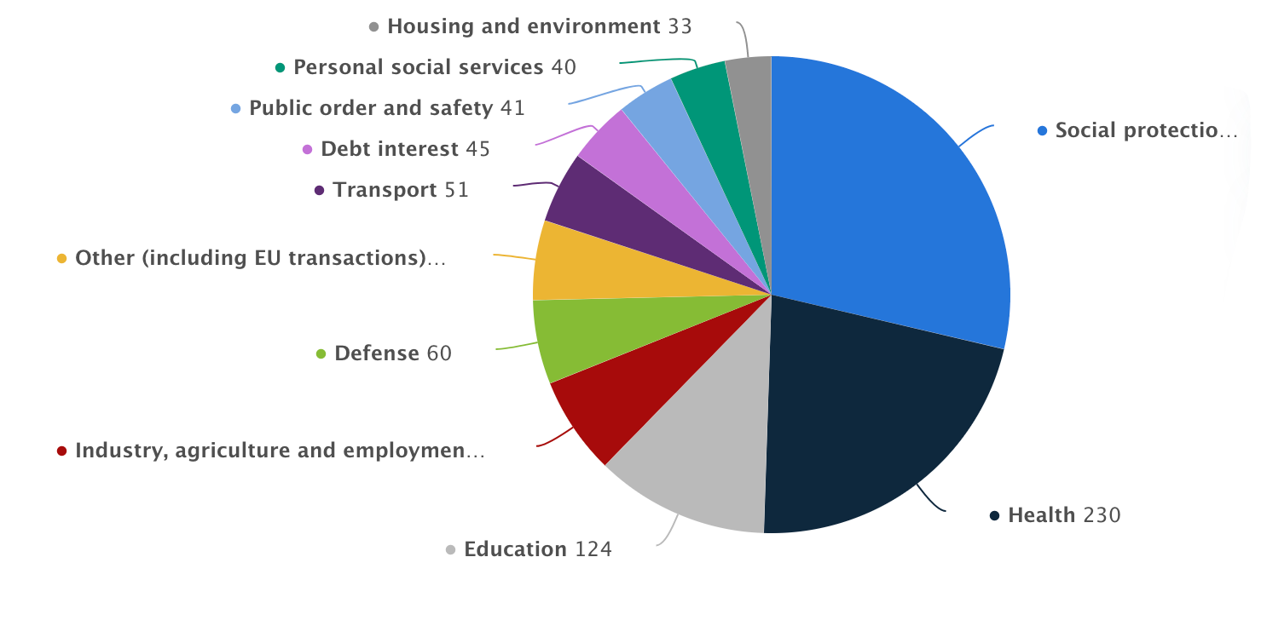
Where does my tax money go?
Match the main areas of public spending (listed in the box) to the segments on the pie chart
Health
Industry, agriculture and employment
Social protection (hospitals, home care)
Defence
Education
Transport
Notes:
Source: https://www.statista.com/statistics/298524/government-spending-in-the-uk/#:~:text=In%202021%2C%20the%20expenditure%20of,pensions%20and%20other%20welfare%20benefits.

Slide 43
Where does my tax money go?
Match the main areas of public spending (listed in the box) to the segments on the pie chart
Open up the Statista link here to see the full amounts in billions!
Health
Industry, agriculture and employment
Social protection (hospitals, home care)
Defence
Education
Transport
Notes:
Source:
https://www.statista.com/statistics/298524/government-spending-in-the-uk/#:~:text=In%202021%2C%20the%20expenditure%20of,pensions%20and%20other%20welfare%20benefits.

Slide 44
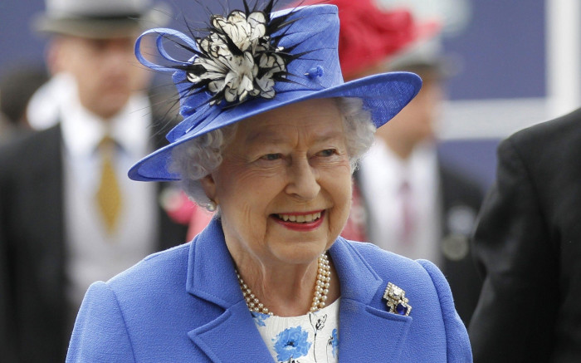
Key income tax facts!
True or false?
HMRC (Her Majesty’s Revenue and Customs) is in charge of tax for the whole country
Cash is tax-free money
You don’t have to pay tax on earnings from abroad
In the UK income tax rates are progressive, meaning the more you earn the more you pay
If you’re self employed, you’re responsible for paying your own tax
Only some people have a tax code
Tax money goes to the government for government spending e.g. NHS, sick pay, welfare, defence, transportation
You’ll never be taxed wrongly
Scottish tax rates are the same as the rest of the UK

Slide 45
Key income tax facts!
True or false?
HMRC (Her Majesty’s Revenue and Customs) is in charge of tax for the whole country
HMRC (Her Majesty’s Revenue and Customs) is in charge of tax for the whole country
2. Cash is tax-free money
2. Cash is tax-free money
3. You don’t have to pay tax on earnings from abroad
3. You don’t have to pay tax on earnings from abroad
4. In the UK income tax rates are progressive, meaning the more you earn the more you pay
4. In the UK income tax rates are progressive, meaning the more you earn the more you pay
5. If you’re self employed, you’re responsible for paying your own tax
5. If you’re self employed, you’re responsible for paying your own tax
6. Only some people have a tax code
6. Only some people have a tax code
7. Tax money goes to the government for government spending e.g. NHS,
sick pay, welfare, defence, transportation
7. Tax money goes to the government for government spending e.g. NHS,
sick pay, welfare, defence, transportation
8. You’ll never be taxed wrongly. You might have overpaid or underpaid your tax and it’s up to you to check and follow up!
8. You’ll never be taxed wrongly. You might have overpaid or underpaid your tax and it’s up to you to check and follow up!
9. Scottish tax rates are the same as the rest of the UK
9. Scottish tax rates are the same as the rest of the UK

Slide 46
By the end of the session, I will be able to:
Understand the advantages and disadvantages of different models of paid work including employment vs. self-employment, and what’s important to me when choosing a job.
Understand the main salary deductions, focusing on national insurance and income tax.
Recognise my rights at work, confidently ask for a pay rise and know where I can turn for support when issues arise in the workplace.

Slide 47
Chapter 3:
Speaking up

Slide 48

The Equality Act
The Equality Act 2010 legally protects people from discrimination in the workplace and in wider society.
There are different types of discrimination. It is against the law to discriminate against anyone because of:
Age, sex or disability
religion or belief
sexual orientation
being married/ in a
civil partnership
These are called ‘protected characteristics’...
gender reassignment
being pregnant or on maternity leave
race including colour, nationality, ethnic or national origin

Slide 49

Equal pay for equal work!
How does watching this video make you feel? Are there any trends in the kinds of work that we expect men/ women to do? How do you think the gender pay gap can be closed?

Slide 50
Asking for a pay rise
CAN you ask for a pay rise?

Slide 51
Asking for a pay rise
SHOULD you ask for a pay rise?

Slide 52
Top tips when asking for a pay rise
Prepare key points before booking your meeting with your manager
Be specific when it comes to the value of your work, both in terms of what you have achieved and how you have achieved results
Use facts where you can e.g. “My work led to a 10% increase in sales last year”
Demonstrate the value you will bring to your employer in the future
Discuss your soft skills and how you add value internally to the company e.g. have you organised a volunteers’ day, or supported colleagues through problems?
Use clear and concise language

Slide 53


Making your case for a pay rise
In pairs, you’re going to pick the strongest arguments for a pay rise pitch using either Nic or Naomi. Make your case to each other (5 mins to prep, 2 mins each to share). How convincing can you be?
Naomi
Marketing manager at top fashion brand
Nic
Shop manager at major sports brand
Notes:
BBC
---
Podcast on pay transparency gap
Gender pay gap- how much - do 16 year olds need to know

Slide 54

Making your case
Meet Naomi
Naomi works in the marketing department at a large fashion brand. At the start of the year she was involved in a big project that led to a £200,000 increase in the company’s profit. But she hasn’t had a pay rise since she started working there three years ago. Furthermore, two members of the team left and were not replaced,
so Naomi has picked up their work too, working over her contracted hours at least a couple of days a week.
What should Naomi say to her boss?
Now - can you identify the key points for her pay rise pitch? After 5 minutes of writing, pitch to one another…

Slide 55

Making your case
Meet Nic
Nic works as a shop manager at a big sports brand. He has been working at the company for five years and is well liked by both his shop assistants and customers. He always seems to resolve problems and has increased clothes sales for the company by 12% over the past year. Yet, he received only a small pay rise when he was promoted to shop manager. He’s been offered a job at a competitor sports brand for a higher salary but is keen to stay as he enjoys the people he works with and has a good work/life balance.
At the same time, over the past year, inflation has risen by 9% meaning a lot of his costs and the things he buys have become much more expensive. He’s noticed the cost of petrol, his weekly food shop and heating bill rise a lot! In order to be convinced to stay in his current role, Nic is looking for a pay rise.
What should Nic say to his boss?
Now - can you identify the key points for his pay rise pitch? After 5 minutes of writing, pitch to one another…

Slide 56
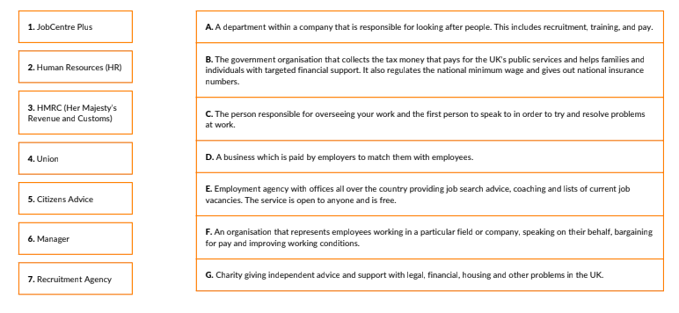
Resolving Pay Problems
People or organisations you should get to know.
Match the definition to the organisation!

Slide 57
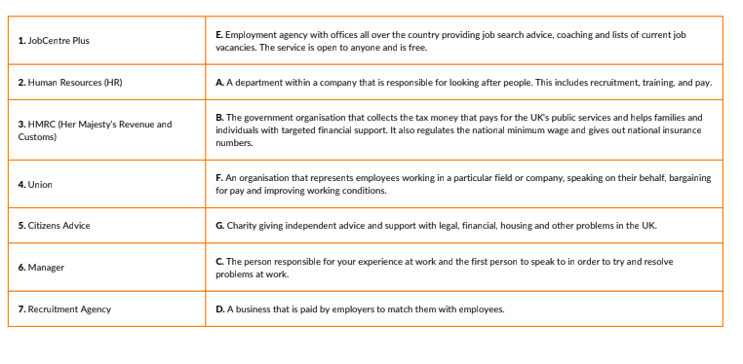
Resolving Pay Problems
ANSWERS | People or organisations you should get to know

Slide 58
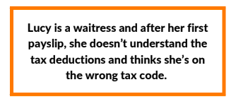
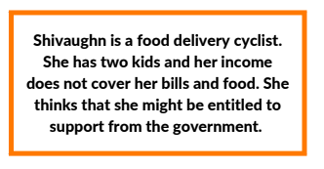
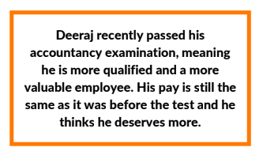



Resolving Pay Problems
Who should you speak to? Match the 8 scenarios to the 8 blue answer cards

Slide 59
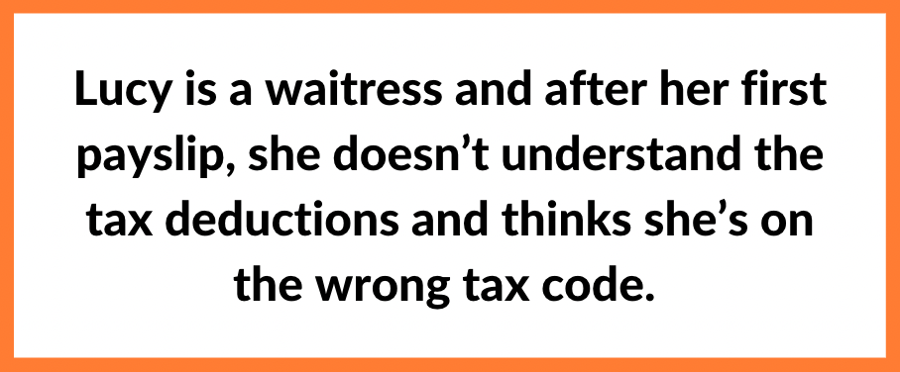
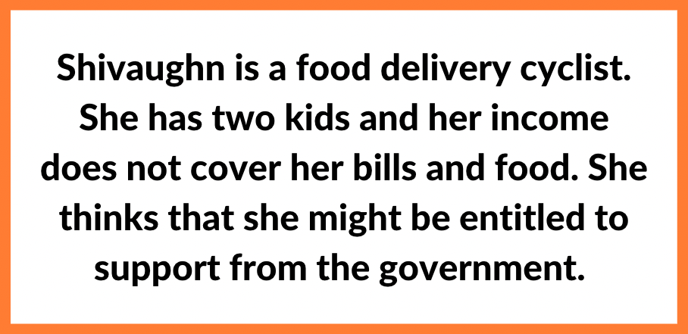
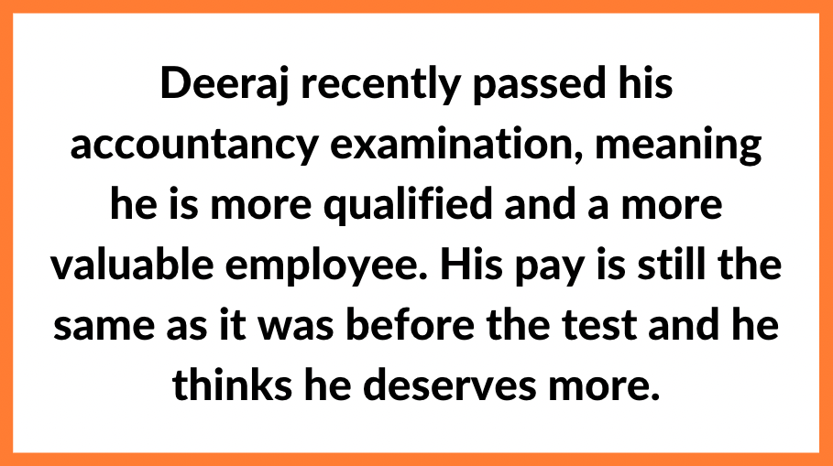
Resolving Pay Problems
ANSWERS | Who should you speak to?

Slide 60
By the end of the session, I will be able to:
Understand the advantages and disadvantages of different models of paid work including employment vs. self-employment, and what’s important to me when choosing a job.
Understand the main salary deductions, focusing on national insurance and income tax.
Recognise my rights at work, confidently ask for a pay rise and know where I can turn for support when issues arise in the workplace.

Slide 61
Over to you…
What 3 things have you learned
about getting paid?

Slide 62
Create a storyboard, video
or post giving your friend
your top tips on getting paid

Slide 63
Links to learn more!
Articles to extend learning
How does UK tax work? (Youtube ‘Joe Georgekutty’, Sept 2020)
What are the tax implications of earning over £100,000? (TaxScouts, July 2022)
Difference between sole trade and limited company (Youtube ‘Pennies to Pounds’, Nov 2020)
A guide to the living wage (Living Wage Foundation)
Benefits checker/calculator and grants finding website which also has useful info about benefits. (Turn to Us, UK National Charity)

Slide 64




Who can I talk to if I’m worried about money?
63
Citizen’s Advice – ‘Debt and Money’ – this resource contains links to advice on a number of topics including financial difficulties, cost of living and communications with creditors
MoneyHelper – Help if you’re struggling with debt – this resource provides a guide for individuals who are having issues keeping up with their debts.
CHILDLINE
0800 1111
NSPCC Helpline
0808 800 5000
Notes:
https://www.citizensadvice.org.uk/debt-and-money/
https://www.childline.org.uk/
https://www.moneyhelper.org.uk/en/money-troubles/dealing-with-debt/help-if-youre-struggling-with-debt
https://www.nspcc.org.uk/about-us/what-we-do/

