Slide 1
How to plan for the world of work
This session is aimed at key stage four (recommended for Year 10)

Slide 2
Unit outline
Session 1 | Session 2 | Session 3 | Session 4 | Session 5 | Session 6
Careers in the City | Apprenticeships | Entrepreneurship | Understanding gig work and employment rights | Speaking up at work | Decision- making Creating a career plan

Slide 3
Having a respectful learning environment
We will listen to each other respectfully
We will avoid making judgements or assumptions about others
We will comment on what has been said, not the person who has said it
We won’t put anyone on the spot and we have the right to pass
We will not share personal stories or ask personal questions
If there is a question that you do not wish to ask aloud, you can write it on a post-it note which will be collected throughout the session and answered at the end

Slide 4
4
Session 4:
Understanding Gig Work and Your Rights

Slide 5
By the end of the session, I will be able to:
Describe changes to the gig economy
Understand workers’ rights and how they relate to the gig economy
Assess the protection of workers rights in the gig economy

Slide 6
Starter
How do musicians earn a living?
How might this be similar to the work of a delivery driver?
Consider factors such as hours of work, pay and employment rights.
Notes:
Teacher delivery
Present question to students and take a small handful of responses. Students should identify record sales, streaming, and live performances. As soon as a student identifies live performances, stick with this theme. Use the prompt questions below to deepen understanding of where the term ‘gig economy’ comes from.
Prompt questions
How might musicians earn money if they have not released a new song or album in a while?
Are live performances a stable source of income?
Would this be the same for all musicians?
What characteristics would determine whether live performances will be a stable source of income?
Teacher explanation
The term ‘gig economy’ comes from the idea of live performances, with each individual piece of work that a person engages in being similar to a gig. It is used to describe aspects of the labour market that rely heavily on short-term contracts/freelance work, rather than permanent jobs.

Slide 7
Workers are usually independent contractors or freelancers
Labour is provided through online digital platforms
The Gig Economy
Work is allocated on a temporary basis
This structure often allows companies to provide services at lower cost
Workers gain an element of flexibility and independence

Slide 8
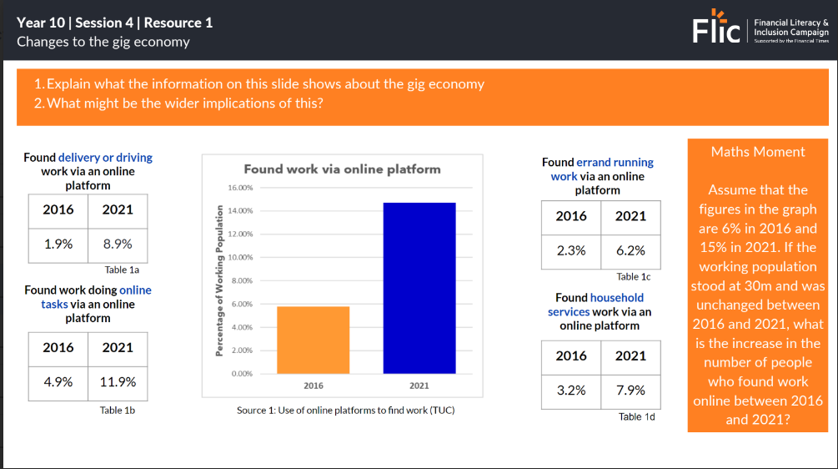
Changes to the Gig Economy
Explain what the information shows about the gig economy
What might be the wider implications of this?
Resource 1: Changes to the gig economy

Slide 9
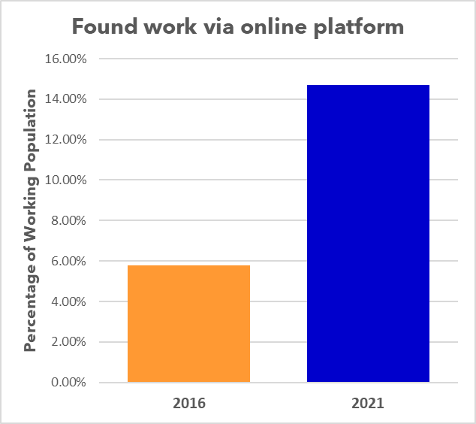
Changes to the Gig Economy
Explain what the information on this slide shows about the gig economy
What might be the wider implications of this?
Maths Moment
Assume that the figures in the graph are 6% in 2016 and 15% in 2021. If the working population stood at 30m and was unchanged between 2016 and 2021, what is the increase in the number of people who found work online between 2016 and 2021?
Found delivery or driving work via an online platform
Found errand running work via an online platform
2016 | 2021
1.9% | 8.9%
2016 | 2021
2.3% | 6.2%
Table 1a
Table 1c
Found work doing online tasks via an online platform
Found household services work via an online platform
2.7m people
2016 | 2021
4.9% | 11.9%
2016 | 2021
3.2% | 7.9%
Source 1: Use of online platforms to find work (TUC)
Table 1b
Table 1d
Notes:
Prompt questions
Feel free to use the following questions to support students on question 2
Do you thinking that gig work offers much job stability?
How do think working in the gig economy compares to having a regular job?
What would society look like if all workers worked in the gig economy?
Do you think workers in the gig economy are afforded the rights we looked at in the last task?
Teacher explanation
Expected feedback from Q1:
There has been a significant increase in the number of people using online platforms to find work between 2016 and 2021
This increase is not just limited to delivery and driving, but is also experience in a wider set of jobs
There are two ways of completing the Maths Moment:
6% of 30m = 1.8m. 15% of 30m = 4.5m. 4.5m - 1.8m = 2.7m
15 - 6 = 9. 9% of 30m = 2.7m

Slide 10
So why are more people choosing gig work?
Flexibility
Gig work allows workers to choose exactly when they want to work, meaning they can schedule their work around other commitments
Choice
As seen in the previous slide, gig work is available in a range of industries, giving individuals a lot of choice as to what they want to do
Hints
What might working in the gig economy allow you to do that a regular job will not?
What type of people do you think may benefit from working in this economy?
Low Barriers (Sometimes)
Some gig work has very low barriers to entry, meaning it doesn’t take much to begin working in the gig economy. Deliveroo workers only need a bicycle and a phone, which many already have.
Students
Gig work can be beneficial for sections of the population, such as students, who might need to juggle working while studying.

Slide 11
By the end of the session, I will be able to:
Describe changes to the gig economy
Understand workers’ rights and how they relate to the gig economy
Assess the protection of workers rights in the gig economy

Slide 12
Employment Rights
13
How well do you think you know your rights?
Activity
Using the provided worksheet, determine whether each right is or isn’t afforded to employees in the UK
Make sure to leave some space in each box in order to write down explanations later
Resource 2 Employment Rights
Notes:
Teacher delivery
Provide students with the Lesson 4 - Worksheet 1, and instruct them to simply write a ‘Yes’ on the rights they believe workers in the UK have, and a ‘No’ for the ones they do not believe are afforded. If you are not handing out the answer sheet after they have completed the task, it will be a good idea to ask them to write their answers in the top left corner off the box in order for them to have space to make notes on the answers later.
Teacher explanation
Please refer to Resource 2 (answers) for guidance on what to explain to students during the feedback of this task.

Slide 13
Are employees entitled to…
Sick Pay
Holidays
Pensions
Maternity/Paternity Leave
Yes – If an employee is ill for four or more days they will be entitled to statutory sick pay (currently £99.35 per week)
Yes – Full-time employees must be provided 28 days holiday as a legal minimum. Self-employed gig workers have different holiday rights.
Yes – Employers are required to have pension schemes for their employees, where both the employer and employee contribute. Since 2012, employees have been auto enrolled on these schemes and must opt out if they do not want to take part.
Yes – Employees can take up to 52 weeks maternity leave, of which they are entitled to 39 weeks Statutory Maternity Pay. Women can take the whole time off work and are entitled to return to the same/similar role. Paternity leave can be taken for two weeks. Shared parental leave allows some parents to split the 52 weeks between them.

Slide 14
Are employees entitled to…
A Minimum Wage
Unionisation
Dependants
Working Time
Yes - All individuals must be paid a certain amount dependent on age
Yes – employees have the right to choose whether or not to join a union, belong to more than one union, and engage in lawful union activities. Employers cannot offer you a benefit to leave a union or treat you unfairly because of your union membership
Yes – You are allowed “reasonable time off” to deal with an emergency involving a dependant. Dependants can be a spouse, child, grandchild, parent, or anyone that depends on your care
Kind of – Employees cannot work more than 48 hours per week on average unless:
They agree to do so
They work in a job exempt from this, such as ambulance workers, firefighters, and prison staff

Slide 15
Employment Rights
12
How might right be applied depending on employment status?
Self-employed
A person is responsible for how and when they work
A person is the owner of a company or are a freelancer
A person who provides an invoice for their pay instead of getting a wage
A person gets contracts to provide services for clients
A person is able to send someone else to do the work, if appropriate
A person is able to work for different clients and charge different fees
Employee
The employer, manager or supervisor is in charge of a person’s workload and how the work should be done
The person is required to work regularly unless they are on leave
A person can expect work to be consistently available
A person cannot refuse to do the work
Receiving a consistent or predictable wage
Employer contributing to pension
Worker
The work for the organisation is more casual, for example work is less structured or not regular
A person is not offered regular or guaranteed hours by their employer
A person has very little obligation to make themselves available for work, but should do work they've agreed to
Notes:
Teacher delivery
Read through the employment status. Use targeted questioning to invite students to assess how the a right they previously made notes on is/isn’t applied i.e sick pay for those who are self employed

Slide 16
By the end of the session, I will be able to:
Describe changes to the gig economy
Understand workers’ rights and how they relate to the gig economy
Assess the protection of workers rights in the gig economy

Slide 17
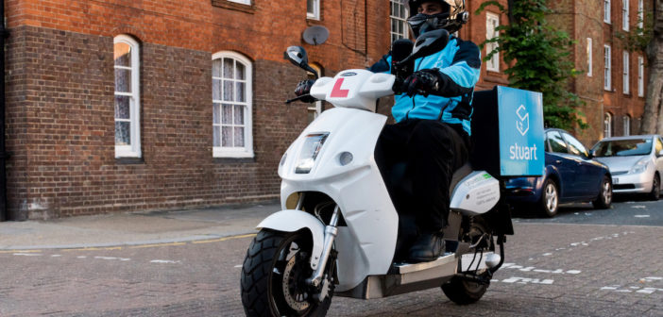
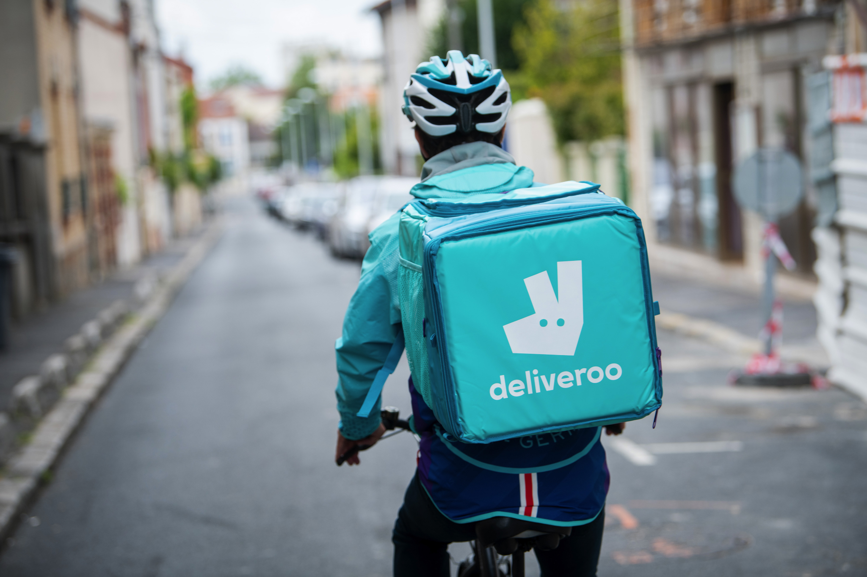
Case Studies
As the gig economy has developed over recent years, it has also brought certain challenges, particularly between companies and people who carry out work for these companies.
A number of these challenges have ended up in court and brought about outcomes that determine the relationship between companies and people who work in the gig economy.
You’ll be assigned a number between 1-3, that will correspond to a particular case.
Read through the case and answer the questions at the top of the worksheet.
Do you think the expansion of the gig economy has been good or bad for workers?
Write a short paragraph explaining your answer.
Worksheet 2: Gig Economy Case Studies
Notes:
Teacher delivery
Allow 10 minutes for students to read through the case study and answer the 4 questions. Allow a further 5 minutes to go through the feedback for each case study, drawing feedback from different students in the class.
Prompt Question
Once all feedback has been gathered from the class, challenge a student to describe the difference between the Deliveroo and Stuart Delivery case. You can use supporting questions such as:
What was the difference in outcome between the two cases?
What was the key reason as to why the verdict was reached in each case?
By doing this, students should come to an understanding that the ability to substitute the worker is key to determining whether or not someone is classed as a worker.
Teacher explanation
In order to highlight the point made through the prompt question above, you can explain that in the Deliveroo case, the person was able to choose a substitute out of a wide range of people (essentially anyone they knew) whereas in the Stuart Delivery case, the substitute had to be someone registered with Stuart Delivery, which limited their ability to substitute, and put more onus on them personally to fulfil the job. As such, this is why the Stuart Delivery driver was classed as a worker and the Deliveroo driver was not.

Slide 18
Plenary
21
What are the three most important messages that you’ll take away from this lesson?
You have one minute to summarise what you have learnt today.
No hesitating, repeating or long pauses.

Slide 19
By the end of the session, I will be able to:
Describe changes to the gig economy
Understand workers’ rights and how they relate to the gig economy
Assess financial vulnerability in the gig economy

Slide 20
Key Takeaways
In the gig economy, the use of contracts stating that workers are independent contractors is widespread
Organisations often suggest they are tech companies, rather than employers
Classing people as contractors rather than employees would allow these businesses to reduce costs and increase profits
Courts will sometimes assess the reality of the relationship between the worker and the company, rather than solely looking at the contract between the two
If an organisation can easily use a an alternative method or person to complete work, it is unlikely that they will be seen as a worker in the eyes of the law, and as such will not have access to certain workers’ rights
This is the key difference between the Deliveroo and Stuart Delivery cases

Slide 21
Any questions?
?

Slide 22
Services available for people who have concerns about their rights at work
Money Helper - Work
Gov UK - Workplace rights
Citizens Advice - Work
At school, you can speak with an adult you trust.
This could be your form tutor, head of year or the school’s safeguarding officer

Slide 23
Links to learn more!
Articles to extend learning
Self-employed gig workers holiday rights.
Types of employment
Please visit the FLIC learning hub - https://ftflic.com/learning-hub/ for further resources

