Slide 1
Preparing for my financial future
This session is aimed at key stage five

Slide 2
Unit outline
Session 1 | Session 2 | Session 3 | Session 4 | Session 5 | Session 6
Managing Student Finance | Borrowing and Debt | Property - Renting and Buying | Cryptocurrency Risk and Reward | Money and Well-being | Decision- Making Financial literacy in the curriculum

Slide 3
Having a respectful learning environment
3
We will listen to each other respectfully
We will avoid making judgements or assumptions about others
We will comment on what has been said, not the person who has said it
We won’t put anyone on the spot and we have the right to pass
We will not share personal stories or ask personal questions

Slide 4
4
Session 6:
Financial literacy in the curriculum

Slide 5
5
By the end of the session, I will be able to:
Identify the different ways young people can receive financial literacy education
Evaluate who is best placed to deliver financial literacy education
Present a case for the importance of financial literacy education

Slide 6
Financial literacy education
‘All young people should learn about the risks and opportunities of money at school.’
What is your first reaction to this statement?

Slide 7
Financial literacy education
7
Thinking about what you have learnt over the last few weeks,
you have two minutes to mind map the information that young people
should be aware of when it comes to financial literacy.

Slide 8
Financial literacy education
8
Who should be responsible for teaching young people about money?
Create this table in your books
 | Should be responsible for teaching young people about money | Should not be responsible for teaching young people about money
Parents and carers
Schools
Other

Slide 9
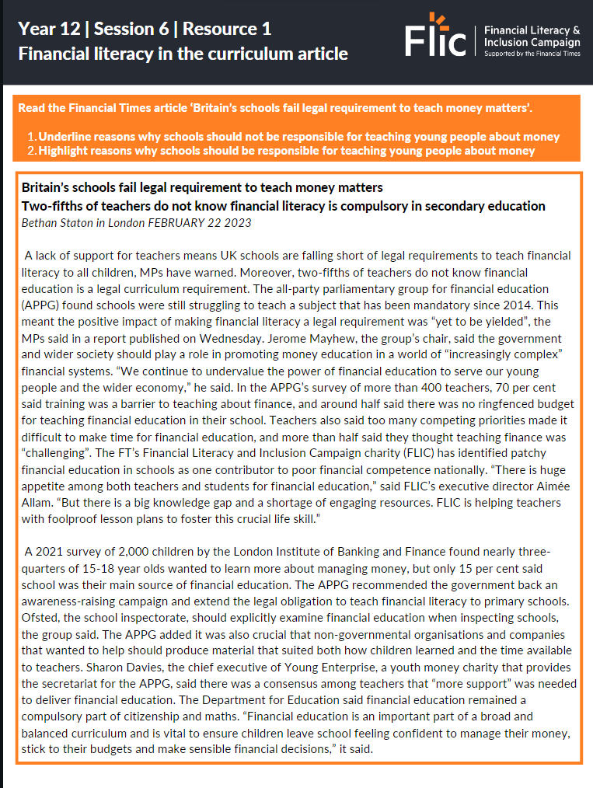
Financial literacy education
A school’s perspective
9
Read the Financial Times article ‘Britain’s schools fail legal requirement to teach money matters’.
Underline reasons why schools should not be responsible for teaching young people about money
Highlight reasons why schools should be responsible for teaching young people about money
https://www.ft.com/content/320c43fa-2e12-43d0-baaf-4a37ca93917b

Slide 10
Financial literacy education
10
Who should be responsible for teaching young people about money?
 | Should be responsible for teaching young people about money | Should not be responsible for teaching young people about money
Parents and carers
Schools
Other

Slide 11
Financial literacy education
Parents and carers perspective
11
Read the experience of the person below and identify why this person may or may not be the best person to teach a young person about financial literacy.
I am the owner of my local village convenience shop. It is a family business that I took over from my dad. I feel both proud and lucky to be able run a business as I wasn’t really academic and didn’t do very well in school. However, it can be really stressful as business has really slowed down lately. I’ve had to take out a personal loan to cover my household costs but I’m sure things will pick up in the summer.

Slide 12
Financial literacy education
Parents and carers perspective
12
Read the experience of the person below and identify why this person may or may not be the best person to teach a young person about financial literacy.
I am the owner of my local village convenience shop. It is a family business that I took over from my dad. I feel both proud and lucky to be able run a business as I wasn’t really academic and didn’t do very well in school. However, it can be really stressful as business has really slowed down lately. I’ve had to take out a personal loan to cover my household costs but I’m sure things will pick up in the summer.

Slide 13
Debate
“All young people should learn about the risks and opportunities of money at school.”
Can or should parents and carers be responsible for ensuring that young people are educated on these topics?
How do young people teach themselves?
Why are schools considered an ideal place to teach young people about these topics?
What limitations or challenges do schools face?

Slide 14
Financial literacy education
14
You have the power to make a difference.
There are many students who are missing out on financial literacy education.
It would be life-changing for many young people and their families if they were to be guaranteed financial literacy education.
You can help this happen be writing a letter to your local MP sharing what you have learnt over the last six weeks and presenting reasons why more schools should include financial literacy in their curriculum.

Slide 15
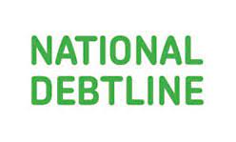
Services available for people who have concerns about their personal finances
Citizens Advice – Debt and Money – This resource contains links to advice on a number of topics, including financial difficulties, cost of living and communicating with creditors.
National Debtline – Debt and Money – a debt advice charity run by the Money Advice Trust, offering a free and confidential debt advice service.
Childline Helpline 0800 1111
At school, you can speak with an adult you trust.
This could be your form tutor, head of year or the school’s safeguarding officer.
Notes:
Read the moneysavingexpert debt problems guide
https://www.stepchange.org/
https://www.moneyhelper.org.uk/en/everyday-money/types-of-credit/overdrafts-explained

