Slide 1
How to prepare for your financial future
This session is aimed at key stage four and five (recommended for Year 12 and above)

Slide 2
Unit outline
Session 1 | Session 2 | Session 3 | Session 4 | Session 5 | Session 6
How the economy works | Mortgages | Credit cards | Pensions | ISAs | Decision- making - Financial decisions
Notes:
Josh oliver

Slide 3
Having a respectful learning environment
We will listen to each other respectfully
We will avoid making judgements or assumptions about others
We will comment on what has been said, not the person who has said it
We won’t put anyone on the spot and we have the right to pass
We will not share personal stories or ask personal questions
If there is a question that you do not wish to ask aloud, you can write it on a Post-it Note which will be collected throughout the session and answered at the end

Slide 4
4
Session 6:
Financial decisions

Slide 5
5
By the end of the session, I will be able to:
Assess different financial products

Slide 6
Starter | Financial decisions
Smita is 8 years into her career as a real estate agent, earning a £45,000 salary and making up to £7,000 per year commission.
Smita likes to travel a lot and enjoys socialising and meeting her friends for dinners and coffees.
She wants to build her credit score as she would like to be eligible for a mortgage in the next 2 to 3 years.
Is Smita financially ready to buy a house?
Explain two factors that show Smita is ready to consider buying a house.
Notes:
Teacher Explanation
Delivery Instructions
Prompt Questions
Employment status?
Spending habits?
What does it mean to build a credit score? How can someone do this?
What is a mortgage?

Slide 7
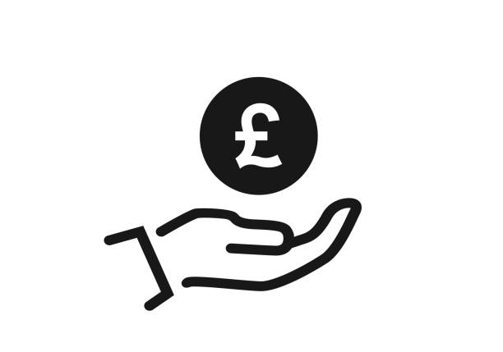
Make a financial decision
This lesson we are going to review our learning and make financial decisions for Smita
Saving
Pensions
Mortgages
Credit cards
Go to final reflection

Slide 8
Savings (ISAs) | Recap
Look over your notes from our session on savings and ISA
Create a mind map or list of at least ten things you learnt about ISAs
Type of ISA
Age to open
Deposit limit
Savings at risk?
Benefits and bonus’

Slide 9
Savings (ISAs) - medium term
Smita is planning to buy a home within the next 5 years.
Which savings account should she consider and why?
 | Age to open | Annual deposit limit | Savings at risk? | Government bonus?
Cash ISA | 16+ | £20,000 | No | No
Stocks and shares ISA | 18+ | £20,000 | Yes | No
Lifetime ISA | 18-39 | £4,000 | Depends | Yes, 25%
Junior ISA | 0-17 | £9,000 | Depends | No
Cash ISA
Stocks and shares ISA
Lifetime ISA
Lunch out
Junior ISA

Slide 10
Savings (ISAs) - medium term
Smita is planning to buy a home within the next 5 years.
Which savings account should she consider and why?
 | Age to open | Annual deposit limit | Savings at risk? | Government bonus?
Cash ISA | 16+ | £20,000 | No | No
Stocks and shares ISA | 18+ | £20,000 | Yes | No
Lifetime ISA | 18-39 | £4,000 | Depends | Yes, 25%
Junior ISA | 0-17 | £9,000 | Depends | No
Cash ISA
Stocks and shares ISA
Lifetime ISA
Lunch out
Junior ISA
Lunch out

Slide 11
Savings (ISAs) - medium term
Smita leave some savings to grow for the next 5 to 10 to years, and is willing to take some risk with these savings.
Which savings account should she consider and why?
 | Age to open | Annual deposit limit | Savings at risk? | Government bonus?
Cash ISA | 16+ | £20,000 | No | No
Stocks and shares ISA | 18+ | £20,000 | Yes | No
Lifetime ISA | 18-39 | £4,000 | Depends | Yes, 25%
Junior ISA | 0-17 | £9,000 | Depends | No
Cash ISA
Stocks and shares ISA
Lifetime ISA
Lunch out
Junior ISA
Lunch out

Slide 12
Savings (ISAs) - medium term
Smita leave some savings to grow for the next 5 to 10 to years, and is willing to take some risk with these savings.
Which savings account should she consider and why?
 | Age to open | Annual deposit limit | Savings at risk? | Government bonus?
Cash ISA | 16+ | £20,000 | No | No
Stocks and shares ISA | 18+ | £20,000 | Yes | No
Lifetime ISA | 18-39 | £4,000 | Depends | Yes, 25%
Junior ISA | 0-17 | £9,000 | Depends | No
Cash ISA
Stocks and shares ISA
Lifetime ISA
Lunch out
Junior ISA
Lunch out

Slide 13
ISAs | Key takeaways
ISAs are a way to save money and earn interest
Up to £20,000 can be put into different ISA accounts
ISAs are a way to save money without getting taxed

Slide 14
Make a financial decision
Saving
Pensions
Mortgages
Credit cards
Go to final reflection

Slide 15
What is a pension? | Recap
Optional video | https://www.youtube.com/watch?v=AFVYSwKWwKo

Slide 16
Pensions - long term savings
When Smita first started her job she opted into her pension but she decided to opt out last year as she thought she could put some of those savings aside towards her mortgage.
Smita realises that she hasn’t really considered her savings for the future when
she can’t work.
Once she buys her house, she’s worried that she won’t have enough money
to save but she is keen to have long-term savings.
Why should Smita review her pension options as a way to save for retirement?
Which pension option would be best for Smita?
What other options does Smita have?
Session 4 | Resource 2 | Pensions
Notes:
Teacher delivery
There is no ‘right’ answer, students must be able to justify their choice

Slide 17
Pensions summary
State pension
Workplace pension
Private pension
The State Pension is a regular payment you can get from the
government once a person reaches State Pension age (currently 66
years for men and women).
The full State Pension is currently worth £203.85 per week
(2023/24) totalling £10,600.20 per year.
An employee saves some of their wages into a workplace pension scheme and their employer also makes a contribution. These contributions
must be a minimum of 8% of a worker's qualifying earnings
The size of a person’s pension pot when they retire will depend on:
· how long a person saves for
· how much a person pays into their
pension pot
· how much, if anything, their employer
pays in
· how well their investments have
performed
A person who may be receiving a state and/or workplace pension
can also choose to buy into private pension schemes to try to bridge
the gap and maintain the standard of lifestyle they may have
become used to.
These can also be used as an alternative to occupational (workplace
pension) pensions and are a great option for the self-employed (If a
person works for themselves).
Notes:
Teacher delivery
There is no ‘right’ answer, students must be able to justify their choice

Slide 18
Pensions | Key takeaways
State pension may not provide you with the income to support the lifestyle you worked for
Opting for a workplace pension allows you to choose the percentage of your income that you would like to allocate to your pension
Your employer might match your pension contributions e.g. if you pay 6% of your monthly salary into your pension, your employer will do the same
A pension is deducted from your salary before taxes are deducted

Slide 19
Pensions | Personal reflection
Do you think you will opt in to paying a pension when you get your first full-time job?

Slide 20
Make a financial decision
Saving
Pensions
Mortgages
Credit cards
Go to final reflection

Slide 21
What is a mortgage? | Recap
Video | https://www.youtube.com/watch?v=g-uAurjxCiU
Notes:
Teacher Explanation
Emphasise that the goal isn't to predict the content perfectly, but to prime their thinking about mortgages. After watching the video, facilitate a brief discussion comparing the expected vs actual content of the video.
Delivery Instructions
Prior to playing the video (which is on the next slide), have students take a moment to jot down bullet points on what they expect the video will cover about mortgages. After the video, students should review their bullet points and note any discrepancies or new information learned.
Prompt Questions

Slide 22
Maths moment | Recap
Shivaughn wants to take out a mortgage for a property valued at £200,000.
How much is the deposit?
What amount is being borrowed for the mortgage?
What salary would they need to be earning?
Property value
£200,000 one bedroom flat
10% deposit needed
£20,000 deposit
Value of mortgage offered
£200,000 - £20,000
£180,000 mortgage
Salary needed
£180,000 4.5
£40,000 salary

Slide 23
Choosing a mortgage
Smita works in the city centre but she is willing to explore her options when choosing to buy her first home. However she is keen to live somewhere where she can still meet up with friends and accommodate guests.
If Smita has £35,000 saved for her deposit, which property best matches Smita’s needs?
What is the value of the mortgage being applied for?
What salary is needed if the bank will lend Smita 4.5x what she earns?
Notes:
Delivery notes
There is no correct answer. It’s important for young people to justify their choice.
Property value: £300k
Deposit: £35k
Mortgage required: 265/4.5
Salary required: £58k per annum
Property value: £350k
Deposit: £35k
Mortgage required: £315/4.5
Salary required: £70k per annum

Slide 24
Mortgages | Key takeaways
House prices can vary depending on location
The house you choose might reflect your current circumstances or factor future plans like having a family
In most cases, the bank will require a minimum of a 5% deposit
The bank will lend between three and five time the amount of your income
The bank will request details of your income and expenditure
When considering a mortgage other costs such as legal fees, stamp duty and even travel should be considered

Slide 25
Mortgages | Personal reflection
What are your thoughts on home ownership for yourself?
Where in the city, country or world would you like to live?
How important is location for you i.e. living near friends and family, work or places of interest?

Slide 26
Make a financial decision
Saving
Pensions
Mortgages
Credit cards
Go to final reflection

Slide 27
Credit card - expensive purchases
In order to furnish the house she will need to purchase some furniture.
Smita needs to manage cash flow. She has a furniture wishlist amounting £8,000 and can afford to pay a credit card bill of £400 per month.
She needs to make decisions around prioritising which items to buy.
Why has she decided to do this?
What are the pros and cons of taking out a credit card?
What features should Smita look out for when choosing a card?
What else could Smita have done?
Choose and calculate Smita’s purchases?
Explain which items did were depriorised and why?
Sofa £3000
Dining table £700
Rug £100
TV £1000
Bed £800
Wardrobe £800
Washing machine £400
Cooker £500
Dining table £700
Notes:
What are the pros and cons of taking out a credit card
Pro- credit score, make purchase that she can afford but not in one lump sum
Con - she adjusting to her new budget, typically accepted for one credit product at a time
What features should Smita look out for when choosing a card?
Low or no interest

Slide 28
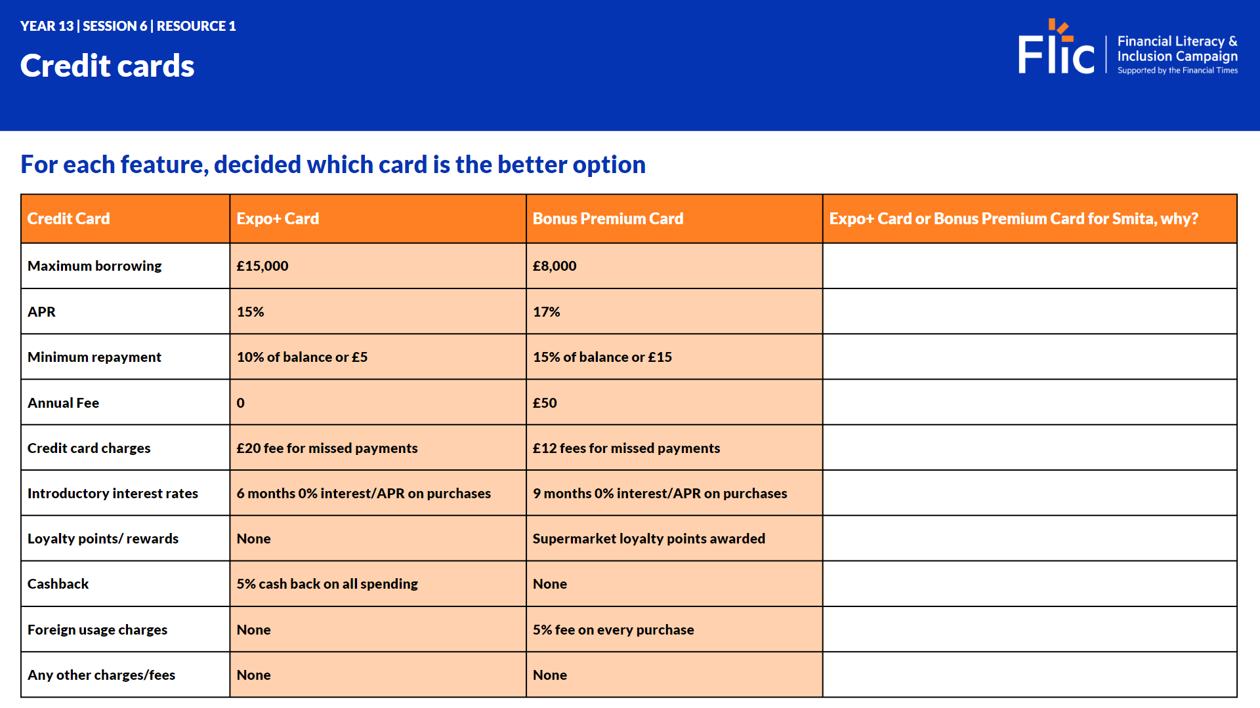
Credit cards
Which credit card should
Smita choose?
Discuss
How much do you think Smita should borrow from the maximum borrowing amount?
How much should she aim to pay back each month?

Slide 29
Make a financial decision
Saving
Pensions
Mortgages
Credit cards
Go to final reflection

Slide 30
Financial decisions
Smita has made significant decisions for her financial future.
What can Smita do to keep on track with her financial goals?

Slide 31
Any questions?
?

Slide 32
Services available for people who have concerns about their personal finances
Citizens Advice – Debt and Money – This resource contains links to advice on a number of topics, including financial difficulties, cost of living and communicating with creditors.
National Debtline – Debt and Money – a debt advice charity run by the Money Advice Trust, offering a free and confidential debt advice service.
Childline Helpline 0800 1111
At school, you can speak with an adult you trust.
This could be your form tutor, head of year or the school’s safeguarding officer.

