Slide 1
How to manage
financial risk
This session is aimed at Year 9 and is also appropriate for KS4 and KS5

Slide 2
Unit outline
Session 1 | Session 2 | Session 3 | Session 4 | Session 5 | Session 6
Mobile phone products | Cryptocurrency | Financial exploitation | Online gaming | Online safety | Decision- making Pocket money debate

Slide 3
Having a respectful learning environment
We will listen to each other respectfully
We will avoid making judgements or assumptions about others
We will comment on what has been said, not the person who has said it
We won’t put anyone on the spot and we have the right to pass
We will not share personal stories or ask personal questions

Slide 4
Session 3:
Financial exploitation

Slide 5
By the end of the session, I will be able to:
Identify situations where young people are vulnerable to exploitation
Explain the impact of financial exploitation
Rehearse strategies to respond to unwanted pressures

Slide 6
What is fraud?
Read the scenarios below. Are there any problems with what is being described?
Fraud is “wrongful or criminal deception intended to result in financial or personal gain.”
Using parents’ bank account details to pay for online shopping without them knowing
Allowing a stranger to transfer money through a personal bank account
Giving credit card details to someone you don’t know
The scenarios described are examples of making personal account details vulnerable to criminal activity.
Source: adapted from https://www.cifas.org.uk/
Notes:
https://www.cifas.org.uk/secure/contentPORT/uploads/documents/Protective%20Registration/Lesson%201-%20%20Is%20it%20fraud%20sort%20card-%202022.pdf

Slide 7
Young people and fraud
It can be really easy to get into financial troubles, especially if someone is unaware of the signs to look out for, or how to protect themselves.
Let’s have a look at a series of events that happened for two young people over the course of five days.
As we go through the information, make a note of any warning signs that the young people are at risk of financial exploitation.

Slide 8
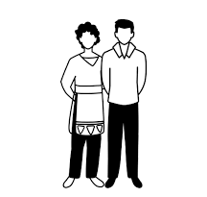
Young people and fraud
Yaz and Adnam are best friends.
They always meet at Adnam's house and then walk to school together.
After school they always meet in the playground and walk home together.

Slide 9
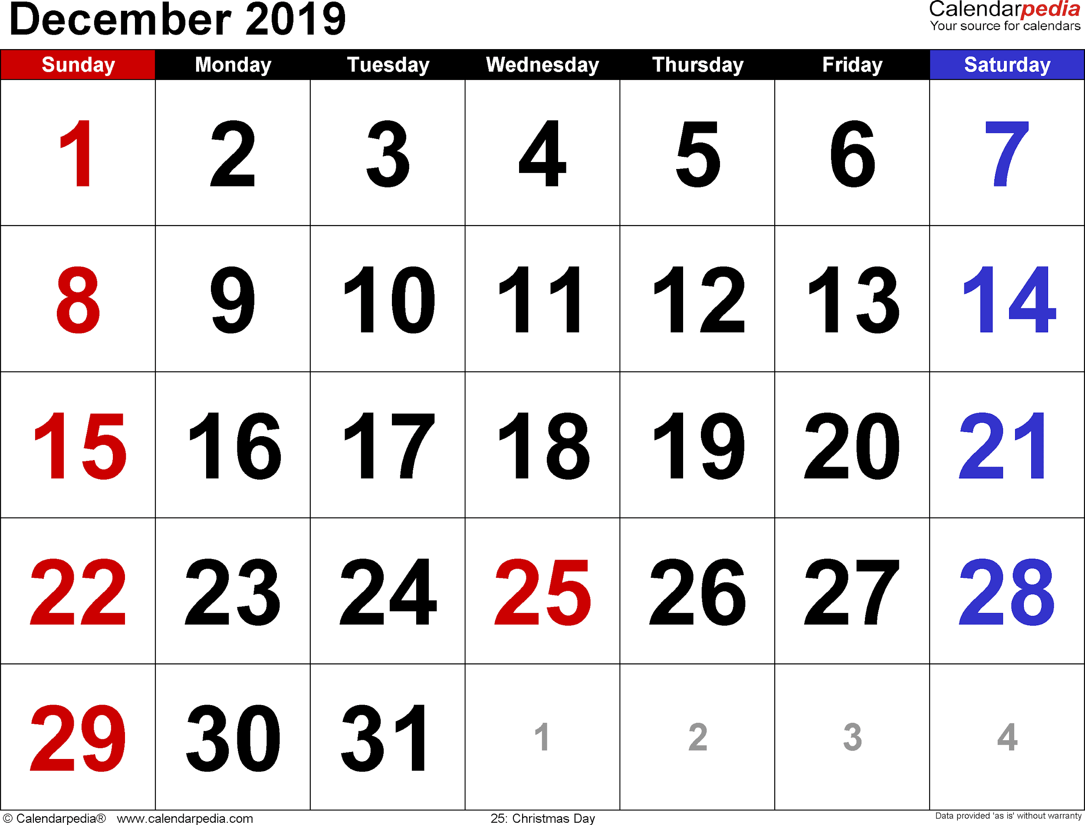
Young people and fraud
Monday
On Monday, Yaz arrives at Adnam’s house as normal.
As they walk to school they both tell each other about all the things they did at the weekend.

Slide 10
Young people and fraud
Tuesday
On their way to school Yaz and Adnam meet up with Mike.
Mike has two heavy bags full of energy drinks with him.
Mike asks Adnam to take one of the bags to school for him and offers to pay £2.
When they arrive at school Adnam gives Mike the bag back in the playground.

Slide 11
Young people and fraud
Wednesday
On Wednesday, Mike tells Yaz that he is having problems with his bank account and asks if he can pay some money into her bank and then she can take it out and give it to him.
Mike offers Yaz £20 if she does this for him.
On the way home they visit the bank and make the payments.

Slide 12
Young people and fraud
Thursday
On Thursday, Mike offers Yaz and Adnam a lift home in his brother’s car.
On the way home, Mike’s brother asks Adnam if he can use his bank account to pay the money into for some things that he is selling on Ebay.
Adnam agrees and passes over his bank account details.

Slide 13
Young people and fraud
Friday
On Friday, Adnam shows Yaz an online advert which offers £10 for volunteers to help by taking wage payments for people without a bank account.
Yaz is interested; she signs up through the advert and provides her bank details.

Slide 14
Young people and fraud
What were the red flags?
Discuss with your partner where you have identified risks to financial exploitation.
Be prepared to feed back to the class.
As we go through the answers, make a note of any warning signs you missed. These will be highlighted in orange and explained in a blue box like this.

Slide 15
Young people and fraud
Yaz and Adnam are best friends.
They always meet at Adnam's house and then walk to school together.
After school they always meet in the playground and walk home together.

Slide 16
Young people and fraud
Monday
On Monday, Yaz arrives at Adnam’s house as normal.
As they walk to school they both tell each other about all the things they did at the weekend.

Slide 17
Young people and fraud
Tuesday
On their way to school Yaz and Adnam meet up with Mike.
Mike has two heavy bags full of energy drinks with him.
Mike asks Adnam to take one of the bags to school for him and offers to pay £2.
When they arrive at school Adnam gives Mike the bag back in the playground.
On their way to school Yaz and Adnam meet up with Mike.
Mike has two heavy bags full of energy drinks with him.
Mike asks Adnam to take one of the bags to school for him and offers to pay £2.
When they arrive at school Adnam gives Mike the bag back in the playground.
This could be the beginning of a grooming process - checking if a young person is open to exchanging a request for money.

Slide 18
Young people and fraud
Wednesday
On Wednesday, Mike tells Yaz that he is having problems with his bank account and asks if he can pay some money into her bank and then she can take it out and give it to him.
Mike offers Yaz £20 if she does this for him.
On the way home they visit the bank and make the payments.
On Wednesday, Mike tells Yaz that he is having problems with his bank account and asks if he can pay some money into her bank and then she can take it out and give it to him.
Mike offers Yaz £20 if she does this for him.
On the way home they visit the bank and make the payments.
Again, this could be part of the grooming process. However, it has escalated from the previous request as the young person is now using their bank account.

Slide 19
Young people and fraud
Thursday
On Thursday, Mike offers Yaz and Adnam a lift home in his brother’s car.
On the way home, Mike’s brother asks Adnam if he can use his bank account to pay the money into from some things that he is selling on Ebay.
Adnam agrees and passes over his bank account details.
On Thursday, Mike offers Yaz and Adnam a lift home in his brother’s car.
On the way home, Mike’s brother asks Adnam if he can use his bank account to pay the money into from some things that he is selling on Ebay.
Adnam agrees and passes over his bank account details.
The young person has now shared their bank details with someone they are unfamiliar with. They cannot be certain where this transaction is coming from.

Slide 20
Young people and fraud
Friday
On Friday, Adnam shows Yaz an online advert which offers £10 for volunteers to help by taking wage payments for people without a bank account.
Yaz is interested; she signs up through the advert and provides her bank details.
On Friday, Adnam shows Yaz an online advert which offers £10 for volunteers to help by taking wage payments for people without a bank account.
Yaz is interested; she signs up through the advert and provides her bank details.
This can be considered as a ‘get-rich-quick’ scam.
They create the impression that users can obtain a rate of return with little skill, effort, or time, and with minimal risk.

Slide 21
Young people and fraud
Based on this scenario, how would you define a ‘money mule’
A money mule is a person who transfers illegal money on behalf of others, usually through their bank account, and receives money for doing so.
Criminals contact people and offer them cash/commission to receive money into their bank account and transfer it to another account. The person who is moving money between criminals is called a ‘money mule.’
Based on the previous activity;
Who was the money mule?
Did you consider Mike to be a criminal?
When do people typically need to share their bank details?
Notes:
Prompt questions
Who was the money mule?
Did you consider Mike to be a criminal?
When do people typically need to share their bank details

Slide 22
By the end of the session, I will be able to:
Identify situations where young people are vulnerable to exploitation
Explain the impact of financial exploitation
Rehearse strategies to respond to unwanted pressures

Slide 23
What is the impact of financial exploitation?
An alert has been raised on Adnam and Yaz’s bank account as they are receiving money from unfamiliar sources.
The bank start to investigate as they are suspicious of the unusual account activity.
What do you think might happen next?

Slide 24
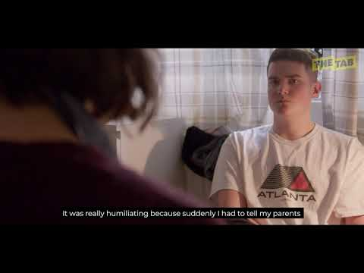
What is the impact of financial exploitation?
As you watch the clip, make a note of the consequences for the young person that was used as a money mule.
Source: Natwest MoneySense
Notes:
https://natwest.mymoneysense.com/teachers/resources-16-18s/topic-9-how-can-my-money-choices-affect-my-mental-wellbeing/video/

Slide 25
What is the impact of financial exploitation?
SOCIAL
FINANCIAL
Can feel alone, different or separated from friends
Can lead to inability to access financial system and transfer money to friends
Can lead to situation where unable to access credit in the future e.g. opening a bank account, or getting a mobile phone contract or credit card
PERSONAL
LEGAL
Can feel stressed, uncertain or anxious
May have an effect on relationships with friends or family
Getting caught can lead to criminal record
The money used could be used to fund criminal activity

Slide 26
By the end of the session, I will be able to:
Identify situations where young people are vulnerable to exploitation
Explain the impact of financial exploitation
Rehearse strategies to respond to unwanted pressures

Slide 27
Keeping safe
Write down a few sentences that a young person could use if faced with a situation like Adnam.
On Thursday, Mike offers Yaz and Adnam a lift home in his brother’s car.
On the way home, Mike’s brother asks Adnam if he can use his bank account to pay the money into from some things that he is selling on Ebay.
Adnam agrees and passes over his bank account details.
What if Adnam is quite shy?
Now share with your partner, who will feedback on the following on your response:
Keeps a young person safe
Realistic response in this situation
Highlights consequences
What if Mike becomes threatening?
What if Mike is begging and pleading?

Slide 28
Keeping safe
Example responses
On Thursday, Mike offers Yaz and Adnam a lift home in his brother’s car.
On the way home, Mike’s brother asks Adnam if he can use his bank account to pay the money into from some things that he is selling on Ebay.
Adnam agrees and passes over his bank account details.
“Sorry, I don’t feel comfortable sharing bank details”
“My parent/ carer checks my bank account online, so I have to ask them first”
“I don’t have my own bank account”
If anyone threatens you, you should speak to adult

Slide 29
By the end of the session, I will be able to:
Identify situations where young people are vulnerable to exploitation
Explain the impact of financial exploitation
Rehearse strategies to respond to unwanted pressures

Slide 30
Any questions?
?

Slide 31
Services available for people who have concerns about their personal finances
Citizens Advice – Debt and Money – This resource contains links to advice on a number of topics, including financial difficulties, cost of living and communicating with creditors.
Crimestoppers – an independent charity where information can be reported anonymously.
0800 555 111
Childline Helpline 0800 1111
At school, you can speak with an adult you trust.
This could be your form tutor, head of year or the school’s safeguarding officer.

Slide 32
Links to learn more!
Articles to extend learning
https://www.bbc.co.uk/iplayer/episode/p0994yyd/scam-stories-the-money-drop
https://www.ft.com/content/7ae1e942-d173-4ea5-8806-ca1843797bee
https://www.takefive-stopfraud.org.uk/
https://crimestoppers-uk.org/campaigns-media/campaigns/dontbeamoneymule
https://nationalcrimeagency.gov.uk/moneymuling
https://crooksoncampus.co.uk/crooks-on-campus-project/
https://www.moneyhelper.org.uk/en/blog/scams-and-fraud/money-mules-what-are-they-and-could-you-fall-victim
https://www.interpol.int/en/News-and-Events/News/2022/YourAccountYourCrime-Global-campaign-exposes-use-of-money-mules
Please visit the FLIC learning hub - https://ftflic.com/learning-hub/ for further resources

