Slide 1
How to manage
financial risk
This session is aimed at Year 9 and is also appropriate or KS4 and KS5

Slide 2
Unit outline
Session 1 | Session 2 | Session 3 | Session 4 | Session 5 | Session 6
Mobile phone products | Cryptocurrency | Financial exploitation | Online gaming | Online safety | Decision- making Pocket money debate

Slide 3
Having a respectful learning environment
3
We will listen to each other respectfully
We will avoid making judgements or assumptions about others
We will comment on what has been said, not the person who has said it
We won’t put anyone on the spot and we have the right to pass
We will not share personal stories or ask personal questions

Slide 4
4
Session 6
Pocket money debate

Slide 5
5
By the end of the session, I will be able to:
Identify reasons for and against young people having pocket money
Assess the risks involved with young people managing their money
Suggest the best ways for young people to manage their money responsibly

Slide 6
Young people and money management
“All young people should have pocket money”
What is your first reaction to this statement?

Slide 7
Young people and money management
7
Thinking about what you have learnt over the last few weeks, describe 2-3 things that young people should be aware of when it comes to managing their own money.

Slide 8
Young people and money management
8
“All young people should have pocket money”
Create the table below in your book
No- young people should not have pocket money | Yes - all young people should have pocket money

Slide 9
Young people and money management
9
With your partner, discuss the questions below to give reasons why young people should not have pocket money
 | No- young people should not have pocket money
 | When it comes to online gaming, in what ways have young people been irresponsible with money management?
 | What are some of the financial risks that young people are exposed to online?
 | Why might some parents and carers choose not to give their children pocket money?

Slide 10
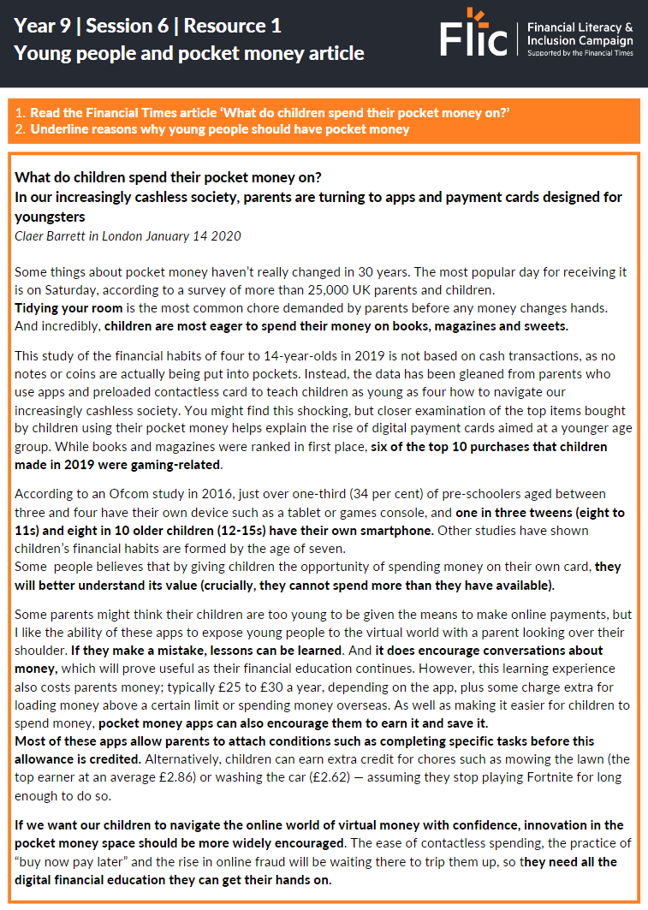
Young people and money management
10
Read the Financial Times article ‘What do children spend their pocket money on?’
Underline reasons why young people should have pocket money
https://www.ft.com/content/4801084d-41bb-461b-9b92-d9479b07aee3

Slide 11
Young people and money management
11
 | Yes - all young people should have pocket money
 | What items do young people typically spend their pocket on?
 | How are apps designed to help young people make positive money decisions?
 | How can parents and carers help young people to manage their pocket money?

Slide 12
Young people and money management
“All young people should have pocket money”

Slide 13
Debate
“All young people have pocket money”
Why do young people need access to their own money?
Other than spending, what are the benefits of young people having access to their own money?
What are some of the financial risks that young people are exposed to?
Stretch | What have you learned to help you make positive choices with money? Write these down for your own personal reflection.

Slide 14
Any questions?
?

Slide 15
Services available for people who have concerns about their personal finances
Citizens Advice – Debt and Money – This resource contains links to advice on a number of topics, including financial difficulties, cost of living and communicating with creditors.
National Debtline – Debt and Money – a debt advice charity run by the Money Advice Trust, offering a free and confidential debt advice service.
Childline Helpline 0800 1111
At school, you can speak with an adult you trust.
This could be your form tutor, head of year or the school’s safeguarding officer.

