Slide 1
How to plan for the world of work
This session is aimed at Key Stage Four (recommended for Year 10)

Slide 2
Unit outline
Session 1 | Session 2 | Session 3 | Session 4 | Session 5 | Session 6
Careers in the City | Apprenticeships | Entrepreneurship | Understanding gig work and employment rights | Speaking up at work | Creating a career plan

Slide 3
Having a respectful learning environment
We will listen to each other respectfully
We will avoid making judgements or assumptions about others
We will comment on what has been said, not the person who has said it
We won’t put anyone on the spot and we have the right to pass
We will not share personal stories or ask personal questions
If there is a question that you do not wish to ask aloud, you can write it on a Post-it Note which will be collected throughout the session and answered at the end
Notes:
Teacher delivery
Students should be invited to ask questions and they should be provided with an opportunity to ask questions anonymously. It is useful to have a question box or allocated space on the whiteboard for students to share questions.
It is suggested that students are provided with post-its or slips to write their questions on and as the teacher circulates throughout the lesson these questions can be collected and answers throughout the session or using an allocated ‘question time’ at the end of the session.
Students can be invited to respond to questions asked by their peers. If responses to questions are based on personal preference or opinion, the teacher should be clear to preface any answers with this.

Slide 4
Session 3:
Entrepreneurship
Notes:
Exploratory lesson. Based on careers in the City, doesn’t look at other career

Slide 5
By the end of the session, I will be able to:
Define what it means to be an entrepreneur
Assess the pros and cons of entrepreneurship vs other jobs
Practise the enterprise skills needed to be an entrepreneur

Slide 6
Entrepreneurship | Starter
Explain the role of an auditor.
What are the different levels of apprenticeships, and what alternative name can be used for each level?
Explain one advantage of doing a degree apprenticeship rather than going to university
Answers
An auditor checks organisations' financial records and procedures to make sure they are accurate and efficient.
Intermediate (Level 2), Advanced (Level 3), Higher (Level 4), Higher (Level 5)
Advantages of doing an apprenticeship:
Earn money sooner
Work in a vocation / trade
Don’t take on student loan
Notes:
Delivery Instruction
2 minutes of students working independently. A further 2 minutes for feedback

Slide 7
What comes to mind when you hear the word?
Keywords relating to entrepreneurship:
Vision
Risk
Innovation
Leadership
Resilience
Strategy
Growth
Adaptability
Opportunity
Passion
Entrepreneur
Notes:
Delivery Instruction
Ask students to create a mindmap of words and phrases that come to mind when they hear the word entrepreneur.
Gather feedback from students
Teacher Explanation
Expected Student Feedback: Students are likely to suggest words and phrases associated with wealthy entrepreneurs seen on tv. Prompt students by asking whether all entrepreneurs fit this criteria.

Slide 8
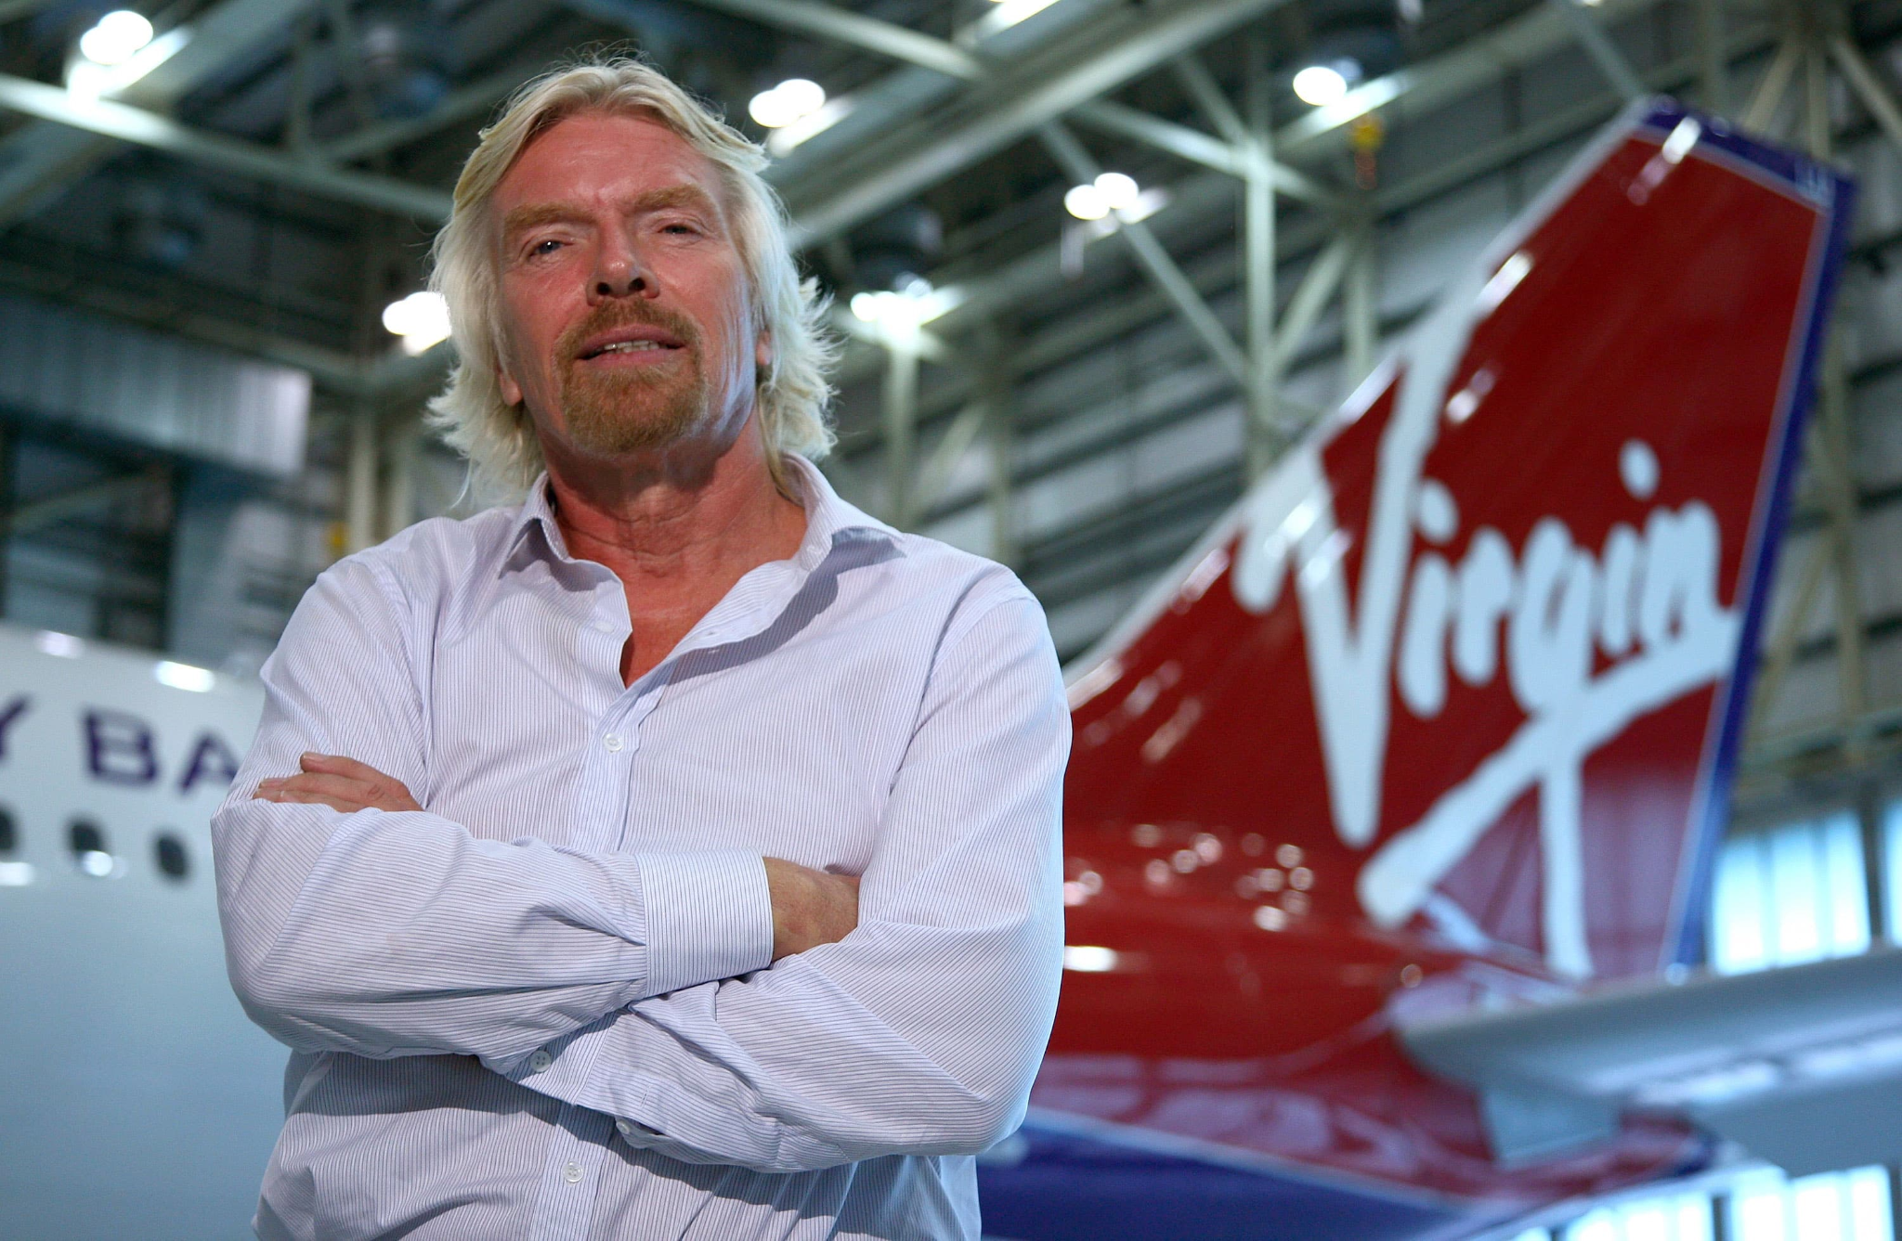
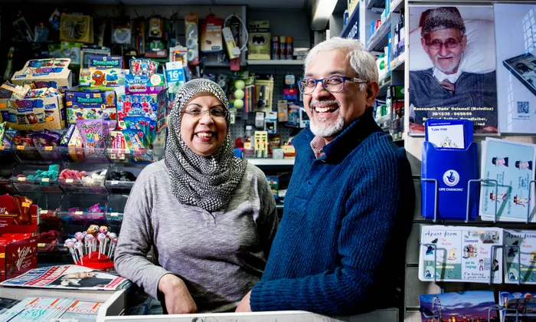
Which of these people are entrepreneurs?
Notes:
Delivery Instruction
Lead a class discussion where students try to determine which of the people in the images are entrepreneurs.
Prompt Question
What makes someone an entrepreneur?
Additional Context
Clockwise from top left
Richard Branson, owner of Virgin
Yusuf and Sabi Gulamali, Owners of Maks News in Bethnal Green
An unidentified owner of a clothes shop
Oprah Winfrey, founder of Harpo Inc
Elon Musk, founder of Tesla and owner of Twitter
6. An uniudentified business owner.

Slide 9
An entrepreneur is…
“...A person who sets up a business or businesses, taking on financial risk in the hope of gaining profit”
All of these people are entrepreneurs
Notes:
Delivery Instruction
Lead a class discussion where students try to determine which of the people in the images are entrepreneurs.
Prompt Question
Can you explain the financial risks that these people would have taken on when setting up their businesses?
Additional Context
All of the above would have needed funding to start their businesses. They would either have used their own savings, or used a loan. In each case, the money used to establish their company was at risk, as there was no guarantee that the business would be a success.
Clockwise from top left
Richard Branson, owner of Virgin
An unidentified business owner.
Yusuf and Sabi Gulamali, Owners of Maks News in Bethnal Green
Steven Bartlett - Entrepreneur, Speaker, Investor,
An unidentified owner of a clothes shop
Oprah Winfrey, founder of Harpo Inc

Slide 10
Entrepreneurs in the UK
Key Facts
In the private sector, small and medium businesses account for over half of the turnover at £2.4 trillion (52%)
On average, almost 20% of new businesses fail in their first year
Small businesses employ
48% of the workforce
Notes:
Additional Context
SMEs: Small and medium sized enterprises.
Turnover: The total value of the sales made by a business in a period.
Source: https://www.gov.uk/government/statistics/business-population-estimates-2022/business-population-estimates-for-the-uk-and-regions-2022-statistical-release-html

Slide 11
Entrepreneurs in the UK
Using full sentences, you have two minutes to write a brief description of what it means to be an entrepreneur and the role entrepreneurs play in the UK economy.

Slide 12
By the end of the session, I will be able to:
Define what it means to be an entrepreneur
Assess the pros and cons of entrepreneurship vs other jobs
Practise the enterprise skills needed to be an entrepreneur

Slide 13
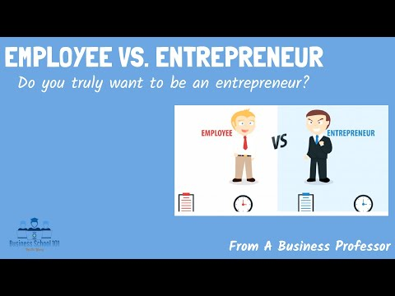
Pros and cons of entrepreneurship
Task
Watch the video on the difference between being an entrepreneur and an employee.
Create a table that details the pros and cons of being an entrepreneur vs an employee.
https://www.youtube.com/watch?v=RN6fLLFVem4
Notes:
Video here: https://www.youtube.com/watch?v=RN6fLLFVem4

Slide 14
Pros and Cons of Entrepreneurship
Pros
Cons
On the left are some of the pros and cons from the video you’ve just watched.
Looking at the statements in bold, can you identify how each pro/con may be seen the other way?
Compensation
Determines own pay
Often the last to be paid
Can establish a flexible working schedule to meet their needs
Some people work better with structure
Work Schedule
Doesn’t have to answer to anyone. Can make all decisions independently
Responsibility
All responsibility falls on their shoulders
Has the freedom to choose their own work environment
May have to run business from an environment suited to other purposes
Work Environment
Competition
Is not in competition with other colleagues
Is in competition with other businesses
Notes:
Additional Context
The context below is in reference to the alternative pros and cons that students are asked to identify through the task on the slide.
Pro 1: Whilst entrepreneurs may be last to be paid, they determine how much they get paid. This is especially useful when businesses are very profitable.
Con 1: Some may find it very appealing to be in complete control of their working schedule, but others prefer a level of structure to be imposed upon them
Pro 2: Entrepreneurs have autonomy over the direction of their business, so even though all responsibility falls on them, it may be worth it considering they can take the business in whatever direction they choose.
Con 2: Although entrepreneurs don’t have to work from an office, and can in theory work from wherever they like, they may be forced to work in environments that are not conducive to working productively. This is particularly true for startups and young businesses, where entrepreneurs may work from their kitchen, bedroom, or basement. Common examples of this are amazon, which started in Jeff Bezos’ garage, and Facebook, which started in Mark Zuckerberg’s dorm room. In actual fact, garages play a crucial role in the history of Amazon, Google, and Apple
Con 3: Whilst entrepreneurs do not compete with other colleagues (as there often aren’t any, and if there are, the entrepreneur has a higher standing) entrepreneurs must compete with external competition. This can often be more difficult, as the stakes tend to be higher (loss of revenue, survival of business).

Slide 15
Pros and Cons of Entrepreneurship
 | Pros | Cons
Compensation | Determines own pay | Often the last to be paid
Work schedule | Can establish a flexible working schedule to meet their needs | Some people work better with structure
Responsibility | Doesn’t have to answer to anyone. Can make all decisions independently | All responsibility falls on their shoulders
Work Environment | Has the freedom to choose their own work environment | May have to run business from an environment suited to other purposes
Competition | Is not in competition with other colleagues | Is in competition with other businesses
On the left are some of the pros and cons from the video you’ve just watched.
Looking at the statements in bold, can you identify how each pro/con may be seen the other way?
Notes:
Additional Context
The context below is in reference to the alternative pros and cons that students are asked to identify through the task on the slide.
Pro 1: Whilst entrepreneurs may be last to be paid, they determine how much they get paid. This is especially useful when businesses are very profitable.
Con 1: Some may find it very appealing to be in complete control of their working schedule, but others prefer a level of structure to be imposed upon them
Pro 2: Entrepreneurs have autonomy over the direction of their business, so even though all responsibility falls on them, it may be worth it considering they can take the business in whatever direction they choose.
Con 2: Although entrepreneurs don’t have to work from an office, and can in theory work from wherever they like, they may be forced to work in environments that are not conducive to working productively. This is particularly true for startups and young businesses, where entrepreneurs may work from their kitchen, bedroom, or basement. Common examples of this are amazon, which started in Jeff Bezos’ garage, and Facebook, which started in Mark Zuckerberg’s dorm room. In actual fact, garages play a crucial role in the history of Amazon, Google, and Apple
Con 3: Whilst entrepreneurs do not compete with other colleagues (as there often aren’t any, and if there are, the entrepreneur has a higher standing) entrepreneurs must compete with external competition. This can often be more difficult, as the stakes tend to be higher (loss of revenue, survival of business).

Slide 16
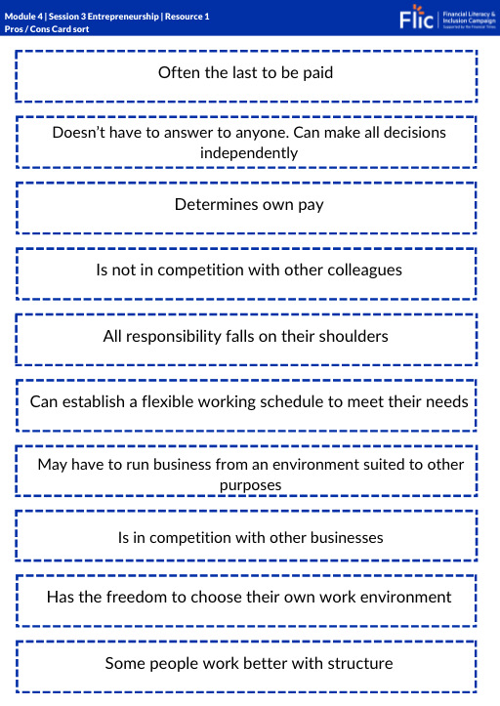
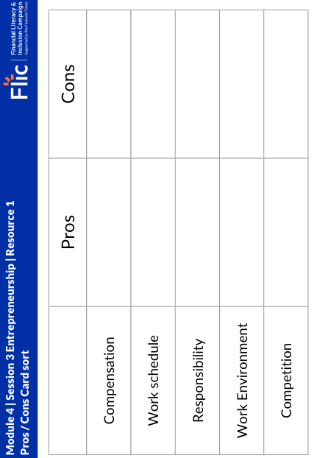
Pros and Cons of Entrepreneurship
Optional Resource
Optional Resource:
Resource 1
Instructions:
Cut out the Pros and Cons on the worksheet (page 1)
Sort them into the table on page 2
Notes:
Additional Context
The context below is in reference to the alternative pros and cons that students are asked to identify through the task on the slide.
Pro 1: Whilst entrepreneurs may be last to be paid, they determine how much they get paid. This is especially useful when businesses are very profitable.
Con 1: Some may find it very appealing to be in complete control of their working schedule, but others prefer a level of structure to be imposed upon them
Pro 2: Entrepreneurs have autonomy over the direction of their business, so even though all responsibility falls on them, it may be worth it considering they can take the business in whatever direction they choose.
Con 2: Although entrepreneurs don’t have to work from an office, and can in theory work from wherever they like, they may be forced to work in environments that are not conducive to working productively. This is particularly true for startups and young businesses, where entrepreneurs may work from their kitchen, bedroom, or basement. Common examples of this are amazon, which started in Jeff Bezos’ garage, and Facebook, which started in Mark Zuckerberg’s dorm room. In actual fact, garages play a crucial role in the history of Amazon, Google, and Apple
Con 3: Whilst entrepreneurs do not compete with other colleagues (as there often aren’t any, and if there are, the entrepreneur has a higher standing) entrepreneurs must compete with external competition. This can often be more difficult, as the stakes tend to be higher (loss of revenue, survival of business).

Slide 17
By the end of the session, I will be able to:
Define what it means to be an entrepreneur
Assess the pros and cons of entrepreneurship vs other jobs
Practise the enterprise skills needed to be an entrepreneur

Slide 18
Starting a Business
You are all entrepreneurs for the day!
In groups create a business plan for an exciting, new start-up. You’ll need to think about the product or service you will sell, how you’ll market it, and how you’ll structure your organisation.
Crucial to this is understanding the skills that will be necessary to establish and grow your business, so be sure to make a note of this as you go along.
Stretch
You’ve managed to secure a start-up loan of £10,000. Allocate these funds to the different expenses that you will have when starting your business
Resource 2: Business Plan

Slide 19
Learning review
What comes to mind when you hear the word
Look back at your mindmap from the beginning of the lesson.
Using a different colour add anything new that you have learnt this lesson about entrepreneurship.
Entrepreneur
Notes:
Delivery Instruction
Ask students to create a mindmap of words and phrases that come to mind when they hear the word entrepreneur.
Gather feedback from students
Teacher Explanation
Expected Student Feedback: Students are likely to suggest words and phrases associated with wealthy entrepreneurs seen on tv. Prompt students by asking whether all entrepreneurs fit this criteria.

Slide 20
By the end of the session, I will be able to:
Define what it means to be an entrepreneur
Assess the pros and cons of entrepreneurship vs other jobs
Practise the enterprise skills needed to be an entrepreneur

Slide 21
Any questions?
?

Slide 22
Services available for people who have concerns about their rights at work
Money Helper - Work
Gov UK - Workplace rights
Citizens Advice - Work
At school, you can speak with an adult you trust.
This could be your form tutor, head of year or the school’s safeguarding officer

Slide 23
Links to learn more!
Articles to extend learning
Please visit the FLIC learning hub for further resources
Money Helper Apprenticeships Explained

