Slide 1
How to plan for the world of work
This session is aimed at Key Stage Four (recommended for Year 10)

Slide 2
Unit outline
Session 1 | Session 2 | Session 3 | Session 4 | Session 5 | Session 6
Careers in the City | Apprenticeships | Entrepreneurship | Understanding gig work and employment rights | Speaking up at work | Creating a career plan

Slide 3
Having a respectful learning environment
We will listen to each other respectfully
We will avoid making judgements or assumptions about others
We will comment on what has been said, not the person who has said it
We won’t put anyone on the spot and we have the right to pass
We will not share personal stories or ask personal questions
If there is a question that you do not wish to ask aloud, you can write it on a Post-it Note which will be collected throughout the session and answered at the end
Notes:
Teacher delivery
Students should be invited to ask questions and they should be provided with an opportunity to ask questions anonymously. It is useful to have a question box or allocated space on the whiteboard for students to share questions.
It is suggested that students are provided with post-its or slips to write their questions on and as the teacher circulates throughout the lesson these questions can be collected and answers throughout the session or using an allocated ‘question time’ at the end of the session.
Students can be invited to respond to questions asked by their peers. If responses to questions are based on personal preference or opinion, the teacher should be clear to preface any answers with this.

Slide 4
By the end of the session, I will be able to:
Apply knowledge from the previous lessons to plan an educational and career path

Slide 5
Session 6:
Decision-making
Creating a career plan

Slide 6
Today’s activity
In today’s lesson, you will use the knowledge gained in the previous lessons in order to plan a career path
If you don’t know what career you want in the future, that’s okay. You can see how you get on making choices that sound interesting to you
Throughout the lesson, you’ll make decisions on a direction to take in order to meet specific career goals

Slide 7
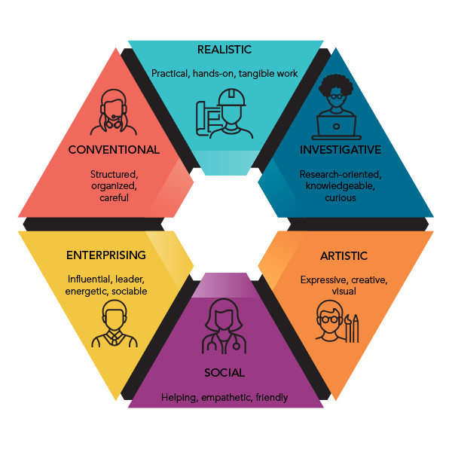
Starting with personality types
We'll begin with a personality test based on the RIASEC model to explore careers that may align with your attitudes, interests, and behaviors.
What is the RIASEC model?
The RIASEC model, developed by John Holland, categorizes both people and work environments into six types: Realistic, Investigative, Artistic, Social, Enterprising, and Conventional. It's a widely used tool for career planning.
Notes:
A version of the test can be taken here: https://openpsychometrics.org/tests/RIASEC/
It takes around 5 minutes to complete if answering quickly.

Slide 8
Starter: Match up types and definitions
ARTISTIC
Influential, leader, energetic sociable
INVESTIGATIVE
Expressive, creative, visual
CONVENTIONAL
Practical, hands-on, tangible work
ENTERPRISING
Helping, empathetic, friendly
SOCIAL
Structured, organised, careful
REALISTIC
Research-oriented, knowledgeable, curious
Notes:
A version of the test can be taken here: https://openpsychometrics.org/tests/RIASEC/
It takes around 5 minutes to complete if answering quickly.

Slide 9
Starter: Match up types and definitions | Answers
ARTISTIC
Expressive, creative, visual
INVESTIGATIVE
Research-oriented, knowledgeable, curious
CONVENTIONAL
Structured, organised, careful
ENTERPRISING
Influential, leader, energetic sociable
SOCIAL
Helping, empathetic, friendly
REALISTIC
Practical, hands-on, tangible work
Notes:
A version of the test can be taken here: https://openpsychometrics.org/tests/RIASEC/
It takes around 5 minutes to complete if answering quickly.

Slide 10
Starting with personality types
We’ll start by understanding what motivates us, and what kind of personality types we are
Step 1: You’ll see a number of statements in Tables A to F. Place a tick next to any statement you agree with; you can tick multiple statements
Step 2: Add up the number of ticks in Tables A to F. Place the total in the relevant columns in the bottom table
Read through the rest of the information to see what this means about you!
Notes:
Teacher delivery
As this activity involves personal reflection, students should only be invited to share what they feel comfortable to.
Use questioning like and students can expand if they wish
Would anyone like to share what they learnt about themselves?
Are the results a reflection of how you would typically describe yourself?
Is anyone surprised by the result?
Remind students that quizzes like these help to provide insight but are not definitive of their characteristics. These types of personality quizzes can give helpful indications about the types of roles/careers students might be more interested in, but are not fixed or limited in terms of what they can do in the future.
They can use the information that is useful to them and further explore or dismiss information that they don’t feel applies to them,

Slide 11
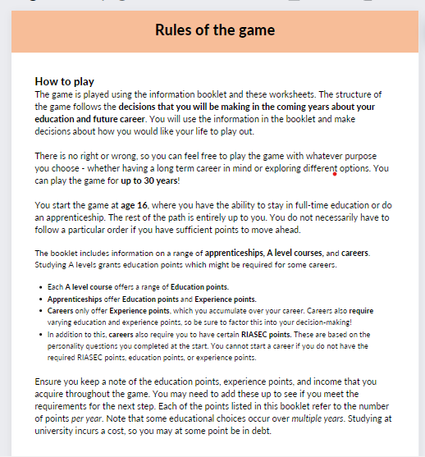
Rules of the game
Before diving in,
let’s read the rules!

Slide 12
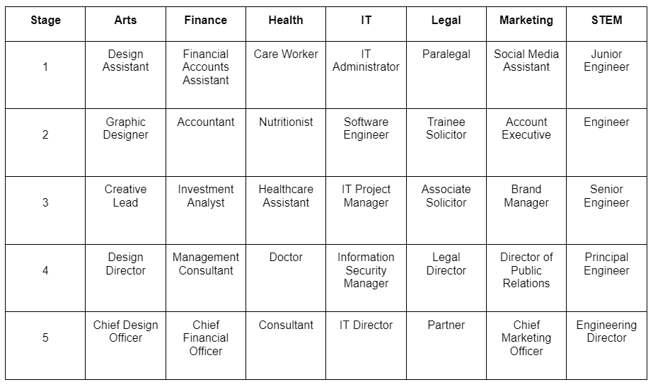
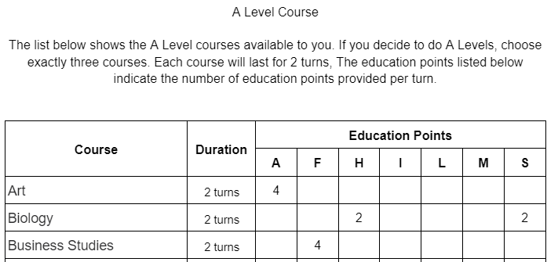
Rules of the game
Take 5 mins to look through the ‘information booklet’ to get a sense of all the different options
out there for you.

Slide 13
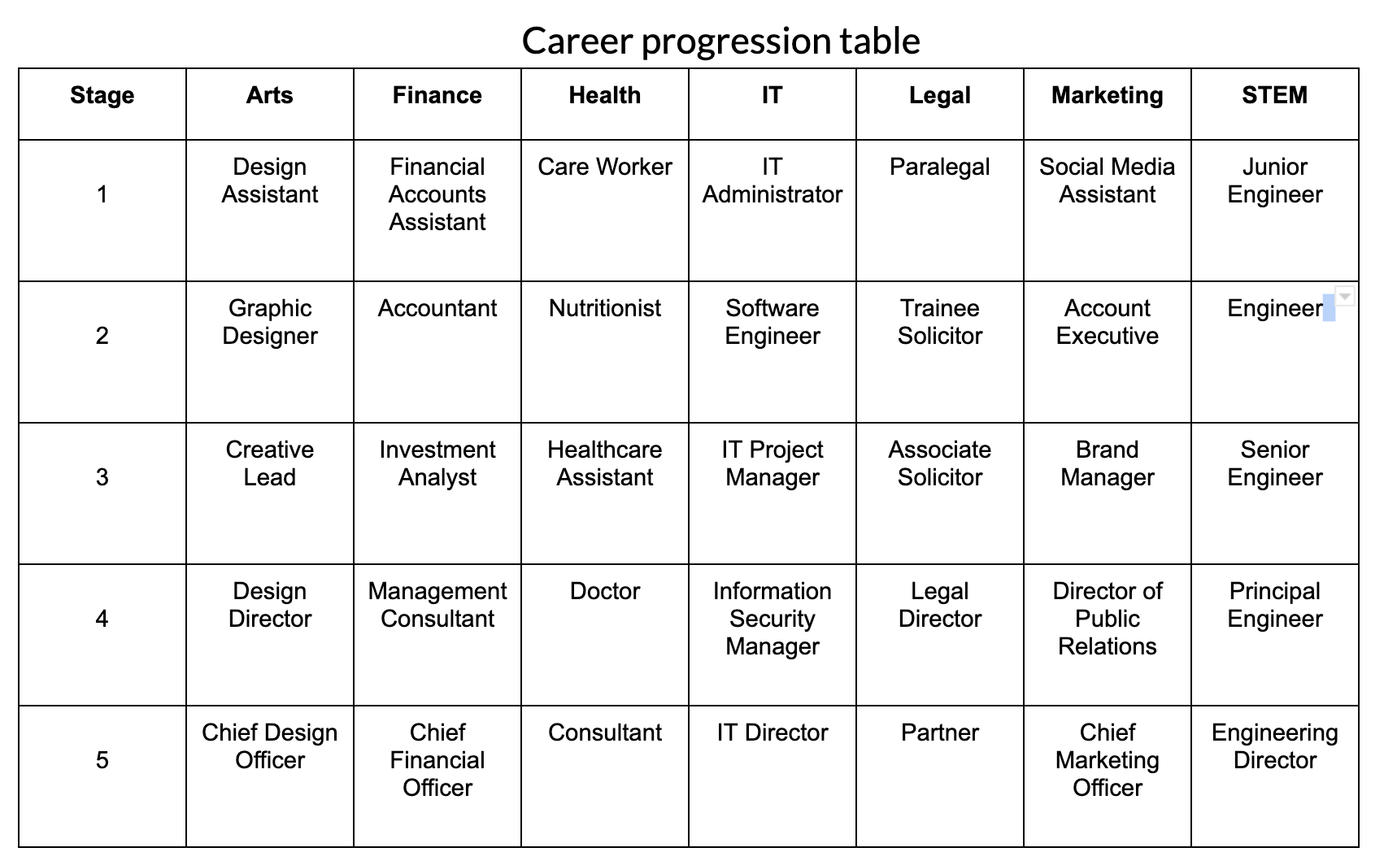
Career progression table
This can help you see how you may progress in a certain career.
However, you may experience different kinds of jobs on the way and that’s okay!

Slide 14
Worked example:
David’s career journey
David would like a career as a Marketing Director at a sports retail company
David decides to do the apprenticeship on the right
He gets 8 Marketing Education points
Add these to the Education Points in the Career scoresheet
He gets 4 Marketing and 1 IT Experience points
Add these to the Experience Points in the Career scoresheet
Add the £12,000 salary for each year
Because it’s a 2 year course, we complete the table for the first 2 rows
Career scoresheet
Year | Academic or work decision | Experience Points |  |  |  |  |  |  | Education Points |  |  |  |  |  |  | Yearly Salary (£)
 |  | A | F | H | I | L | M | S | A | F | H | I | L | M | S
1
2
8
Digital Marketing and Social Media Apprenticeship
1 4
12,000
8
Digital Marketing and Social Media Apprenticeship
1 4
12,000
Notes:
Teacher explanation
David wants to do a DMSM apprenticeship. In order to do this he needs;
He needs 8 marketing education points
Add 4 marketing 1 IT to the experience points
Add 8 marketing to the education points
Add the 12000 salary

Slide 15
Worked example:
David’s career journey
In order to access a job as an Account Executive, he needs 25 Marketing Education point and 12 Marketing Experience points.
David needs to find a way of acquiring these points before starting this career.
This leads him to do the Digital Marketing Degree Apprenticeship
David meets the requirements to start a Digital Marketing Degree
Apprenticeship
From there, he can be an Account Executive

Slide 16
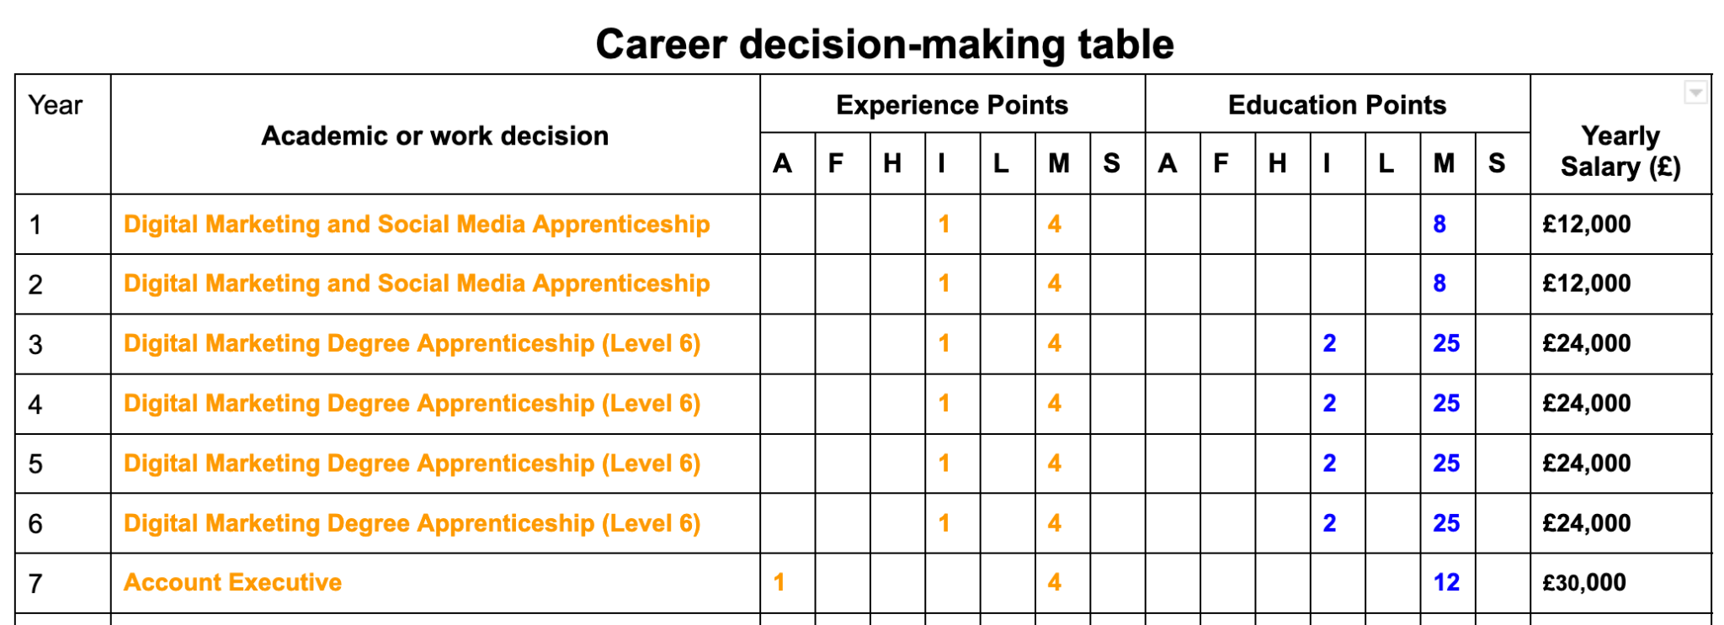
Worked example:
David’s career journey
David now has enough Experience and Education points to be hired as an Account Executive.
He starts this job.

Slide 17
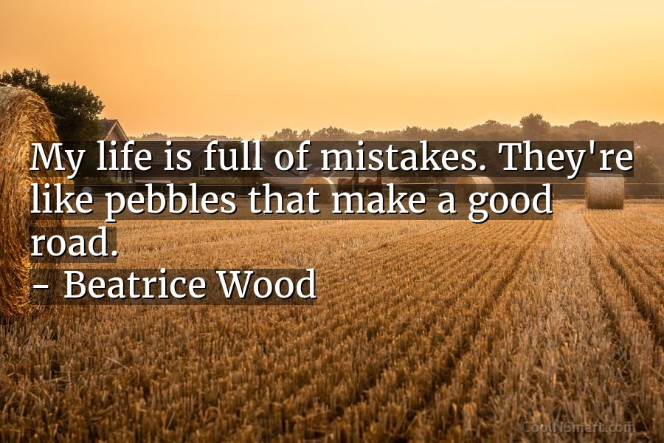
Learning from mistakes
We all make mistakes, but these make us who we are.
Once you’ve committed a decision to the scoresheet it must remain there.
If you ever feel like changing path, consider:
The education and experience you already have
The education and experience you need to gain to get to where you want to be

Slide 18
Over to you!
It’s your turn to begin planning your career
Start filling in the ‘Decision-making table’ in the way that we have done for David, but this time making decisions that are exciting for you!
Don’t worry if you’re not sure what career you want for your future. Use this as an opportunity to explore different education and career paths

Slide 19
Reflection
What have you learnt about experience vs education required for certain jobs?
Do you have a clearer idea about any of your next steps to lead you to your ideal career?
What were your main 3 learnings?

Slide 20
By the end of the session, I will be able to:
Apply knowledge from the previous lessons to plan an educational and career path

Slide 21
Any questions?
?

Slide 22
Services available for young people exploring their career options
Get personalised careers advice and information
Events and experiences that grow young people’s strengths to become world-ready and work-ready
UK-wide youth volunteering programme that provides young people aged 14-30 with access to thousands of opportunities
Gov UK National Careers Service
National Citizens Service
V-inspired
At school, you can speak with an adult you trust.
This could be your form tutor, head of year or the school’s safeguarding officer.
Notes:
https://careers.startprofile.com/page/home-page

Slide 23
Links to learn more!
Articles to extend learning
Please visit the FLIC learning hub for further resources

