Slide 1
How to protect my financial future
This session is aimed at Key Stage Four (recommended for Year 11)

Slide 2
Unit outline
Session 1 | Session 2 | Session 3 | Session 4 | Session 5 | Session 6
Take home pay | Budgeting for the future | Savings | Investing for the long term | Insurance | Investment exercise

Slide 3
Having a respectful learning environment
We will listen to each other respectfully
We will avoid making judgements or assumptions about others
We will comment on what has been said, not the person who has said it
We won’t put anyone on the spot and we have the right to pass
We will not share personal stories or ask personal questions
If there is a question that you do not wish to ask aloud, you can write it on a post-it note which will be collected throughout the session and answered at the end
Notes:
Teacher delivery
Students should be invited to ask questions and they should be provided with an opportunity to ask questions anonymously. It is useful to have a question box or allocated space on the whiteboard for students to share questions.
It is suggested that students are provided with post-its or slips to write their questions on and as the teacher circulates throughout the lesson these questions can be collected and answers throughout the session or using an allocated ‘question time’ at the end of the session.
Students can be invited to respond to questions asked by their peers. If responses to questions are based on personal preference or opinion, the teacher should be clear to preface any answers with this.

Slide 4
Session 2:
Budgeting for the future

Slide 5
By the end of the session, I will be able to:
Describe the difference between financial needs and wants
Explain the purpose of budgeting
Apply a budgeting framework to needs, wants and future spending

Slide 6
Starter - needs and wants
Lucy is looking to sort the items below into needs and wants.
Have a go by completing the Venn diagram. Do any items overlap?
Smart phone
Paying housing rent
Home heating
New pair of trainers
Stationery (pens, ruler, pencils)
Weekly food shop
Holiday book
Flips flops to replace broken ones
Netflix subscription
Takeaway meals
Needs
Wants
Notes:
Prompt questions
Are there any items which you consider to be strictly needs?
How would you differentiate weekly food shop from takeaway meals?
Are there any items that change category based on age or circumstance?

Slide 7
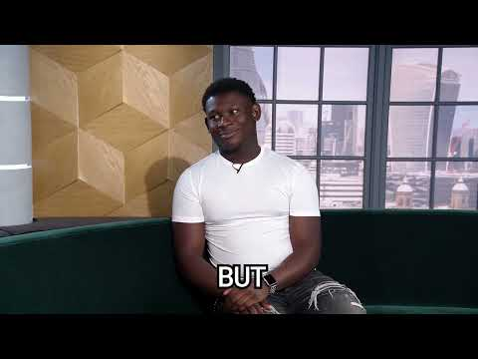
Needs vs Wants - Poku Banks
How can you tell what is a NEED from what is a WANT when making purchases?
If it is difficult to tell the difference, ask the three questions in this video.
Video: Needs vs wants
Notes:
The three questions:
Do I really need this item to live and function?
Can I get this in a less expensive way?
Would your life be different with this item?

Slide 8
Discussion
How might a person’s needs change over time?

Slide 9
How might a person’s wants change over time?
Sometimes, changes to needs and wants are not due to changes to personal circumstances.
Political and economic changes can determine changes to our spending behaviours.
Notes:
Teacher explanation
Examples to draw on can include a person might need a car for work purposes or because they live in a remote area, societal changes or events like Covid meant more people needed access to ICT at home where they may have relied on using school or work equipment before this, how much we spend on outings and gifts might change depending on life events like starting a family or managing money in a cost of living crisis.

Slide 10
Needs and wants
Write a few sentences explaining the difference between a need and a want

Slide 11
By the end of the session, I will be able to:
Describe the difference between financial needs and wants
Explain the purpose of budgeting
Apply a budgeting framework to needs, wants and future spending

Slide 12
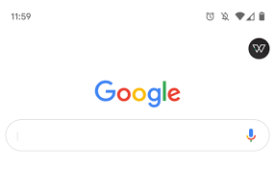
Budgeting for needs and wants
How should I split my wages?
Think - Pair - Share
What is a budget?
How do people budget?
Why do people budget?
Notes:
Teacher explanation
Use targeted questioning, linking to the notion of needs vs wants

Slide 13
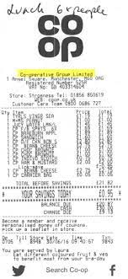
How do people budget?
There are two main things to consider when it comes to budgeting:
Income - how much money is available every month
Expenditures - regular payments that need to be made throughout the month
Then people can see how much there is left to spend on other needs and additional wants, taking into account money they will want to save for the future.
Receipts can a be useful way of tracking spending
Notes:
@ 20 min

Slide 14
Budgeting
What is a budget?
A way of planning finances, taking into account income and expenses.
Why budget?
A person can feel more in control over their money
Understand spending better and where to cutback if needed
Allows us to save for the future
Provides financial security and safety
Can increase confidence and improve wellbeing
Notes:
Teacher explanation
What is a budget?
Budgeting is a way of planning your finances to ensure that you have enough money to purchase items you want. It’s a way of tracking money coming in and money going out.
Why budget?
There are numerous reasons for people to budget. Others may be mentioned and true that aren’t listed on the slide. This question may also bring up sensitivities so depersonalisation is key in the discussion.

Slide 15
Budgeting for needs and wants
How should I split my wages?
Now write your answers, based on our discussion:
What is a budget?
How do people budget?
Why do people budget?
Notes:
Delivery instruction
Students to write a brief explanation

Slide 16
By the end of the session, I will be able to:
Describe the difference between financial needs and wants
Explain the purpose of budgeting
Apply a budgeting framework to needs, wants and future spending

Slide 17
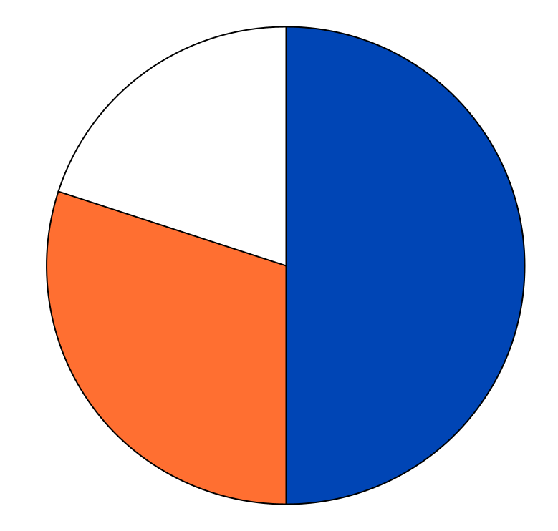
A guide to help you budget:
20%
Needs
Wants
50%
Future (savings, investments and emergency fund*)
30%
*Emergency fund is 3+ months of savings for unplanned expenses

Slide 18
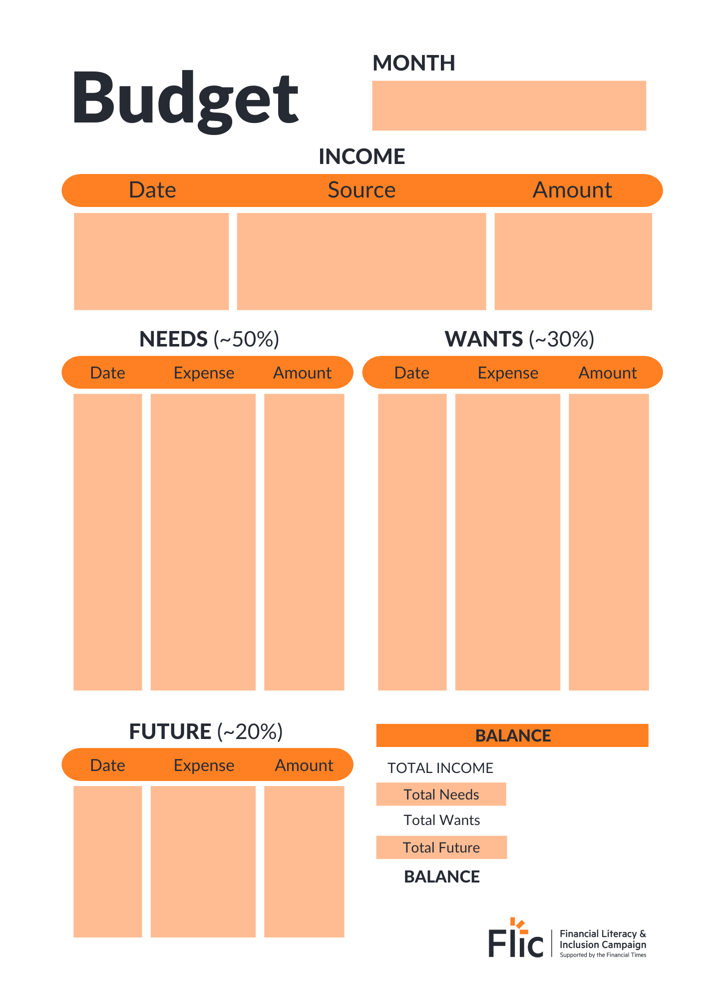
Calculating your needs
What do people spend their money on?
Task:
Lucy has a monthly amount of £2,000 to budget from after tax and other deductions
Read through the bills catalogue
Budget for needs. Choose somewhere to live, utilities, taxes, transport, TV, internet and food. Add the cost of each of these to your worksheet
Budget for wants. Look at the ‘other potential costs’. Are these needs or wants? Are there any others that could be added to the sheet?
Can you think of top tips to help slow down when it comes to wants?
Stretch - Can you apply the 50:30:20 guidance?
Resource 1 and 2 - Budgeting booklet
Notes:
Teacher explanation
Hand out the bills catalogue and budgeting sheet with worked example (over budget). Students need to consider the £2,000 and create their own budget showing how they can stay within budget.
Students should add their take-home pay as their monthly budget. They then choose their needs from the catalogue completing the worksheet. There will still be some choices here like house size, internet package, where they shop for food etc.
Remember needs should fit into the monthly amount previously calculated, the 50% of the monthly income (net pay).
Students should understand the bottom line, i.e. after a person has spent money on the essentials in the bills catalogue, how much do they have left at the end of the month?

Slide 19
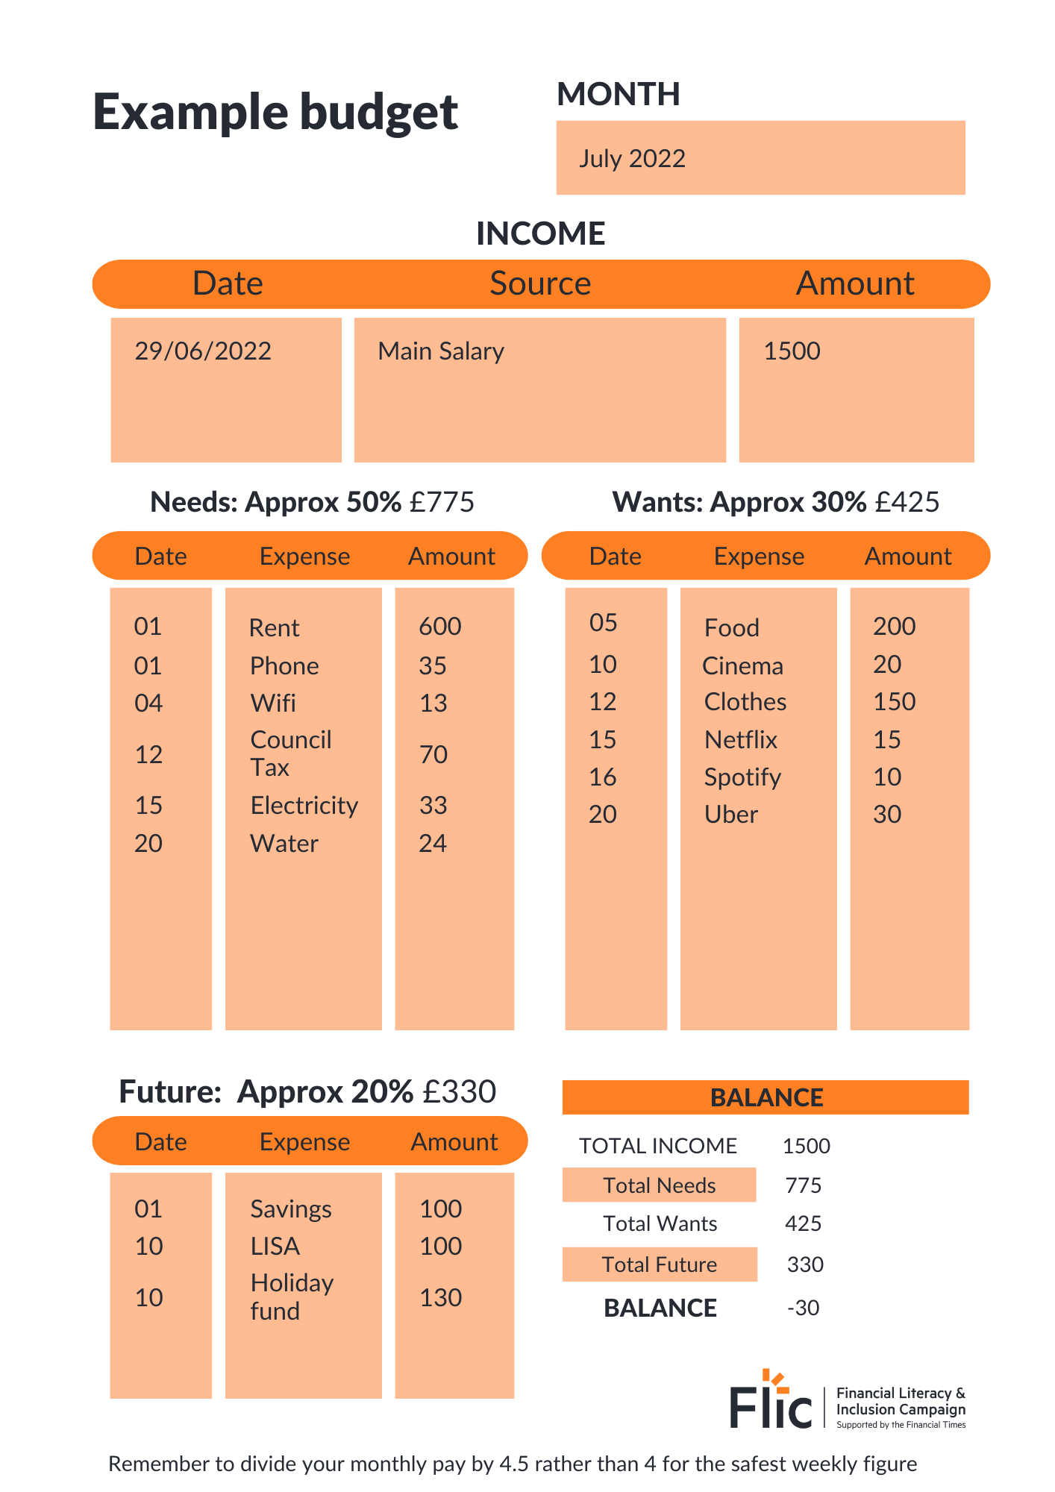
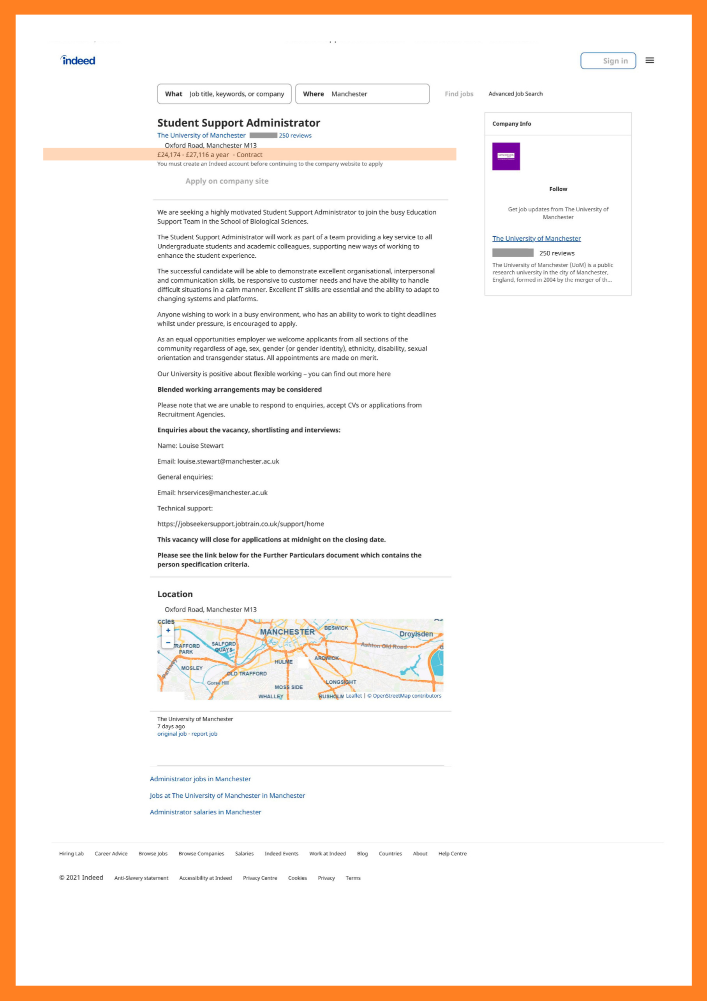
Calculating your needs
Discussion
What are some of the issues people might face when budgeting?
Were there any items that were switched from a need to a want?
Resource 1 and 2 - Budgeting booklet
Notes:
Delivery instruction - Adaptive learning
After all these deductions, how much is left to live on? Divide this by 4 to think about a weekly budget. Divide by 7 for a daily budget. Ask students if it’s realistic.
Stretch - Return to bills catalogue and think about whether there are savings that could be made. Can you share a house with a friend or walk to work to save money? Can you use someone else's Netflix account?

Slide 20
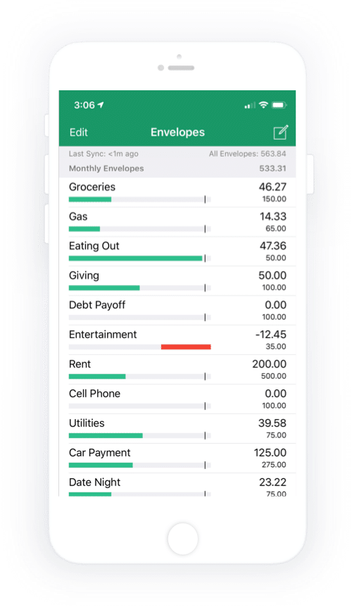
Digital budgeting tools
How might apps be able to help people with budgeting?

Slide 21
Digital budgeting tools
How might apps be able to help people with budgeting?
Set up an emergency savings pot or holiday money pot
Track how much money is really being spent and on what different categories
Set spending limits
Set alerts for different categories
Any more?
Notes:
Different reasons students may identify:
Set up an emergency savings pot or holiday money
Track how much money you’re really spending and on what different categories
Set spending limits
Set alerts for different categories

Slide 22
Planning your future
Write a savings goal on your goal card
Stretch - break this down into different steps you can take to achieve your goal
Notes:
Teacher delivery
Talk about how this should be motivational - something that would really encourage them to stick to a budget. They can keep
these goals as printouts or suggest that they change the wallpaper on their phones to this goal.
Can ask for some students to share theirs but if they are reluctant, then share examples from staff.
Explain to students that when thinking about planning your future, consider money for savings on items like a new car, holiday; investments in things like property, or company stocks/shares to increase future money; and importantly setting money aside for unforeseen events such as house appliances/car faults, or for periods of time where one may not have a regular income

Slide 23
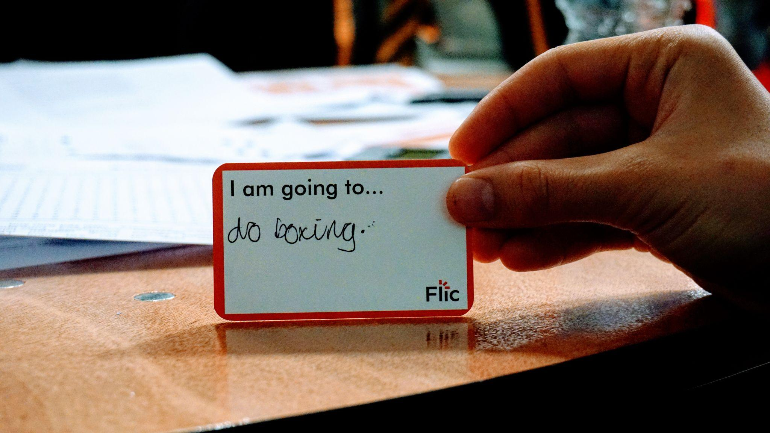
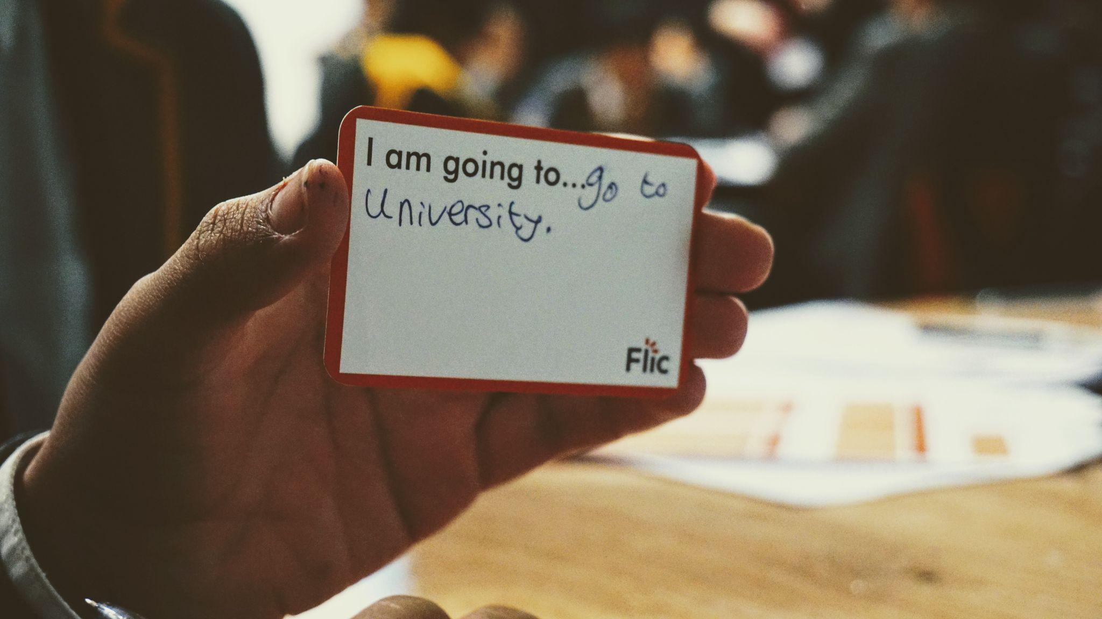
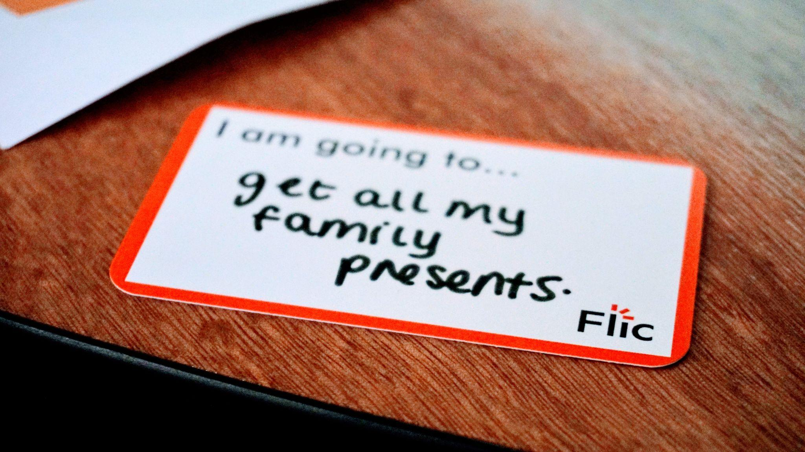
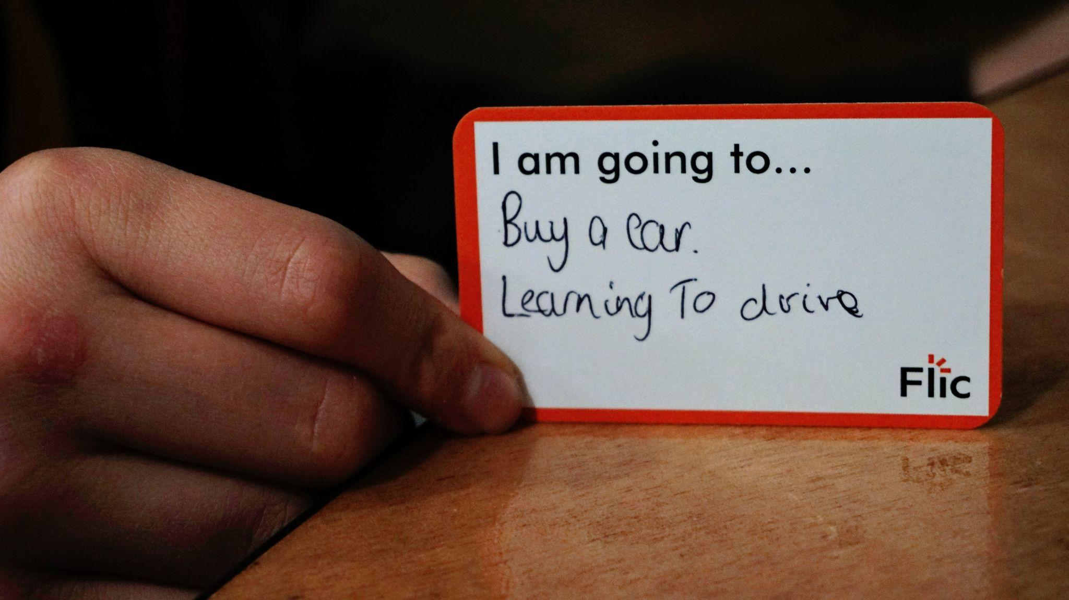
Planning your future

Slide 24
Budgeting and well-being
Inflation is the rise in prices of goods and services. The Bank of England is responsible for keeping inflation low and stable. The government has a target of keeping inflation (price rises) at 2%. After a few years of very high inflation, the rate is now back at 2% (July 2024).
For many families rising inflation has been stressful to manage
Remember that inflation changes over time and this period will not last forever
As you have learnt, there are things that people can do to adjust their budgets including reconsidering what things are needs and wants
There are many sources of advisory services and help for families who are experiencing financial difficulties
Learn more: Personal inflation calculator: what is your inflation rate? (FT)

Slide 25
Plenary
What are the three most important messages that you’ll take away from this lesson?
You have one minute to summarise what you have learnt today.
No hesitating, repeating or long pauses.

Slide 26
Learning Review
3
Share 3 things you have learnt today.
This could be a definition such “The purpose of budgeting is…” or“The difference between financial needs and wants is…”
2
Identify 2 skills that you practised today.
How have you applied numeracy skills today?
How have you used communication and teamwork skills today?
1
Is there one question that you still have about budgeting?

Slide 27
By the end of the session, I will be able to:
Describe the difference between financial needs and wants
Explain the purpose of budgeting
Apply a budgeting framework to needs, wants and future spending

Slide 28
Any questions?
?

Slide 29
Services available for people who have concerns about their personal finances
Citizens Advice – Debt and Money – This resource contains links to advice on a number of topics, including financial difficulties, cost of living and communicating with creditors.
National Debtline – Debt and Money – a debt advice charity run by the Money Advice Trust, offering a free and confidential debt advice service.
Childline Helpline 0800 1111
At school, you can speak with an adult you trust.
This could be your form tutor, head of year or the school’s safeguarding officer.

Slide 30
Links to learn more!
Articles to extend learning
Please visit the FLIC learning hub for further resources
The Budget Planner (MoneySavingExpert, Jan 20223)
How to stop spending (MoneySavingExpert, March 2022)
5 steps to automating your finances (Forbes, Jan 2018)

