Slide 1
How to protect my financial future
This session is aimed at Key Stage Four (recommended for Year 11)
Notes:
Teacher delivery
Students should be invited to ask questions and they should be provided with an opportunity to ask questions anonymously. It is useful to have a question box or allocated space on the whiteboard for students to share questions.
It is suggested that students are provided with post-its or slips to write their questions on and as the teacher circulates throughout the lesson these questions can be collected and answers throughout the session or using an allocated ‘question time’ at the end of the session.
Students can be invited to respond to questions asked by their peers. If responses to questions are based on personal preference or opinion, the teacher should be clear to preface any answers with this.

Slide 2
Having a respectful learning environment
We will listen to each other respectfully
We will avoid making judgements or assumptions about others
We will comment on what has been said, not the person who has said it
We won’t put anyone on the spot and we have the right to pass
We will not share personal stories or ask personal questions
If there is a question that you do not wish to ask aloud, you can write it on a post-it note which will be collected throughout the session and answered at the end

Slide 3
Unit outline
Session 1 | Session 2 | Session 3 | Session 4 | Session 5 | Session 6
Take home pay | Budgeting for the future | Savings | investing | Insurance | Investment exercise

Slide 4
4
Session 4:
Investing

Slide 5
By the end of the session, I will be able to:
Describe what investing is and what I can invest in
Explain the difference between shares and bonds
Recognise the factors that will affect people’s risk profiles

Slide 6
Starter | Investing
Talk to the person next to you …
1. What is investing?
2. Why do people invest?
3. What types of things (assets) can people invest in?
Notes:
Teacher explanation
Investing can be risky, but there’s a reason why people often think it’s better than stuffing all their money in a biscuit tin. Over time, the price of goods and services increases. This is known as inflation. This means the same amount of cash will buy you less with every passing year.
However, if money is invested into companies that are listed on stock markets like the FTSE or Dow Jones [Might be useful to name a couple - such as Sainsbury’s or Apple] or invested into bonds, it’s being put to work. There are no guarantees, and the value of investments will fluctuate (move up and down) - but if the risks are managed and money is invest smartly then over the long term the investments can be worth more than when they started.
Additional context
Difference between trading and investing:
Trading is putting money into a financial asset (stocks, bonds, mutual or exchange-traded fund, etc) that are held for a short period of time with the goal of making quick profits. Traders think in terms of weeks, days, or even minutes. Investing, however, is about thinking about the long run and typically measure their time horizon in years. For example, people in their 20s will invest in their pension fund for when they retire in 40 or 50 years’ time. That’s a long time to be invested!

Slide 7
Investing
What is investing?
Putting money into an asset (valuable item) with the hope that it makes more money in the future. Examples include stocks, bonds, property or business ventures.
Why do people invest?
Grow (compound) money
Save for long-term goals, like buying a house and for retirement
Help expand businesses
Beat inflation (the rising prices of goods and services)
Inflation lowers the value of money today, so by investing a person can try to make a profit that’s higher than the inflation rate
Gain financial independence and confidence
Notes:
Teacher explanation
Investing is risky, but there’s a reason why people often think it’s better than stuffing all their money in a cookie jar. Over time, the price of goods and services increases. This is known as inflation. The same amount of cash will buy you less with every passing year.
However, if money is invested, it’s being put to work. There are no guarantees, and the value of investments will fluctuate (move up and down) - but if the risks are managed and money is invest smartly then over the long term the investments can be worth more than when they started.
Additional context
Difference between trading and investing:
Trading is putting money into a financial asset (stocks, bonds, mutual or exchange-traded fund, etc) that are held for a short period of time with the goal of making quick profits. Traders think in terms of weeks, days, or even minutes. Investing, however, is about thinking about the long run and typically measure their time horizon in years.

Slide 8
What different things can people invest in?
When it comes to investing, people can invest in almost anything. Here are some assets and you may have thought of more not listed here.
Jewellery and watches
Property
Art
Stocks and shares
Digital assets e.g. bitcoin
Commodities e.g. gold, wheat
Government and corporate bonds
Currency
Notes:
Additional context
Other digital assets include: cryptocurrencies such as bitcoin and ethereum
Other commodities include: metals such as copper and silver; oil and grains such as wheat and barley
Some people buy vintage jewellery or watches which they hope will go up in value over time. This is similar to buying vintage cars or even the latest pair of trainers which people believe will go up in value.

Slide 9
By the end of the session, I will be able to:
Describe what investing is and what I can invest in
Explain the difference between shares and bonds
Recognise the factors that will affect people’s risk profiles

Slide 10
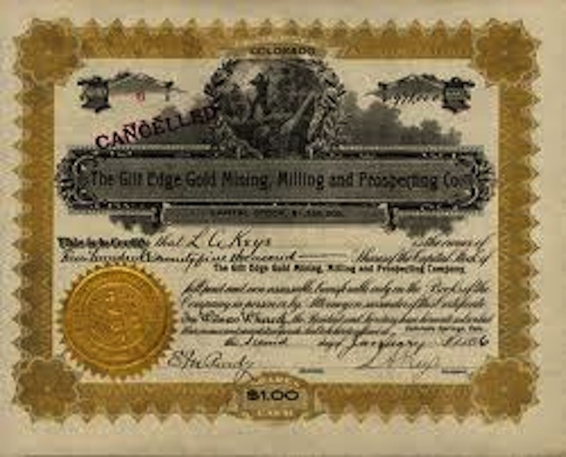
Did you know…?
THE STOCK MARKET
BONDS
The stock market is over 400 years old. It was invented in the 1600s when countries like Holland and Britain needed to make money in ways other than collecting tax.
Click here to see a list of the 100 biggest UK companies!
UK government bonds are known as gilts because they used to be gilt -edged, i.e. lined in gold!

Slide 11
Investing through a platform
An investment platform, sometimes called a fund supermarket or wrap, allows investors to buy, hold and sell a range of investments in one place online.
They sometimes provide research, information and company analysis.
The platform will charge fees: these may be a percentage of the value of the investments and/or fees to trade funds, access information and withdraw money. It’s worth comparing platforms and fees before choosing a platform.
Notes:
Prompt question
Have you heard of any investing platforms e.g. Nutmeg, Vanguard?
Teacher context notes
There are lots of stock market indices, some of the main ones being the NASDAQ, the S&P 500 and then numerous others in different countries.
Additional context
Dot-com bubble
Financial crisis 2009
Coronavirus

Slide 12
Stocks, shares and bonds
There are lots of ways to invest, as we just saw, but there are two very popular ways to invest for the long term:
1. Stocks and shares: a fraction of ownership of a company
2. Bonds: loans to a company or government which it promises to pay back at a future date
Notes:
Teacher explanation
Shares in listed companies on an index like the FTSE can be bought and sold by anyone; private companies might only offer shares to partners in that company as a reward for loyalty - and these latter cannot be traded publicly.

Slide 13
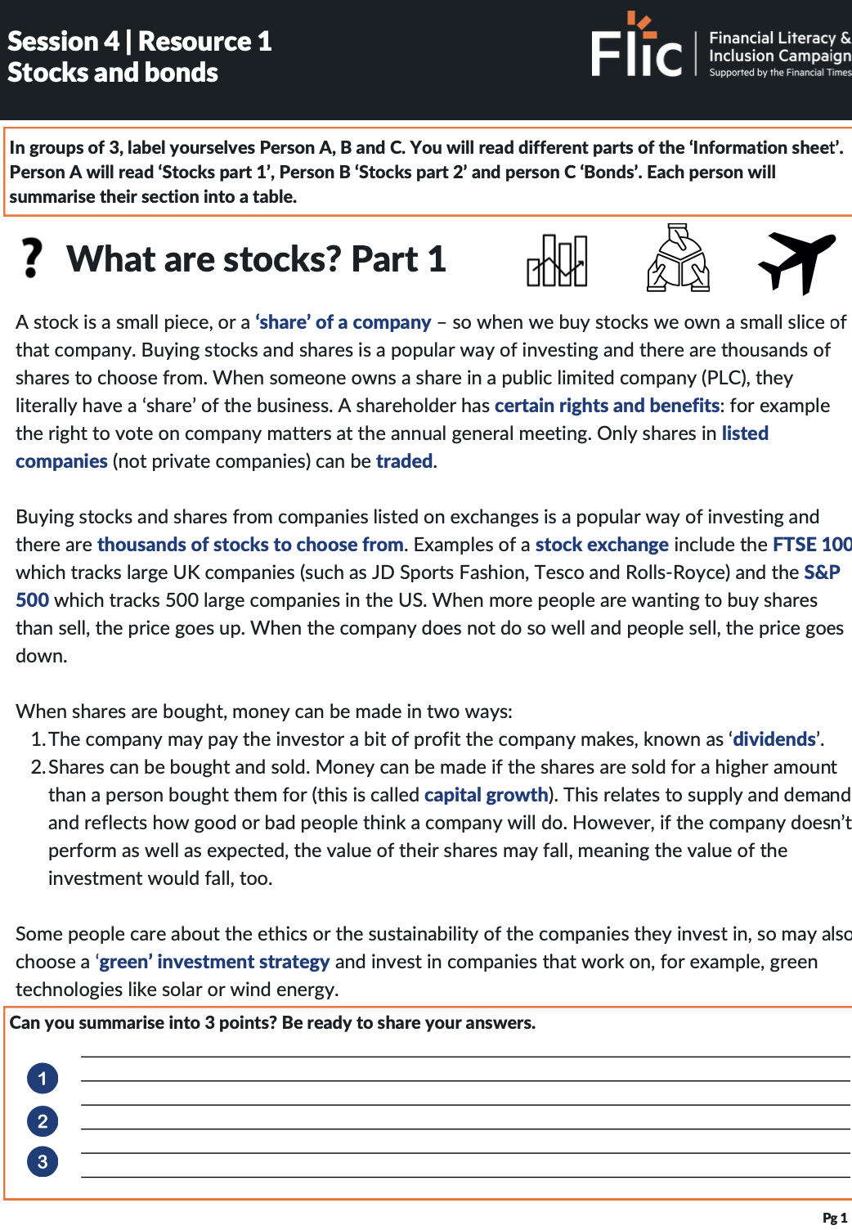
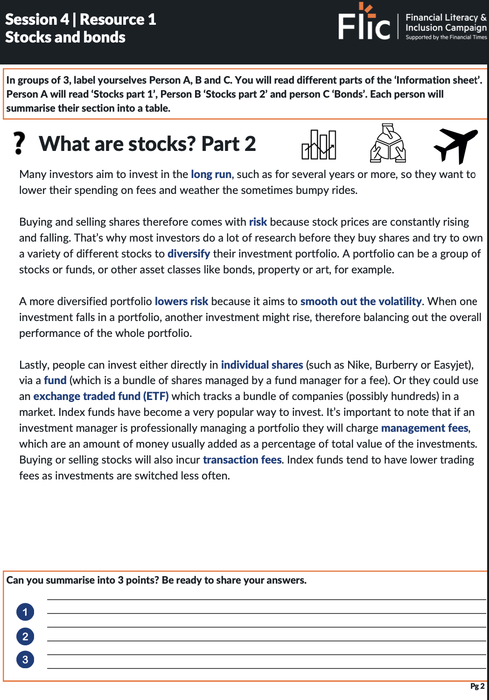
Literacy moment | Stocks/shares and bonds
In groups of 3 label yourselves Person A, B and C and read different parts of the ‘Information sheet’
Person A - Stocks part 1
Person B - Stocks part 2
Person C - Bonds
Each person will summarise their section into a table (please copy from below).
Highlight/underline key words and concepts as you go.
 | Key information
Shares | 1. 2. 3.
Bonds | 1. 2. 3.
Resource 1: Stocks and bonds information sheet
Notes:
Teacher delivery
Adaptive learning: ask more confident students to respond to the ‘Stocks’ sections and less confident students to respond to the ‘Bonds’ section.

Slide 14
Stocks and bonds
Literacy moment - Tell your partners 3+ key facts about stocks or bonds using the keywords below.
Keywords
Volatility
Ownership
Company
Long term
Value
Loan
Future date
Interest
Management
fees
Government
Diversify
FTSE 100
Interest
payments
Borrow
Portfolio
Dividends
Risk
Index fund
IOU
Rights & benefits
Resource 1: Stocks and bonds information sheet
Notes:
Teacher delivery
Adaptive learning: some students may find it useful to refer back to the sheet which is fine.

Slide 15
Key facts | Shares
1. Owning stocks and shares is owning of a small slice of a company
1. What is a stock?
2. There are two ways to make money from investing in stocks:
(i) Dividends - a bit of profit the company gives back to the investor (at its discretion)
(ii) Change in value - the profit from the difference in price from buying and selling the share
2. What are the two ways to make money from investing in stocks?
3. What type of fees do investors need to pay?
3. An investor will need to pay various types of fee:
If an investment manager is professionally managing a portfolio they will charge management fees, which are an amount of money usually added as a percentage of total value of the holding.
Buying or selling stocks will also incur transaction fees.
If you are using a broker or adviser to buy and sell for you, you will pay them a fee, too
(Note that fees will also need to be paid when buying bonds)

Slide 16
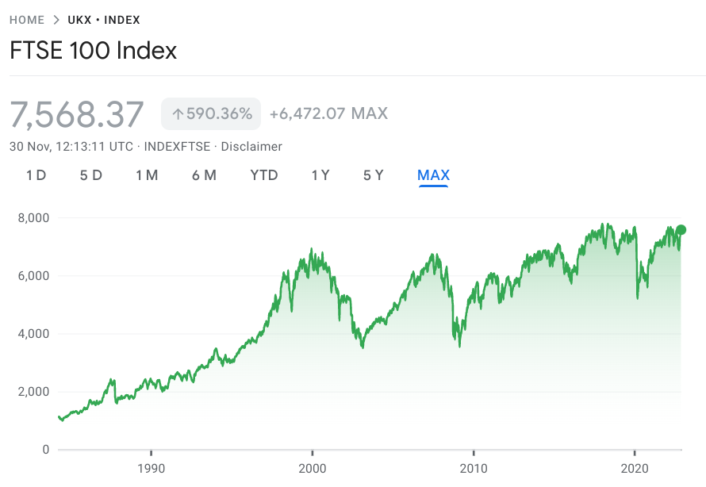
The stock market
A stock market index tracks the performance of a group of stocks
The main stock market in the UK is the FTSE 100
It was launched in 1984 and is made up of the 100 largest valued companies listed on the London Stock Exchange
Some popular companies on the FTSE 100 are HSBC, Coca-Cola, Rolls-Royce and Tesco
Dotcom bubble
Burst
Early 2000’s
This is when investors pumped money into internet based startups. The bubble then burst and share prices dropped suddenly.
Covid-19 pandemic
Share prices as global economies were badly affected by the outbreak.
Financial crisis
2008-2009
Huge jolt to the financial system
Start year: 1984
Source: https://www.google.com/finance/quote/UKX:INDEXFTSE?sa=X&ved=2ahUKEwjVmfbK7dX7AhUDRkEAHYs1ApsQ3ecFegQILRAg&window=MAX
Notes:
Teacher context notes
There are lots of stock market indices, some of the main ones being the NASDAQ, the S&P 500 and then numerous others in different countries.
Prompt question
What do you think the main slumps/ market dips represent?
Additional context
Dot-com bubble
Financial crisis 2009
Coronavirus

Slide 17
Key facts | Bonds
1.What are bonds?
1.They are a form of a loan and promise to pay back the money in a certain amount of time. That is what the interest rate on a bond is - the promise that in, say, 10 years’ time, you will get back 1.5% interest on your ‘loan’.
2. How do bonds compare with stocks?
2. Bonds are generally less volatile than stocks meaning they are lower risk than stocks
2. How do bonds compare to stocks?
3. Government bonds are usually lower risk than company bonds as the government is unlikely to fail to pay back the loan
Notes:
Stretch content
Look at some countries in the past 100 years who have defaulted - failed to pay back - their loans. Then look at some companies in recent history who have failed to pay back their loans and defaulted on their debt. Useful to give practical examples.

Slide 18
Compounding | What would you rather?
Li wants to know if she’s better off starting with a penny and doubling her money daily for 30 days or having £1 million upfront?
Think - Pair - Share
Which option should Li take?

Slide 19
The magic of compounding
Day 1: £.01
Day 2: £.02
Day 3: £.04
Day 4: £.08
Day 5: £.16
Day 6: £.32
Day 7: £.64
Day 8: £1.28
Day 9: £2.56
Day 10: £5.12
Day 11: £10.24
Day 12: £20.48
Day 13: £40.96
Day 14: £81.92
Day 15: £163.84
Day 16: £327.68
Day 17: £655.36
Day 18: £1,310.72
Day 19: £2,621.44
Day 20: £5,242.88
Day 21: £10,485.76
Day 22: £20,971.52
Day 23: £41,943.04
Day 24: £83,886.08
Day 25: £167,772.16
Day 26: £335,544.32
Day 27: £671,088.64
Day 28: £1,342,177.28
Day 29: £2,684,354.56
Day 30: £5,368,709.12
Notes:
https://www.ramseysolutions.com/financial-literacy/teaching-compound-interest
This is a daily interest rate of 50%

Slide 20
The magic of compounding
When investing, the same concept of compound interest applies to the one we looked at for savings. If someone keeps their returns invested and the value of the investments rise, the money will grow faster and faster!
Looking at the previous example we need to be aware that the rate of compounding, i.e. doubling money, is unlikely to occur in the real world. The compounding rate is much lower, but still impactful over time.

Slide 21
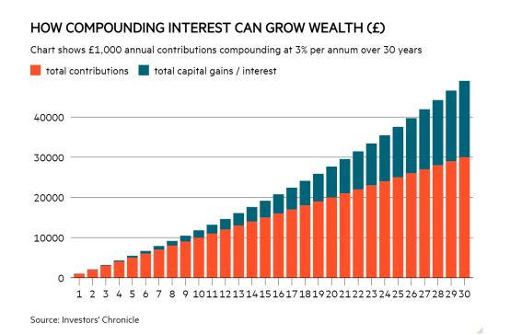
Investing for the long run
Let’s say David, aged 20, invested £1,000 today and didn’t touch it until he reached 50 years old. The investment, left untouched, compounded at 3% each year, would be worth almost £2,500,
30 years later.
With regular payments this can grow to a huge sum. If David paid in £1,000 every year for 30 years, and the returns compounded at 3% a year, at age 50 his returns would be worth over £50,000 - more than 1.5 x the total £30,000 paid in (see graph)!
Amount of money
Number of years
Notes:
Teacher explanation notes
Case study (from Investor’s Chronicle)

Slide 22
By the end of the session, I will be able to:
Describe what investing is and what I can invest in
Explain the differences between shares and bonds
Recognise the factors that will affect people’s risk profiles

Slide 23
Importantly, investing in the stock market is a risk. While a person can make a lot of money, they can also lose a lot of money.

Slide 24
Too good to be true?
Every investment involves a level of uncertainty! The ideal is to put money in and get more money out. But every investment involves some level of risk.
A share is ownership in a company so if the company doesn’t do well, the value of the investment can go down or be completely lost.
A bond is a debt so the borrower might default and not pay it back.
Notes:
Teacher explanation
This slide is important to emphasise due to the proliferation of online “get rich quick schemes”.
There are risks to each and every investment. If it sounds too good to be true - like someone guarantees a high return with little risk - then it definitely is! Generally it’s considered that the higher risk an investment is, the higher the profit (or return) it can make. But a higher risk investment also has the potential to make big losses. The key is to know and understand risks before making an investment.

Slide 25
Risk vs reward
Different people will have different risk appetites depending on their background and circumstances. Being aware of what risk profile is appropriate for people in different situations is key to their financial well-being. A question to ask is:
If the investor lost their investment money, how will it impact their life?
Play until 2:13
Video link: ShareSoc Investing Basics - Episode 03 - Risk and Business
Notes:
Teacher explanation
Investing comes with uncertainty. When somebody invests, they need to ensure that they won’t need to take the money out suddenly. THis is because it may be that at the time they need the money, the value of their investments has fallen, leading to monetary loses.

Slide 26
Risk profile
Is this person likely to be a low, medium or high risk investor?
Identify 3+ factors to explain your reasoning.
Profile 1: David
David has three children under the age of 18. He works full time as a Programmes Manager at a care home and finds that his annual salary of £35,000 goes mostly towards paying the house bills and meeting his kids’ needs.
He is working towards paying off his mortgage loan (the amount of money he borrowed from the bank to help buy his home) but is going to invest some of his savings to learn about how investments work and to try and help him grow some of his income for the future.

Slide 27
Risk profile
Is this person likely to be a low, medium or high risk investor?
Identify 3+ factors to explain your reasoning.
Profile 1: David
David has three children under the age of 18. He works full time as a Programmes Manager at a care home and finds that his annual salary of £35,000 goes mostly towards paying the house bills and meeting his kids’ needs.
He is working towards paying off his mortgage loan (the amount of money he borrowed from the bank to help buy his home) but is going to invest some of his savings to learn about how investments work and to try and help him grow some of his income for the future.
LOW RISK

Slide 28
Risk profile
Is this person likely to be a low, medium or high risk investor?
Identify 3+ factors to explain your reasoning.
Profile 2: Suzanne
Suzanne is a management consultant with finance clients. She earns a high salary of £90,000 per year, from which she puts 10% each year into savings.
Last year she got a bonus of £10,000 which she’s looking to invest.
Notes:
Teacher delivery
Students compare the three profiles to decide which is most likely to be low, medium and high risk.
There may be some discussion here which should be encouraged as the risk levels for each profile are not completely clear cut.

Slide 29
Risk profile
Is this person likely to be a low, medium or high risk investor?
Identify 3+ factors to explain your reasoning.
Profile 2: Suzanne
Suzanne is a management consultant with finance clients. She earns a high salary of £90,000 per year, from which she puts 10% each year into savings.
Last year she got a bonus of £10,000 which she’s looking to invest.
HIGH RISK
Notes:
Teacher explanation notes
Note that even though she might be high risk, she’s still mostly likely to choose a stock index fund, rather than pick individual stocks. This is because she is most likely to reduce her risk while making a return.

Slide 30
Risk profile
Is this person likely to be a low, medium or high risk investor?
Identify 3+ factors to explain your reasoning.
Profile 3: Smita
Smita is in her late 30s. She has a partner, one child and a job as a real estate agent. Her salary is £45,000 per year and when her performance is good, she earns commission (additional money made on the sale of a property) of up to £7,000 per year.
She shares her rental costs and regularly puts monthly savings away for a rainy day. She’s been taking a personal finance course and enjoyed the investment unit. Using her studies, she’s now interested in investing a portion of her savings into the stock market and bonds.

Slide 31
Risk profile
Is this person likely to be a low, medium or high risk investor?
Identify 3+ factors to explain your reasoning.
Profile 3: Smita
Smita is in her late 30s. She has a partner, one child and a job as a real estate agent. Her salary is £45,000 per year and when her performance is good, she earns commission (additional money made on the sale of a property) of up to £7,000 per year.
She shares her rental costs and regularly puts monthly savings away for a rainy day. She’s been taking a personal finance course and enjoyed the investment unit. Using her studies, she’s now interested in investing a portion of her savings into the stock market and bonds.
MEDIUM RISK

Slide 32
Diversification
Diversification is about investing in different types of assets (such as stocks, bonds, property, early stage companies and digital assets)
It can also be about buying small pieces of companies from a range of sectors (such as healthcare, fashion, energy, utilities) or from different countries around the world
Diversification is important because it reduces risk

Slide 33
By the end of the session, I will be able to:
Describe what investing is and what I can invest in
Explain the differences between shares and bonds
Recognise the factors that will affect people’s risk profiles

Slide 34
Forget FOMO
Hype from social media is a bigger risk!
Good research involves:
Using trusted sources like well-known publications or media outlets.
Seeking financial advice from an expert such as a FCA registered financial adviser
Checking for red flags - influencers should provide clear mentions of ads and risk warnings. They should not be giving specific advice
Look at past trends: these can give clues to future performance but there are no guarantees. If it was good before doesn’t mean it will be good again.

Slide 35
When is it a good time to invest?
A person might consider investing when they have:
Paid off short-term debts (money that they owe)
An emergency cash fund (minimum 3 months’ worth of living expenses set aside for emergencies e.g. losing a job)
Tried and tested tracking investments before investing their own money

Slide 36
Who to speak to
We are often overloaded with people and different sources giving us information on how best to invest!
If you really are looking for trusted advice the best person you can speak to is a financial adviser.

Slide 37
Key investment messages for Li
What are the key messages you would share with Li as she begins her investment journey?
THINK-PAIR-SHARE

Slide 38
Key investment messages for Li
1. Risk vs reward. She should consider the risk that she can take. Does she have dependents and an emergency fund before putting money aside for investing?
2. Invest for the long run. The advantages of compounding and the gains from investing tend to come from investing 5 years+ so she can ride out the waves.
3. Diversify. Don’t put all of your eggs in one basket! She should have a combination of bonds and a range of stocks in her portfolio.
4. Research. She should shop around for the best platforms to begin her investment journey - it’s important to consider fees too. If she hasn't already, she can invest in an ISA (individual savings account) where she doesn’t have to pay any tax on gains from the first £20,000 invested (people need to be 18+ to access a cash ISA).
5. Keep calm and carry on. Investments can go down as well as up. Try not to be tempted to sell and buy on impulse when things suddenly change.
Notes:
Teacher delivery
Use the 5 points on these slides as pointers.

Slide 39
Any questions?
?

Slide 40
Services available for people who have concerns about their personal finances
Citizens Advice – Debt and Money – This resource contains links to advice on a number of topics, including financial difficulties, cost of living and communicating with creditors.
National Debtline – Debt and Money – a debt advice charity run by the Money Advice Trust, offering a free and confidential debt advice service.
Childline Helpline 0800 1111
At school, you can speak with an adult you trust.
This could be your form tutor, head of year or the school’s safeguarding officer.

Slide 41
Links to learn more!
Articles to extend learning
Please visit the FLIC learning hub for further resources
Investing Basics (ShareSoc)
Intro guide to investing (Black Bullion)
Investing in stocks for beginners (Money Saving Expert)
How to choose a financial adviser (FT.com)

