Slide 1

How to protect my financial future
This session is aimed at Key Stage Four (recommended for Year 11)
Notes:
Teacher delivery
Students should be invited to ask questions and they should be provided with an opportunity to ask questions anonymously. It is useful to have a question box or allocated space on the whiteboard for students to share questions.
It is suggested that students are provided with post-its or slips to write their questions on and as the teacher circulates throughout the lesson these questions can be collected and answers throughout the session or using an allocated ‘question time’ at the end of the session.
Students can be invited to respond to questions asked by their peers. If responses to questions are based on personal preference or opinion, the teacher should be clear to preface any answers with this.

Slide 2
Unit outline
Session 1 | Session 2 | Session 3 | Session 4 | Session 5 | Session 6
Take home pay | Budgeting for the future | Savings | Investing for the long term | Insurance | Investment exercise

Slide 3
Having a respectful learning environment
We will listen to each other respectfully
We will avoid making judgements or assumptions about others
We will comment on what has been said, not the person who has said it
We won’t put anyone on the spot and we have the right to pass
We will not share personal stories or ask personal questions
If there is a question that you do not wish to ask aloud, you can write it on a post-it note which will be collected throughout the session and answered at the end

Slide 4
Session 5:
Insurance

Slide 5
By the end of the session, I will be able to:
Describe the relationship between risk and insurance
Identify different types of insurance plans and key features of insurance plans
Compare and assess different insurance products

Slide 6
Starter - Insurance
Lucy is planning to go on a package holiday to Spain.
Lucy is a keen mountain climber and will be bringing equipment including her climbing shoes, ropes, harness, chalk and helmet.
She’ll be travelling there and back by train and by car.
She’ll hire a car at the train station in Spain and drop it back off on her return.
What are the risks Lucy faces? Are these low, medium or high?
  Stretch - can you order the risks from most to least likely?
What are the potential financial risks?
What can Lucy do to mitigate (prevent or minimise) the risks?
Keywords
Risk
Insurance
Claim
Policy
Excess
Premium
Notes:
Teacher explanation
Risks include: injury while mountain climbing, losing/damaging his mountain climbing equipment, injury or disruption on the train,
Financial risks include: losing the monetary value of his mountain climbing equipment, damaging his rental car and needing to pay for repair.
Lucy can buy insurance to minimise the financial risks. He can also go climbing with a friend or instructor to manage health risks or potential injury.
There may be other answers not written above.

Slide 7
Risk readiness
Risk involves thinking about what might happen, not what will happen.
  It involves thinking about chance or uncertainty.
Everyone has their own view of risk shaped by their circumstances, experiences and personality.
  Some people are more risk-averse and some are more risk taking.
There are a variety of actions that can be taken to mitigate risk and it’s important to think about the consequences of any decisions.
  One way to mitigate financial risk is to buy insurance.
Notes:
Additional context
We all encounter risks in our everyday lives.

Slide 8

Insurance
Insurance involves paying some money (known as a premium) to an insurance company in return for a promise that the insurance company will pay a larger sum of money if a certain bad event happens*. This promise is a legal contract known as a policy.
Example car insurance: if a car crash happens (and the person involved had been paying car insurance premiums) they would then make a claim for this larger sum of money. The insurer will then give the car owner money to repair the car or arrange to repair the car. The amount depends on the terms and conditions in the policy.
*Not everybody is expected to claim on their policy. Risk is ‘pooled’ meaning somebody’s money is put into a big pool with lots of other people and the people who suffer the unfortunate bad event are covered by insurance, but not everyone does suffer this event and that’s why insurance works for the companies.

Slide 9
Insurance Match Up
Match the key term to the definition
(B) A way of paying a company in order to be protected from having to pay a larger amount of money
1.Insurance
2.Claim
3.Premium
4.Excess
5.Policy
(A) When someone asks their insurance company for money or replacement products, e.g. if an insured product has been damaged or stolen
(C) The contract which describes who and what is covered by insurance
(E) Amount paid each month/year for insurance
(D) The agreed amount of money paid at the start of a claim when someone makes a claim

Slide 10
Insurance Match Up
Match the key term to the definition
(B) A way of paying a company in order to be protected from having to pay a larger amount of money
1.Insurance (B)
2.Claim (A)
3.Premium (E)
4.Excess (D)
5.Policy (C)
(A) When someone asks their insurance company for money or replacement products, e.g. if an insured product has been damaged or stolen
(C) The contract which describes who and what is covered by insurance
(E) Amount paid each month/year for insurance
(D) The agreed amount of money paid at the start of a claim when someone makes a claim

Slide 11
Risk and insurance
OVER TO YOU…
In your own words, describe to your partner the relationship between risk and insurance.
Your neighbour then needs to improve on your response.
Be ready to share with the class.
Notes:
Additional context
We all encounter risks in our everyday lives.

Slide 12
By the end of the session, I will be able to:
Describe the relationship between risk and insurance
Identify different types of insurance plans and key features of insurance plans
Compare and assess different insurance products

Slide 13








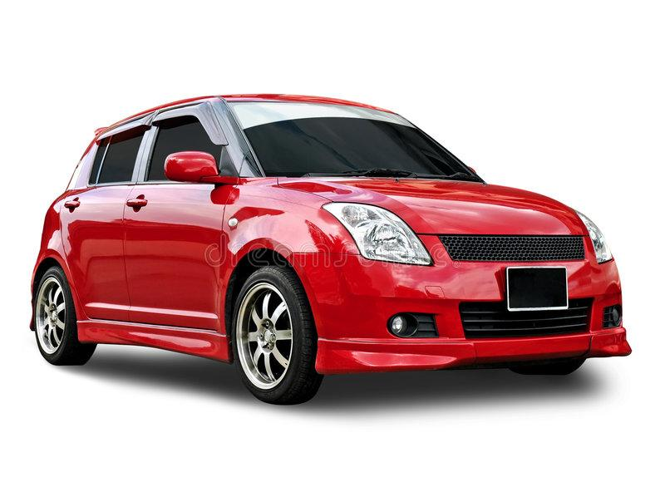

Types of insurance
How many types can you name?
Notes:
Delivery instruction
Mini whiteboards can be used if available.

Slide 14

Types of insurance
Building insurance
Pet insurance
Home contents insurance
Mobile phone insurance
Income protection insurance
Health insurance
Life insurance
Travel insurance
Car insurance
Third party
car insurance

Slide 15

Types of insurance
Which of these types of insurance, if any, do you think are legal or contractual* requirements?
Building insurance
Pet insurance
Home contents insurance
Mobile phone insurance
Income insurance
Health insurance
Life insurance
Travel insurance
Car insurance
Third party
car insurance
*Contractual requirements are pat of an agreement with a company vs a law. Nevertheless, failing to follow a contractual requirement can lead to serious penalties.
Notes:
travel, car, nd third party insurance, https://www.young-enterprise.org.uk/wp-content/uploads/2019/10/Spending-Sense-Resource-2019-WEB4_FINAL.pdf

Slide 16
Types of insurance
Building insurance if a person has a mortgage
Contractual requirement vs legal
Pet insurance
Home contents insurance
Mobile phone insurance
Income insurance
Third party
car insurance
Legal requirement
Car insurance
Legal requirement
Health insurance
Life insurance
Travel insurance
Notes:
Prompt question
What might happen to someone if they drive without insurance?
Teacher explanation
If a person drives without car insurance the consequences can be having their license taken away and/or a fine/criminal record

Slide 17
Types of insurance
Quick explainer…
Third-party car insurance is the minimum level of car insurance the law allows
It covers damage to another person's car, along with costs to cover other people for injuries
If the accident is the fault of the owner of this type of insurance, it won't cover damage to their vehicle or their injuries
Building insurance
Pet insurance
Home contents insurance
Mobile phone insurance
Income insurance
Health insurance
Life insurance
Travel insurance
Car insurance
Third party
car insurance

Slide 18


Health insurance and life insurance
THINK-PAIR-SHARE
What is it?
Why might someone buy it?
What is it?
Why might someone buy it?
Health insurance, or private medical insurance, covers the costs of private healthcare provided to a person or their family.
Someone might get it to avoid long waiting times on the NHS.
It lets someone leave behind a lump sum, helping them pay bills, rent, the mortgage or help towards living costs if they die during the contract period.
Someone might buy it to repay a mortgage or pay for funeral costs.
Health insurance
Life insurance
Notes:
Delivery instruction
The class should be split into 2 groups: half looking at health and half looking at life insurance.
Give students 3 mins in pairs to consider the 3 questions.
Teacher context
Other types of insurance including travel, home and phone insurance will be covered later through case studies.

Slide 19

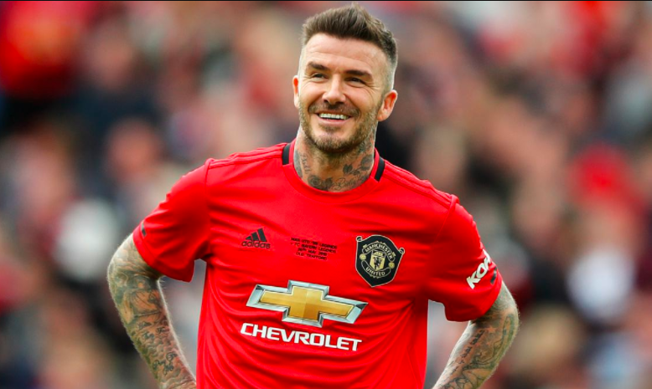
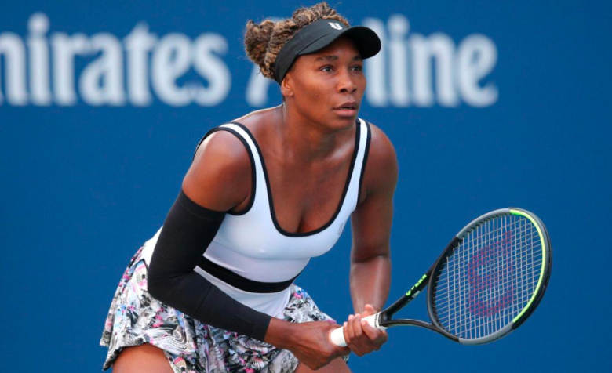
Some of the priciest insurance plans
Sports stars most valuable assets are often their body parts. Footballers would be forced to retire if they suffered a serious injury to their legs and tennis players would be out of the game if they injure their arms. To protect their valuable assets, they have specialist insurance policies.
Based on 2022 values, can you guess…
Which athlete has the most expensive body parts insurance plan?
How much the insurance costs?
Lionel Messi
David Beckham
Venus Williams
Legs, Left foot £720 million
Legs and face £181 million
Wrists £12 million

Slide 20
Reflection
What’s the purpose of having insurance?
What are the consequences of not having insurance?
Stretch - does having insurance cover against all risks?
Notes:
Teacher explanation
The purpose of having insurance is to protect someone against certain risks
The consequences of not having insurance are having to pay big amounts of money if something goes wrong. For example, if a pet gets very sick and needs an operation the pet owner would need to pay the full amount of money for the operation which may be a very big expense.
It’s very important to note the importance of reading terms and conditions in the policy. Insurance policies will cover some things but not others. The more that’s covered, the higher the premium (cost) will be. The message is to do proper research. We’ll see this come up later with expensive equipment. Content insurance may cover some contents but not all expensive items.

Slide 21
Reflection
What’s the purpose of having insurance?
  The purpose of having insurance is to protect someone against certain risks. Think of it like making a bet against something going wrong.
What are the consequences of not having insurance?
  The consequences of not having insurance are having to pay big amounts of money if something goes wrong. For example, if a pet gets very sick and needs an operation the pet owner would need to pay the full amount of money for the operation which may be a very big expense.
Stretch - does having insurance cover against all risks?
  It’s very important to note the importance of reading terms and conditions in the policy. Insurance policies will cover some things but not others. The more that’s covered, the higher the premium (cost) will be. Do proper research. We’ll see this come up later with expensive equipment. Contents insurance may cover some contents but not all expensive items.
Notes:
Teacher explanation
The purpose of having insurance is to protect someone against certain risks
The consequences of not having insurance are having to pay big amounts of money if something goes wrong. For example, if a pet gets very sick and needs an operation the pet owner would need to pay the full amount of money for the operation which may be a very big expense.
It’s very important to note the importance of reading terms and conditions in the policy. Insurance policies will cover some things but not others. The more that’s covered, the higher the premium (cost) will be. The message is to do proper research. We’ll see this come up later with expensive equipment. Content insurance may cover some contents but not all expensive items.

Slide 22
By the end of the session, I will be able to:
Describe the relationship between risk and insurance
Identify different types of insurance plans and key features of insurance plans
Compare and assess different insurance products

Slide 23
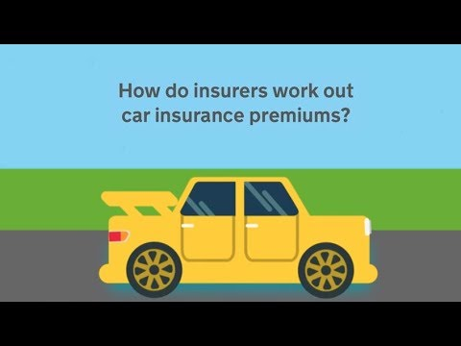
Factors affecting cost - car insurance
Buying insurance can be a bit of a mystery. There are a number of different factors affecting insurance premiums. It’s important to be aware of these to try and get the best possible deal.
When looking for the best deal, a top tip is to shop around by looking at lots of price comparison websites and using other other ways like specialist broker firms.
Watch the video to learn more about car insurance.
*From the video: No claims discount is the reduced price of insurance if no claim is made.

Slide 24

Car insurance - case study
Karim is looking to get car insurance for a second-hand Kia Picanto car. He is 24 years old, lives in Newcastle and passed his driving test when he was 18 years old.
So far, he has not got any points on his licence and drives an average of 4,500 miles per year.
What are the different factors mentioned in the case study that would affect the price of Karim’s insurance plan?
Notes:
Delivery instruction
Mini whiteboards may be used.

Slide 25
Car insurance - case study
Karim is looking to get car insurance for a second-hand Kia Picanto [car model] car.
He is 24 years old [age], lives in Newcastle [area] and passed his driving test when he was 18 years old [years driving].
So far, he has not got any points on his licence [previous history] and drives an average of 4, 500 miles per year [mileage].
How might these different factors mentioned in the case study affect the price of Karim’s insurance plan?
Notes:
Teacher explanation notes

Slide 26
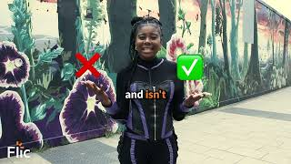
To insure or not to insure?
What are the three things to remember about insurance?
Video | To insure or not to insure?

Slide 27
To insure or not to insure?
Get to grips with the detail. What is and isn’t covered?
Some insurance isn’t optional: car, building.
Shop around for the best price.
Video | To insure or not to insure?

Slide 28
To insure or not to insure?
When it comes to buying insurance, there is an opportunity cost (the cost of missing out on the next best option).
In other words, ‘What could someone do with that money otherwise?’
When deciding whether to buy an insurance policy, it’s important to look at an individual’s circumstances and the risks to the person if they don’t have insurance.
We need to take into account:
(1) whether it’s worth buying the insurance
(2) the best insurance deal for the situation

Slide 29
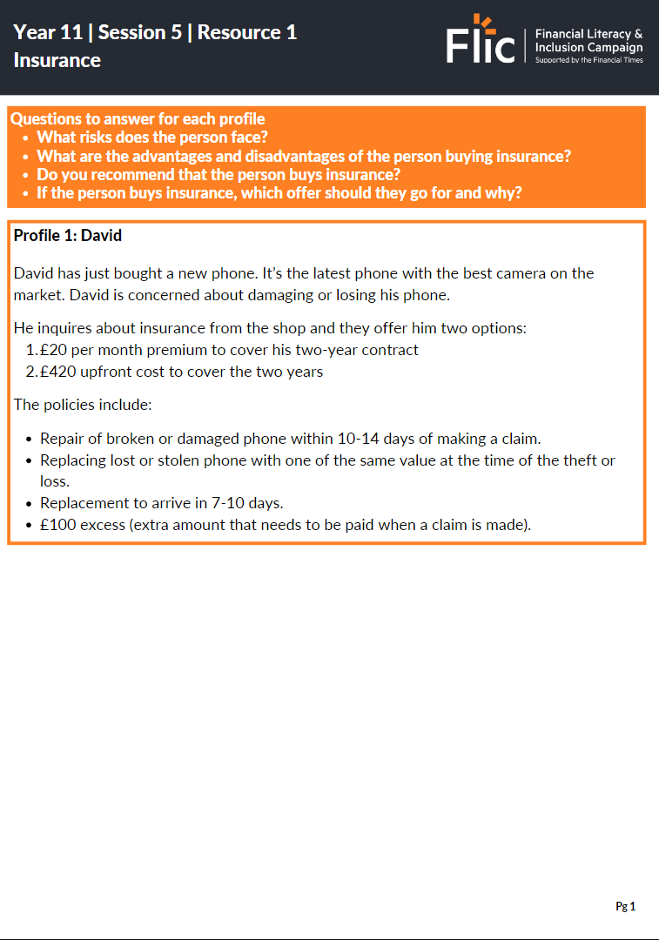
To insure or not to insure?
ACTIVITY
In pairs, choose 2 profiles to read through and answer the three questions per profile. You can create a table to take notes. You have 10 minutes.
If you finish answering the questions on your 2 profiles, begin answering the questions on the 3rd profile.
Be ready to discuss your responses with the class.
Risks | Advantages and disadvantages of buying insurance | Should they buy insurance? | Which insurance offer should they go for?
Resource 1 | Insurance
Notes:
If problems accessing the PDF, please see a word version here: https://docs.google.com/document/d/1Q7eBGhOmAfbJ6RSRv9RUI2qG42u-uED_ycwBdG-9g1Y/edit

Slide 30




To insure or not to insure?
Profile 1: David
Profile 2: Suzanne
Profile 3: Smita
Resource 1: To insure or not to insure?
Notes:
Delivery tips
Adaptive learning - hand out David’s case study to less confident students and Smita’s case study to more confident students. Suzanne’s comes in the middle in terms of difficulty to analyse.
Additional context
Paying by monthly installments will sometimes end up costing more than paying up front, and some insurers will require the policy holder to enter a credit agreement
There may be a cancellation charge if canceling any annual policy mid term, but this should be disclosed in the sales process

Slide 31
Feedback | To insure or not to insure?
Risks include:
Damaging or losing his phone
Key factors to consider:
The different prices of the policies
  Premium cost on a monthly basis totals £20 x 24 months = £480 over the two years
  This is compared to a fixed amount of £420 upfront
Although the upfront cost works out at less, does David have £400 to spend upfront? He will also need to pay £100 for the excess if something goes wrong with the phone
The opportunity cost of that money i.e. David saving the £20 per month or £400 over the two years, is money that he could save for another item or invest. David might also be able to use that money to repair or replace his phone, or even buy a new phone if his old phone is in good condition
Profile 1: David
Resource 1: To insure or not to insure?

Slide 32
Feedback | To insure or not to insure?
Risks include:
Losing or damaging expensive and meaningful camera items
House damage e.g. from flooding, fire or a storm
Key factors to consider:
Premium vs excess: generally the higher the premium the lower the excess will be
Whether to buy individual building and contents or insurance, or buying the combined package to lower overall costs
The level of risk of not insuring a house might depend on the safety of the area. However, having building and contents insurance is generally advisable
Has Suzanne checked that her policy limits cover her high tech camera and other equipment if stolen? Remember the policy might cover some items, but not all
When owning a home building insurance is usually a priority and if Suzanne has a mortgage (a loan to help buy a house) she may be required to have buildings insurance
It’s important to note that Suzanne is a not a professional photographer. If she was, she might need a separate commercial policy
Profile 2: Suzanne
Resource 1: To insure or not to insure?
Notes:
Teacher explanation
Key messages to draw out from the class:
- Shop around for the best deals
- A higher premium tends to mean lower excess and vice versa
- Read carefully what's included in the policy to make sure it addresses personal requirements and risks.
Learn more about building insurance at Citizens Advice

Slide 33
Feedback | To insure or not to insure?
Risks include:
Losing or damaging travel items from her flight
Losing or damaging ski equipment when on holiday
Physical injury from skiing
Key factors to consider:
Smita is an excellent skier and likes to ski both on and off piste so Max Adventure policy may be more appropriate than Adventure basics. However, for Max Adventurer she will need to hire and pay for a professional guide to get the necessary cove
This will depend on how much Smita earns and whether she can afford the higher premium. If not, it may be for this holiday she is less adventurous
Nevertheless, skiing is a high risk sport and the cost of rescue on the slopes or medical provision if needed may be very expensive, so insurance is likely to be recommended
Smita also needs to consider the total cost of the goods she is travelling with to decide whether it is worth it for her to buy travel insurance to cover the items she is bringing with. It’s likely that her ski gear is expensive so insurance is worthwhile
The Max Combo may be the best option to minimise the most risks and it has a price advantage compared to doing the travel and adventure policies separately
Profile 3: Smita
Resource 1: To insure or not to insure?
Notes:
Teacher explanation notes
Please note that some key points have been drawn out on the slide but there are many others that may be discussed.

Slide 34

Key takeaways
When it comes to buying insurance it’s important to weigh up personal risks and costs, and remember it’s mandatory to buy car insurance and sometimes building insurance too!
It’s important that each person carefully assesses their choices and carries out research to find the best options and deals for their personal circumstances.
Lastly, taking the time to read the small print pays off! Fully understand what the policy includes so that you can’t be caught out!

Slide 35
By the end of the session, I will be able to:
Describe the relationship between risk and insurance
Identify different types of insurance plans and key features of insurance plans
Compare and assess different insurance products

Slide 36

*Exit ticket*
There are a whole range of insurance policies available to cover a variety of different situations.
You’ve been asked to respond to the following question as part of a social media post.
Is it always worth buying insurance to protect against risk?
Respond to the question with 4-6 points, using at least one example.
This may be in the form of a role play or multi step social post.
Notes:
Teacher explanation notes
Please note that some key points have been drawn out on the slide but there are many others that may be discussed.

Slide 37
Any questions?
?

Slide 38

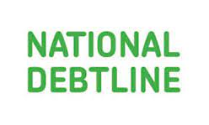
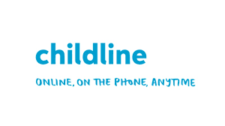
Services available for people who have concerns about their personal finances
Citizens Advice – Debt and Money – This resource contains links to advice on a number of topics, including financial difficulties, cost of living and communicating with creditors.
National Debtline – Debt and Money – a debt advice charity run by the Money Advice Trust, offering a free and confidential debt advice service.
Childline Helpline
0800 1111
At school, you can speak with an adult you trust.
This could be your form tutor, head of year or the school’s safeguarding officer.

Slide 39
Links to learn more!
Articles to extend learning
Please visit the FLIC learning hub - https://resources.ftflic.com/ for further resources
The AA ‘How the cost of your car insurance is calculated’
Money Helper ‘Insurance’ page
Natwest MoneySense quiz

