Slide 1
How to protect my
financial future
This session is aimed at Key Stage Four (recommended for Year 11)

Slide 2
Unit outline
Session 1 | Session 2 | Session 3 | Session 4 | Session 5 | Session 6
Take home pay | Budgeting for the future | Saving for the future | Investing for the long term | Insurance | Investment simulation

Slide 3
Having a respectful learning environment
We will listen to each other respectfully
We will avoid making judgements or assumptions about others
We will comment on what has been said, not the person who has said it
We won’t put anyone on the spot and we have the right to pass
We will not share personal stories or ask personal questions

Slide 4
4
Session 6:
Investment simulation

Slide 5
By the end of the session, I will be able to:
Apply an investment strategy (low, medium or high risk) to calculate how an investment portfolio changes over time due to external events

Slide 6
Introduction
You’re going to be financial advisers for your client, working in pairs.
Your client has put aside £2,000 to invest for the future. It’s your role to choose an appropriate investment strategy for your client who is looking to grow their money over a 10-year period.

Slide 7
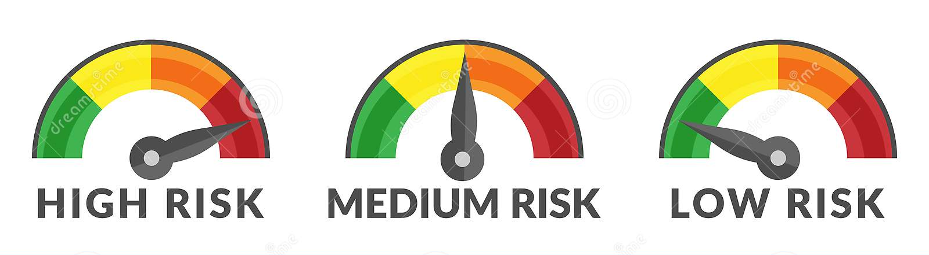
Stage 1
Your teacher will now allocate you a client in pairs: Karim, Zara or Lucy.
Read your client’s profile, underlining or highlighting key words
Choose an appropriate risk profile for your client:
low, medium or high risk
Notes:
Time to understand their profile
Choose risk profile

Slide 8
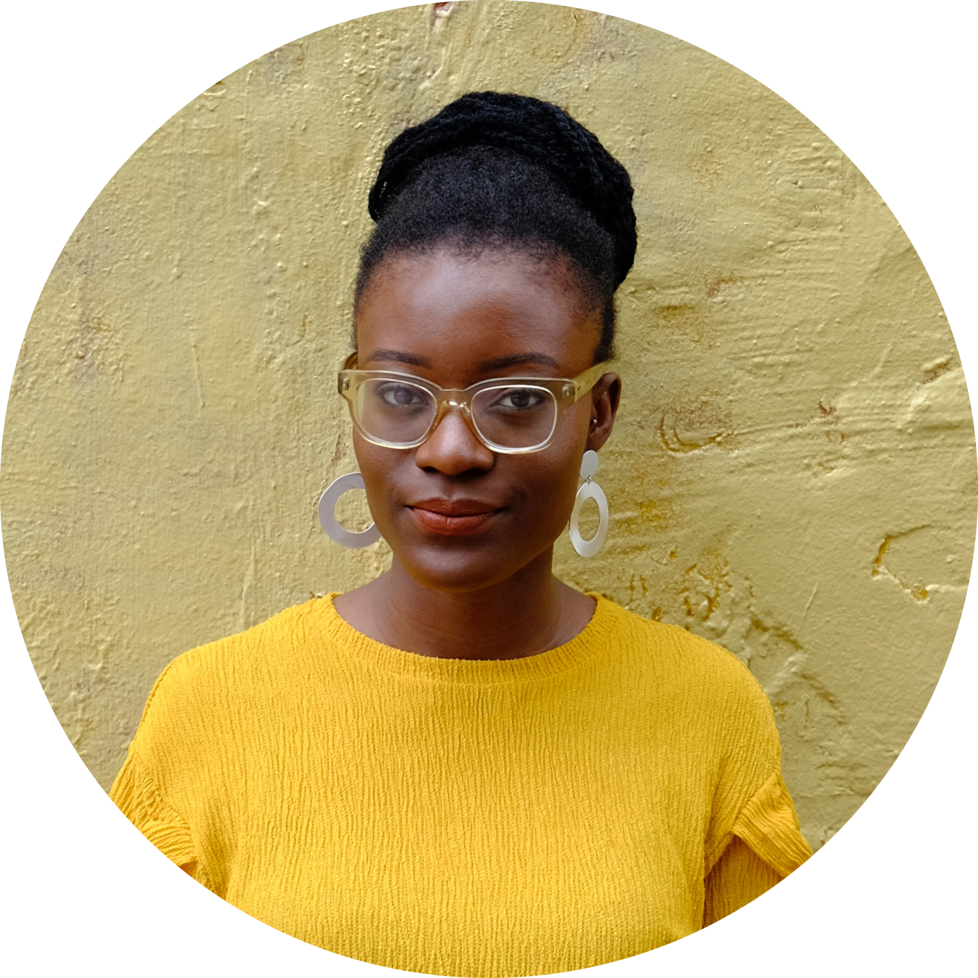
Risk Profiles
Karim
Zara
Lucy
Low
Medium
High

Slide 9
Stage 2: Key risks
Complete the ‘Key Risks’ column, matching the key risks to the different investment options
(5 minutes)
*Note that the investment increases and decreases are not based on real events

Slide 10
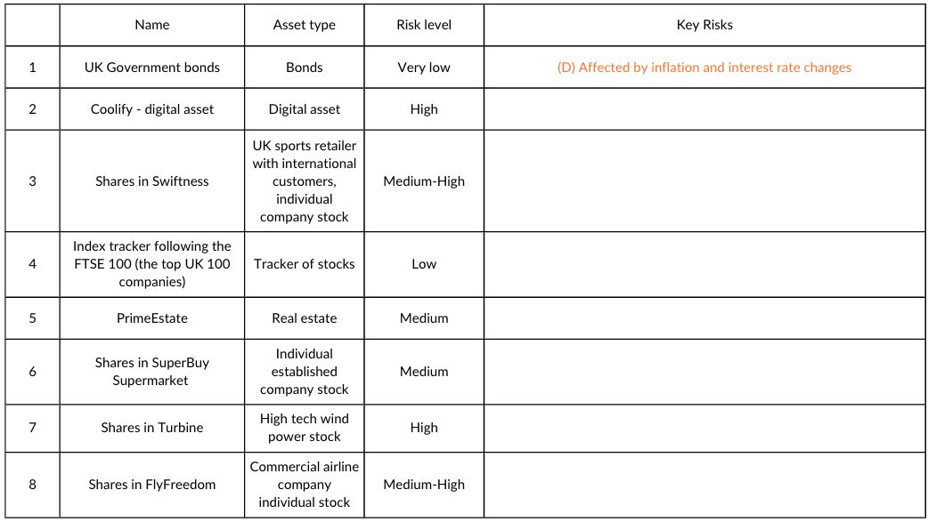
Stage 2: Key risks
Fill in the ‘Key Risks’ column with the relevant risk factor (Table 2)

Slide 11
Stage 2: Key risks

Slide 12
Stage 2: Key risks | ANSWERS
 | Name | Asset type | Risk level | Key Risks
1 | UK Government bonds | Bonds | Very low | (D) Affected by inflation and interest rate changes
2 | Coolify - digital currency | Digital asset | High | (C) It's a speculative and volatile investment, which is hard to value precisely
3 | Shares in Swiftness | UK sports retailer with international customers, individual company stock | Medium-High | (E) Consumer spending and confidence (Costs of raw materials and supply chain)
4 | Index tracker following the FTSE 100 (the top UK 100 companies) | Tracker of stocks | Low | (H) Overall economic conditions (ie economic growth) will affect the value but, being an index tracker, it’s better diversified compared to individual stocks
5 | Shares in PrimeEstate | Real estate | Medium | (G) Affected by whether demand for housing, offices or shop buildings is weak or strong. It’s difficult to sell quickly (illiquid)
6 | Shares in SuperBuy Supermarket | Individual established company stock | Medium | (A) Less affected by consumer demand changing as people always need to buy food
7 | Shares in Turbine | High tech wind power stock | High | (B) Risk of technology failing or not working makes it high risk
8 | Shares in FlyFreedom | Commercial airline company individual stock | Medium-High | (F) Air travel is hard to predict as shocks like a global virus or terrorist attacks
Notes:
Be aware of:
3: Swiftness - consumer spending
4: Index tracker - meaning
7: Turbine - tech
AfL

Slide 13
Stage 3: Rules of the investment game
Distribute all of the £2,000 funds into the different investment opportunities, according to the risk profile of your client
You must invest in a minimum of four assets to have some diversification and you can invest in all asset options. You need to invest a minimum of £100 per investment
You will need to pay a flat fee of £50 to make these transactions (remember to take this off the amount you have left to invest!)
(5 minutes)

Slide 14
Stage 4: Let’s play
We will play the investment game for 10 years
Each year there will be a newsflash where certain investments will be affected. You will need to work out how much value your investments are worth after the change
You’ll see that some years you won’t need to make any changes as the news won’t affect your investments, but some years more than one of your investments may change in value
We’ll go through a worked example together now
(5 minutes)
*Note that the investment increases and decreases are not based on real events
Notes:
At this point: distribute your funds
Delivery: up to 10 years, depending on timings.
Worked example: can use the back page to practise

Slide 15
Example - Jonny’s investment portfolio
This is Jonny’s medium risk portfolio and you can see how his investments have been allocated.
 | Investments |  |  |  |  |  |  |  | Total value of investments
Investment opportunities | UK government bonds | Coolify: digital currency | Swiftness: High performance sports retail company | Index tracker following the FTSE 100 | PrimeEstate: Real estate company | SuperBuy: Supermarket | Turbine: Wind power company | FlyFreedom: Commercial airline company | £2,000
Initial investment distribution | £100 | £200 | £500 | £200 | £100 | £100 | £350 | £400 | £1,950
Year 1
Year 2
Notes:
Be clear: do not write anything right now
If haven’t allocated yet: feel free to use allocations on the board

Slide 16
Newsflash - Year 1
The government is lowering corporation tax (tax on businesses) and the economy is growing.
FTSE 100 Index tracker goes up by 10%
Notes:
Delivery instructions
Each year, an event will affect 1-3 investments, so it may be that students portfolios don’t change at all.
In total, there are 10 different scenarios. If you only have time to complete >=5, that is fine too.
Only focused on index tracker - all other investments will remain the same
Increasing by 10%:
Find 10%: multiple by 0.1
Add to original amount

Slide 17
Example - Jonny’s investment portfolio
This is Jonny’s medium risk portfolio and you can see how his investments have been allocated.
 | Investments |  |  |  |  |  |  |  | Total value of investments
Investment opportunities | UK government bonds | Coolify: digital currency | Swiftness: high performance sports retail company | Index tracker following the FTSE 100 | PrimeEstate: Real estate company | StockUp: supermarket | Turbine: Wind power company | FlyFreedom: Commercial airline company | £2,000
Initial investment distribution | £100 | £200 | £500 | £200 | £100 | £100 | £350 | £400 | £1,950
Year 1 | £100 | £200 | £500 | £200 x 1.1 = £220 | £100 | £100 | £350 | £200 | £1,970
Year 2
Notes:
Delivery instruction
Copy over all numbers that don’t change to the row below

Slide 18
Maths moment:
Percentage change recap
Have a go at the following calculations You may use a calculator.
£100 increased by 10%
£110 decreased by 10%
£200 increased by 5%
£500 decreased by 15%
(5 minutes)
Notes:
Delivery notes
Let’s make sure everyone’s comfortable with increasing/decreasing percentages

Slide 19
Maths moment:
Percentage change recap
1. £100 increased by 10%
Method 1: £100 x 1.10 = £110
Method 2: Find 10% of £100 which is 0.10 x £100 = £10
Then add this to £100 to make £100 + £10 = £110
2. £110 decreased by 10%
Method 1: £110 x 0.9 = £99
Method 2: Find 10% of £110 which is 0.10 x £110 = £11
Then subtract this from £110 to get £110 - £11 = £99
(5 minutes)
Notes:
Answers and methods are on the sheet

Slide 20
Maths moment:
Percentage change recap
3. £200 increased by 5%
Method 1: £200 x 1.05 = £110
Method 2: Find 5% of £200 which is 0.05 x £200 = £10
Then add this to £200 to make £200 + £10 = £210
4. £500 decreased by 15%
Method 1: £500 x 0.85 = £425
Method 2: Find 15% of £500 which is 0.15 x £500 = £75
Then subtract this from £500 to make £500 - £75 = £425
(5 minutes)

Slide 21
Let’s begin the game!
Notes:
Delivery instructions
Each year, an event will affect 1-3 investments, so it may be that students portfolios don’t change it all.
In total, there are 10 different scenarios. If you only have time to complete >=5, that is fine too.

Slide 22
Newsflash - Year 1
The government is lowering corporation tax (tax on businesses) and the economy is growing.
FTSE 100 Index tracker goes up by 10%
Notes:
Delivery instructions
Each year, an event will affect 1-3 investments, so it may be that students portfolios don’t change it all.
Timing
Nice and quick - 60 seconds, don’t question
In total, there are 10 different scenarios. If you only have time to complete >=5, that is fine too.

Slide 23
Newsflash - Year 2
Change in government policy has led to more subsidies for first time buyers of houses.
Real estate goes up 10%
Notes:
Consumer demand – prices go up

Slide 24
Newsflash - Year 3
There’s more confidence in the economy after economic growth increased to 3% year on year.
FTSE 100 Index tracker goes up by 20%
All individual stocks (Swiftness, SuperBuy, FlyFreedom) go up by 10%
Notes:
People earning more, people are shopping more

Slide 25
Newsflash - Year 4
A big crypto institution has been penalised for fraud, knocking confidence in digital assets.
Coolify goes down by 40%

Slide 26
Newsflash - Year 5
Ethical issues related to unfair pay and conditions for workers has been exposed at Swiftness.
Swiftness goes down by 10%

Slide 27
Newsflash - Year 6
The war in Ukraine ended and sanctions have been removed from Russia. This has led to a decrease in the price of oil and lower inflation.
UK government bonds go up by 10%
Notes:
Teacher explanation
Lower inflation means that interest rates are likely to decrease (set by the Bank of England). Interest rates and bond prices have an inverse (opposite) relationship meaning bond prices are likely to increase when interest rates decrease.
A bond with a high interest rate : more valuable (higher yield)
A bond with a lower interest rate : less valuable (lower yield)

Slide 28
Newsflash - Year 7
China opens up which is another market for goods where consumers are excited by international brands, particularly sportswear brands.
Swiftness stocks go up by 10%

Slide 29
Newsflash - Year 8
An international virus affects travel. Flights have been banned for minimum of a month.
FlyFreedom stock goes down by 20%
FTSE 100 tracker goes down by 5%

Slide 30
Newsflash - Year 9
Technology for wind turbine company proves successful.
Turbine stock goes up by 25%

Slide 31
Newsflash - Year 10
Consumer spending falls but sales of food are stable.
FTSE100 Tracker goes down by 5%
Superbuy stays the same
FlyFreedom and Swiftness go down by 5%

Slide 32
Sharing findings
Karim
Zara
Lucy
Notes:
Delivery instruction
Ask pairs to share their findings with a class
Prompt questions
Does a higher risk profile always mean higher rewards (i.e. is a higher return always made)?

Slide 33
Stage 5: Reflection
How does it make you feel when your investments
(a) rise and (b) fall?
Comparing your investment strategy and overall portfolio increase/decrease to another pair with the same client, what was similar and what was different?
What are the three main things you have learnt about investing from working on the activity?
Notes:
Prompt question
Does a higher risk portfolio always lead to higher returns?

Slide 34
Any questions?
?

