Slide 1
Preparing for my financial future
This session is aimed at key stage five (recommended for Year 12 and 13)

Slide 2
Unit outline
Session 1 | Session 2 | Session 3 | Session 4 | Session 5 | Session 6
Managing Student Finance | Borrowing and Debt | Property - Renting and Buying | Cryptocurrency Risk and Reward | Money and Wellbeing | Financial literacy in the curriculum

Slide 3
Having a respectful learning environment
We will listen to each other respectfully
We will avoid making judgements or assumptions about others
We will comment on what has been said, not the person who has said it
We won’t put anyone on the spot and we have the right to pass
We will not share personal stories or ask personal questions
If there is a question that you do not wish to ask aloud, you can write it on a Post-it Note which will be collected throughout the session and answered at the end
Notes:
Teacher delivery
Students should be invited to ask questions and they should be provided with an opportunity to ask questions anonymously. It is useful to have a question box or allocated space on the whiteboard for students to share questions.
It is suggested that students are provided with post-its or slips to write their questions on and as the teacher circulates throughout the lesson these questions can be collected and answers throughout the session or using an allocated ‘question time’ at the end of the session.
Students can be invited to respond to questions asked by their peers. If responses to questions are based on personal preference or opinion, the teacher should be clear to preface any answers with this.

Slide 4
Session 4:
Cryptocurrency

Slide 5
By the end of the session, I will be able to:
Describe key historical crypto events
Recognise the influence of social media and my peers on my financial decisions

Slide 6
Would you recommend that a friend buys cryptocurrency?
Rate your answer out of 10 (1 being very unlikely to recommend and 10 being very likely to recommend).
Write your answer in your book, explaining why.
Notes:
Delivery instruction
Teacher to circulate and invite feedback; or all students can show their responses on their hands.

Slide 7
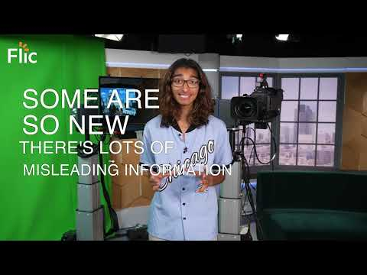
What is cryptocurrency?
5 facts about cryptocurrency
Video | https://youtu.be/PFKke1jDX78
Additional video resource: https://youtu.be/f7iXTyHGYX4 - play to 02:45

Slide 8
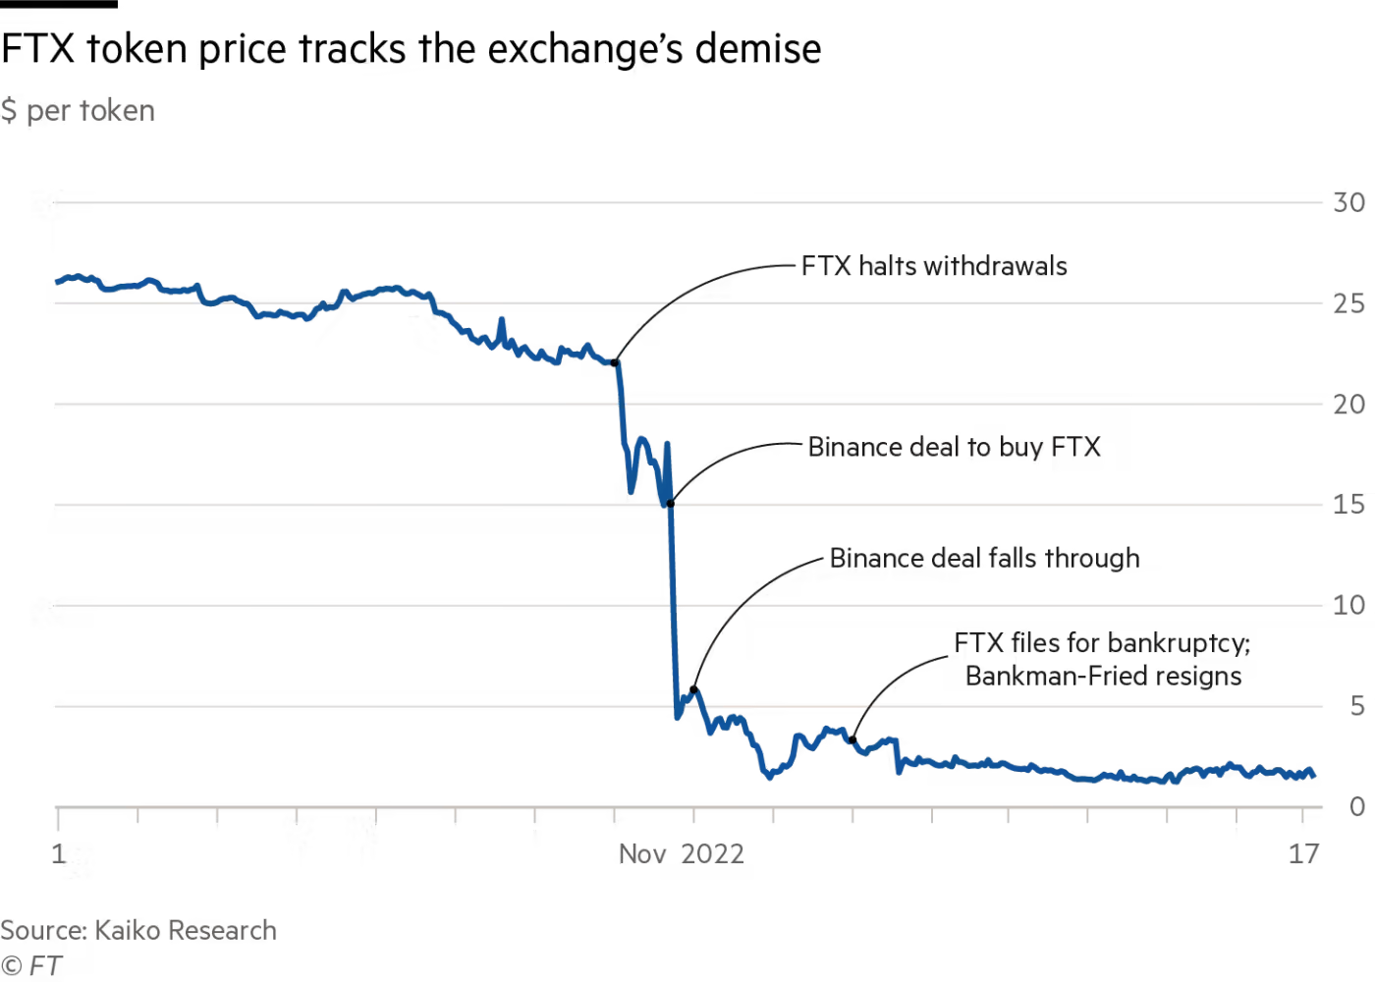
FTX case study
Describe changes to the FTX token price in November 2022

Slide 9
FTX case study
This graph shows how quickly the value of the FTX crypto exchange’s crypto coin, FTT, collapsed when people were worried that FTX was not being run properly.
Between the 8th and 10th November the value of the token dramatically decreased from $23 to $15
The first week of November the FTX token value steadily fluctuate between $23-26
By the third week of November the value of the token was less than $5

Slide 10
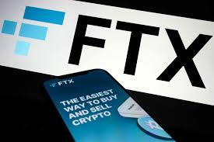
FTX case study
Explanation
People talk about cryptocurrencies but there also places where people hold their coins and exchange their coins called exchanges.
FTX is an example of an exchange which went bankrupt. Lots of well known investors had put money into FTX and over a million people had deposited money at the exchange. Famous people like supermodels and sports stars had also advertised FTX. Lots of people lost a lot of money when it went bankrupt.
The main reason this happened is because crypto exchanges and crypto organisations are currently unregulated. This means customers and investors don’t have the same protections as putting money in a regular bank.
Read the quote below.
What do you think happened?
How might this person feel?
“I and many others - we got caught up in a kind of intense euphoria last year, about the small guy’s chance of going from zero to hero, and this is now the morning after. The hardest thing about this loss is - we didn’t get the chance to lose the money ourselves, it was just taken from us.”
Source found here.
Notes:
Source: https://www.theguardian.com/technology/2022/nov/19/the-money-is-gone-people-who-lost-out-in-ftxs-collapse

Slide 11
Optional chronology activity

Slide 12
Crypto timeline | Can you order the five events below?
Stretch - estimate the year that the events took place
2010
2023
Crypto ‘winter’
The prices of popular cryptocurrencies like bitcoin and ethereum collapsed from what was (at the time) all time highs. The period is infamous in crypto history for causing widespread financial losses for early crypto investors.
Crypto ‘winter’ revisited
A year later the crypto market crashed again, causing an unprecedented amount of financial loss for investors and causing multiple high profile companies (including FTX) to collapse and go bankrupt. Prices have not recovered to 2021 highs and regulators around the world have responded by cracking down on crypto like never before.
Crypto bull run
The crypto industry enjoyed mainstream attention like never before when many big-name companies and investors bought into digital assets. Prices of popular tokens sky-rocketed, including bitcoin which nearly reached $70,000. Companies like Coinbase and (now bankrupt) FTX advertised during the Super Bowl in a watershed moment for the industry.
Silk Road
Was an online darknet marketplace used to trade in illicit goods. Users were able to buy and sell anonymously using cryptocurrency. The platform was eventually shut down by authorities and its founder, Ross Ulbricht, was sentenced to life in prison.
Mt. Gox collapse
Mt. Gox was - at its height - the world’s largest bitcoin exchange, processing roughly 70% of all bitcoin transactions. It was hacked and compromised, causing the price of bitcoin to plummet.
Notes:
Teacher delivery
Use whiteboard to draw a line graph to illustrate changes - Y axis - low to high. X axis - years

Slide 13
Crypto timeline
ANSWERS
What were the causes of changes to the crypto token value in each event?
What was the impact for individuals and organisations?
2011
Silk Road (2011)
Was an online darknet marketplace used to trade in illicit goods. Users were able to buy and sell anonymously using cryptocurrency. The platform was eventually shut down by authorities and its founder, Ross Ulbricht, was sentenced to life in prison.
2014
Mt. Gox collapse
Mt. Gox was - at its height - the world’s largest bitcoin exchange, processing roughly 70% of all bitcoin transactions. It was hacked and compromised, causing the price of bitcoin to plummet.
2018
Crypto ‘winter’
The prices of popular cryptocurrencies like bitcoin and ethereum collapsed from what was (at the time) all time highs. The period is infamous in crypto history for causing widespread financial losses for early crypto investors.
2021
Crypto bull run
The crypto industry enjoyed mainstream attention like never before when many big-name companies and investors bought into digital assets. Prices of popular tokens sky-rocketed, including bitcoin which nearly reached $70,000. Companies like Coinbase and (now bankrupt) FTX advertised during the Super Bowl in a watershed moment for the industry.
2022
Crypto ‘winter’ revisited
A year later the crypto market crashed again, causing an unprecedented amount of financial loss for investors and causing multiple high profile companies (including FTX) to collapse and go bankrupt. Prices have not recovered to 2021 highs and regulators around the world have responded by cracking down on crypto like never before.

Slide 14
End of optional chronology activity

Slide 15
Did you know?
A crypto company’s registration number can be checked on Companies House to check whether it is a legitimate company (applies to UK firms only).
Most cryptocurrencies are not regulated by the FCA (Financial Conduct Authority), even if the firm providing the crypto is. This means people aren’t protected by the UK’s Financial Compensation Scheme.
If someone is scammed, they are unlikely to get their money back.

Slide 16
By the end of the session, I will be able to:
Describe key historical crypto events
Recognise the influence of social media and my peers on my financial decisions

Slide 17
Who does cryptocurrency appeal to?
What is the message being given in this bitcoin advert?
This activity is suggested for Years 11,12 and 13
Please note the information in the video applies to the US, not UK
Notes:
https://news.bitcoin.com/spike-lee-directs-commercial-cryptocurrency-atms/

Slide 18
Who does cryptocurrency appeal to?
Which audiences does crypto appeal to?
Why do we think crypto might appeal to these groups of people?
What are the potential problems or risks with this advert?
This activity is suggested for Years 11, 12 and 13
Notes:
https://news.bitcoin.com/spike-lee-directs-commercial-cryptocurrency-atms/

Slide 19
Who does cryptocurrency appeal to?
Which audiences do crypto appeal to?
Often vulnerable groups of people like ethnic minorities or women.
Why do we think crypto might appeal to these groups of people?
Because it looks like an alternative to traditional money and banks, so people may think that it promotes financial inclusion.
What are the potential problems or risks with this advert?
Crypto is not a good solution as it is unregulated so people can lose a lot of money and be involved in scams and not get their money back.
Notes:
https://news.bitcoin.com/spike-lee-directs-commercial-cryptocurrency-atms/

Slide 20
Who does cryptocurrency appeal to?
What are the factors that would influence this person’s decision to use cryptocurrency?
This is Zak.
Zak is 20 years old and is about to complete his last year at university studying software design. He will be living with his dad, who is a carer for his mum. He will not be able to leave home as he has not saved enough money for his own place. Zak is really interested in cryptocurrency, especially since some of his favourite bands have recently invested. It is all his friends at university talk about.

Slide 21
Who does cryptocurrency appeal to?
How might the highlighted factors influence Zak’s decision to use cryptocurrency?
This is Zak.
Zak is 20 years old and is about to complete his last year at university studying software design. He will be living with his dad, who is a carer for his mum. He will not be able to leave home as he has not saved enough money for his own place. Zak is really interested in cryptocurrency, especially since some of his favourite bands have recently invested. It is all his friends at university talk about.
Notes:
Teacher explanation
Zak - male - gender -
20 years old - age -
University studying software design - education and technical knowledge -
Carer - financial responsibilities -
Bands - celebrities -
Friends - social / personal influence -

Slide 22
Who does cryptocurrency appeal to?
Lots of factors will determine who might engage with cryptocurrency.
Some personal circumstances lead to people having a more positive relationship with money. They then may invest in things such as cryptocurrency which could improve their standard of living.
However, some influencing factors such as information from friends and the media could encourage a lot of risk-taking behaviour.

Slide 23
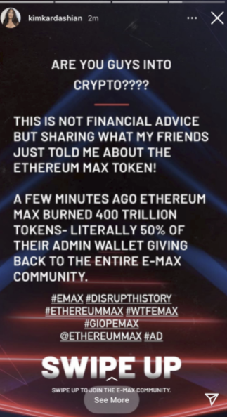
How does social media impact decision-making?
What do you think happened next?
What do you think consumers did?
What do you think happened to the value of the coin?
Notes:
Teacher prompt questions
Why did the value of the coin decrease?
Why is that a bad thing?
Who would have been able to benefit in this scenario?
How might someone protect themselves or make the best out of this situation?

Slide 24
How does social media impact decision-making?
Influencers promote everything from fashion to sport and also cryptocurrencies.
Companies pay them to do this because seeing someone popular endorse a product can be really encouraging. But influencers are not always right!
Reality star Kim Kardashian and boxer Floyd Mayweather promoted the Ethereum Max coin to their followers last year. But then, the value of the coin fell sharply. If you had put $100 into the coins when those ads ran in May 2021, it would have been worth just $3
by the end of the year.
The celebrities, along with the executives from EthereumMax, hit the headlines
when investors sued, accusing them of allegedly making “false and misleading”
statements to their fans.
Notes:
Source: https://www.theguardian.com/technology/2022/jan/13/investors-sue-kim-kardashian-and-floyd-mayweather-jr-over-crypto-scheme-ethereummax

Slide 25
What happened next?
Kim Kardashian had to pay a $1.26 million fine for promotion of the token without disclosing that she was paid for the promotion.
The value of the company’s EthereumMax tokens increased by as much as 1,370% after the social media posts before crashing to an all-time low.
Notes:
Source: https://www.theguardian.com/technology/2022/jan/13/investors-sue-kim-kardashian-and-floyd-mayweather-jr-over-crypto-scheme-ethereummax

Slide 26
Other red flags! ‘Pump and dump’
Unknown coins rising rapidly in value
Paid ads
Lots of social media activity
Play until 1:00
https://www.youtube.com/watch?v=CakdQBB5QnQ
Notes:
Alternative video: https://www.youtube.com/watch?v=YJVtgv6Zmq4

Slide 27
What factors influence financial decisions?
Using full sentences, state and explain two ways that young people might be influenced to buy cryptocurrency.
Include possible problems with the influences you have explained.
Advertising
Social media
Personal circumstances
Celebrity endorsement

Slide 28
How to manage influences
You receive this message from a friend:
“Hey! Have you seen the price of Kattacoin?!
It’s 15% cheaper than it has been.
You should buy. I have!!!”
Use the worksheet to create a conversation in response to the message
Resource: 1 Text conversation template

Slide 29
By the end of the session, I will be able to:
Describe key historical crypto events
Recognise the influence of social media and my peers on my financial decisions

Slide 30
Any questions?
?

Slide 31
‹#›
Services available for people who have concerns about their personal finances
Citizens Advice – Debt and Money – This resource contains links to advice on a number of topics, including financial difficulties, cost of living and communicating with creditors.
National Debtline – Debt and Money – a debt advice charity run by the Money Advice Trust, offering a free and confidential debt advice service.
Childline Helpline 0800 1111
At school, you can speak with an adult you trust.
This could be your form tutor, head of year or the school’s safeguarding officer.

Slide 32
Links to learn more!
Articles to extend learning
Please visit the FLIC learning hub - https://resources.ftflic.com/ for further resources
The Financial Conduct Authority | Crypto: The basics
FTX: the legend of Sam Bankman-Fried | FT Film
Blockchain a clickable guide
What are digital assets?
Tech Tonic Season 4 podcast: A Sceptic’s Guide to Crypto
Money Clinic podcast ‘When trading crypto becomes an addiction

