Slide 1

How to prepare for your financial future
This session is aimed at Key Stage 4 & 5 (recommended for Year 12 and above)

Slide 2
Unit outline
Session 1 | Session 2 | Session 3 | Session 4 | Session 5 | Session 6
The economy | Mortgages | Credit cards | Pensions | ISAs | Financial decisions

Slide 3
Having a respectful learning environment
We will listen to each other respectfully
We will avoid making judgements or assumptions about others
We will comment on what has been said, not the person who has said it
We won’t put anyone on the spot and we have the right to pass
We will not share personal stories or ask personal questions
If there is a question that you do not wish to ask aloud, you can write it on a Post-it Note which will be collected throughout the session and answered at the end
Notes:
Teacher delivery
Students should be invited to ask questions and they should be provided with an opportunity to ask questions anonymously. It is useful to have a question box or allocated space on the whiteboard for students to share questions.
It is suggested that students are provided with post-its or slips to write their questions on and as the teacher circulates throughout the lesson these questions can be collected and answers throughout the session or using an allocated ‘question time’ at the end of the session.
Students can be invited to respond to questions asked by their peers. If responses to questions are based on personal preference or opinion, the teacher should be clear to preface any answers with this.

Slide 4
Session 4:
Pensions

Slide 5
By the end of the session, I will be able to:
Describe what a pension is
Identify the different types of pensions that exist and how they work
Explain the benefits of paying into a pension

Slide 6

Starter
What comes to mind when you hear the word ‘pensions’?
Write as many ideas down as possible.

Slide 7
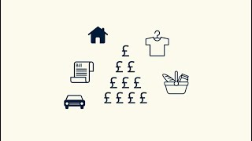
What is a pension?
Throughout working life a person can choose to invest into their future by paying into a pension, often from their monthly salary.
Watch the following video (up to 1 minute 30 seconds only):
Answer the questions below.
What is a pension?
What is auto enrolment?
How old do you have to be before you can start getting money from your pension?
Video: Pension basics explained
Notes:
Teacher delivery
Play the video twice. First time- give students a chance to listen. Second time - students watch the clip and answer the questions before they share their responses with the rest of the class.
The answers for each question are developed on the following slides.

Slide 8
Activity 1: What is a pension?
A pot of money for a person for when they retire. This may be to use when they decide to work less (semi-retire) or stop working entirely (retire).
So, it is a retirement fund built up over the course of a person’s working life.
A person makes regular contributions and typically the money is invested, with the aim to grow the savings over time.
In contrast to other types of long-term saving, pensions come with the added benefit of tax relief.
1. What is a pension?
Notes:
Teacher delivery
Teacher gets feedback from the students and develops this using the information on the slide.
Teacher may be able to draw on their own knowledge too.
Give students a chance to add missing detail to their answers.

Slide 9
Activity 1: What is a pension?
Auto enrolment is when a person is automatically enrolled (signed up to) a workplace pension.
Automatic Enrolment or ‘Auto Enrolment’ is an initiative that was introduced by the government as part of the Pensions Act 2008 (a law that required that every employer in the UK must put certain staff into a workplace pension scheme and contribute towards it.)
Auto enroll aims to deal with the issue of the high number of British workers not saving enough money for their retirement.
The new workplace pension law was introduced between 2012-2018.
As of 2018 all companies must comply with the new Auto Enrolment rules.
2.What is auto enrolment?
Notes:
Teacher delivery
Teacher gets feedback from the students and develops this using the information on the slide.
Teacher may be able to draw on their own knowledge too.
Give students a chance to add missing detail to their answers.

Slide 10
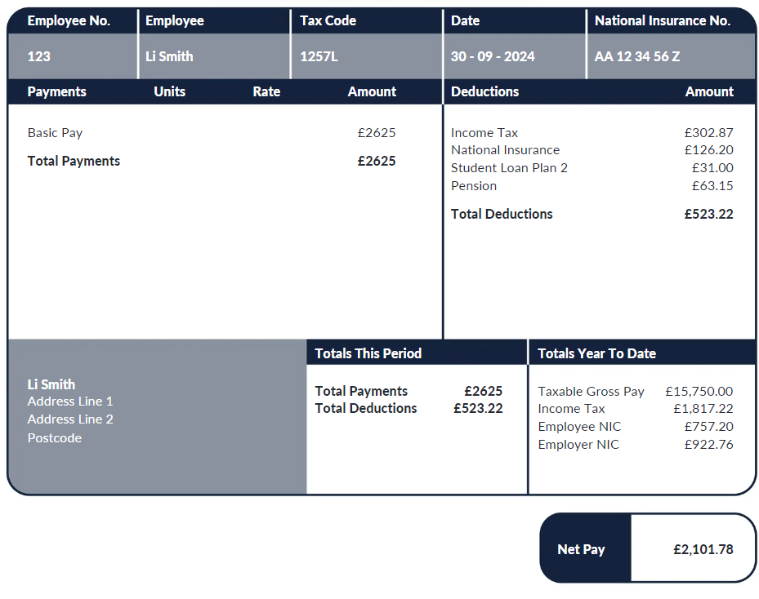
Workplace pension
Pension
Some people also pay into a pension, and their employer will contribute too.
Employees can decide what percentage of their salary is contributed towards their pension.
In April 2021, the gap in employee workplace pension participation rates between the public (91%) and private sectors (75%) was among its lowest levels, mainly driven by increased participation in the private sector up from 32% in 2012.
Notes:
Teacher explanation
Highlight to students that these deductions benefit society as a whole regardless of their income whereas other deductions such as pensions and student loan can be considered as individual investments.

Slide 11
Activity 1: What is a pension?
You can only start receiving payments from your pension fund when you are at least 55 years old.
For a state pension this currently is 66 years (for men & women) but will gradually increase from 2026.
This varies considerably according to the type of pension you have been contributing to.
3. How old do you have to be before you can start getting money from your pension?
Notes:
Teacher delivery
Teacher gets feedback from the students and develops this using the information on the slide.
Teacher may be able to draw on their own knowledge too.
Give students a chance to add missing detail to their answers.

Slide 12




Planning for retirement
What do people spend their pension on?
Living costs
Healthcare costs
Supporting family
Leisure activities

Slide 13
By the end of the session, I will be able to:
Describe what a pension is
Identify the different types of pensions that exist and how they work
Explain the benefits of paying into a pension

Slide 14




What types of pensions are there?
State pension
Workplace pension
Private pension
The government
Employees
Employers
Any individual
Government tax break

Slide 15
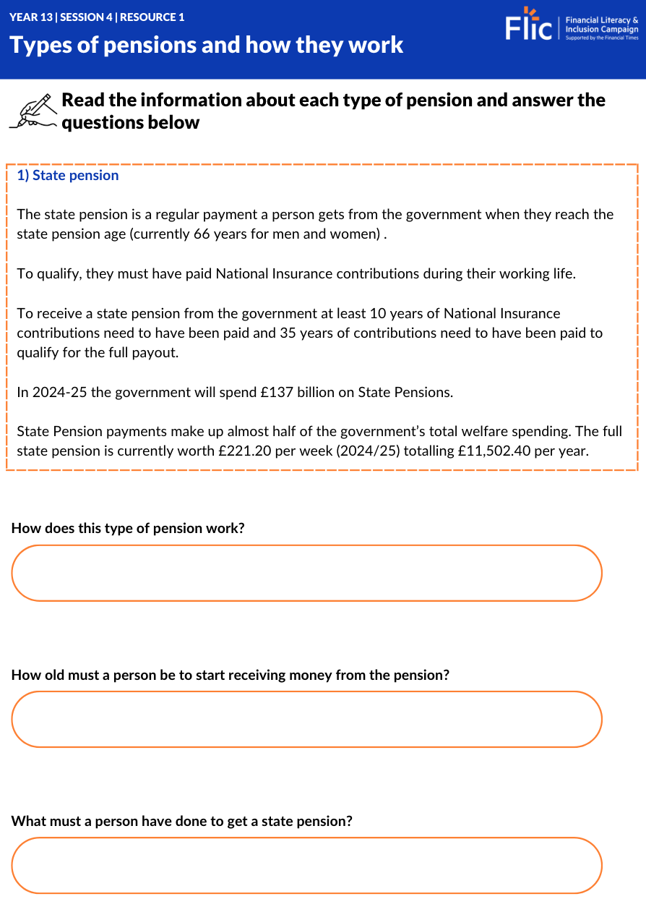
Types of Pension & how they work
Activity 2
In pairs, complete the worksheet on the main types of pensions:
State pensions
Defined contribution pensions (a type of workplace pension)
Defined benefit pensions (a type of workplace or private pension)
Private pensions - if you are self employed or want to top up (a state or workplace pension)
Resource 1
Notes:
Teacher delivery
Read ‘state pensions’ together as a class and then allow students to work in pairs to read about the other types of pension.

Slide 16

Case study
Jorge is 45 and has a varied work history.
He started out running his own business but did not realise he should be saving money for his pension.
Unfortunately, he had to take a period of time off work due to ill-health. This meant closing down his business.
For the last 10 years has worked with the local council, where he has paid into a pension, in order to secure a more stable income to provide for his family.
Jorge cares about climate change and would like to invest in new green energy solutions but he knows he needs to prioritise saving into his pension.
What type of pension should Jorge opt for?
State pension
Defined contribution pension
Defined benefit pension
Private pension
Notes:
Teacher delivery
Read the case study as a class and then give students time to draw out the key factors that need to be considered - these are highlighted on the next slide.
Give students further time to refer to their notes from the previous activity to suggest which pension options might be best for the case study.

Slide 17
Case study
Jorge is 45 and has a varied work history.
He started out running his own business but did not realise he should be saving money for his pension.
Unfortunately, he had to take a period of time off work due to ill-health. This meant closing down his business.
For the last 10 years has worked with the local council, where he has paid into a pension, in order to secure a more stable income to provide for his family.
Jorge cares about climate change and would like to invest in new green energy solutions but he knows he needs to prioritise saving into his pension.
What type of pension should Jorge opt for?
State pension
Defined contribution pension
Defined benefit pension
Private pension
Notes:
Teacher delivery
Use prompt questions to draw out why these factors are significant.
What are the pension options for someone who is self-employed?
What other gaps might people have in the work history?
Is ten years enough time to be able to receive a pension?
What are the implications of having a family? - consider lifestyle like holidays or being able to support grandchildren
Is a pension an investment?

Slide 18
Case study
Jorge will be entitled to an amount of his state pension as he has made contributions for at least 10 years. This payment may not be enough to offer any support to his family when he retires.
The defined benefit pension guarantees a specific payout based on Jorge’s years of service and final salary. The defined benefit pension might be more appealing because Jorge has gaps in his employment, as it's less dependent on consistent contributions. But it might not provide as much flexibility in investment choices.
The defined contribution pension could be good if Jorge wants more control over his investments and could allow him to catch up on retirement savings. His employer might also match his contribution. However, his pension amount here depends on the investment performance.
Jorge will benefit from seeking advice from a financial adviser if he is unsure about his pension options.

Slide 19
By the end of the session, I will be able to:
Describe what a pension is
Identify the different types of pensions that exist and how they work
Explain the benefits of paying into a pension

Slide 20

What are the benefits of having a pension?
Shivaughn is in her 20s.
She hasn’t decided on her career yet but has always worked with a stable income.
Shivaughn does not make any contributions to her pension. She believes she’s too young to be thinking about retirement and would rather enjoy the money she has especially as things can be tight with the rising cost of living.
Discussion:
List as many advantages and disadvantages as possible for Shivaughn putting savings into her pension pot in her 20s
Stretch - What is the most important reason for you to want to save into a pension pot?
Notes:
Teacher delivery
Students work in pairs, using what they have learnt about pensions and how they work to try to come up with as many different benefits of having a pension as they can.
Teacher explanation
Draw on the point that people do have the choice to opt out, inviting students to suggest reasons people might make this decision and the impact of this decision.

Slide 21


Benefits of having a pension
Some benefits of having a pension may include:
A person can save enough money to live comfortably when you retire
A person gets reductions in tax on their income (wages/salary)
A person with a pension pot can get free government contributions to their pension pot through the workplace pension and if they are self-employed and have a private pension
A pension is a great way to save money in the long term
https://www.moneyhelper.org.uk/en/pensions-and-retirement/pensions-basics/why-save-into-a-pension
Notes:
Teacher delivery
Teacher goes through benefits on the slide and any others students may have introduced (some more able students might identify that currently the government does not have enough money to pay into pensions and this alleviates this pressure, if individuals have a pension pot).

Slide 22
By the end of the session, I will be able to:
Describe what a pension is
Identify the different types of pensions that exist and how they work
Explain the benefits of paying into a pension

Slide 23



What are the three most important things you have learnt about pensions today?
3.
1.
2.

Slide 24
Any questions?
?
Notes:
Teacher delivery
Students have an opportunity to ask further questions (time depending). Teachers can signpost other resources for further information.

Slide 25



Services available for people who have concerns about their personal finances
Money Helper - Pensions
Gov UK - State pensions
Citizens Advice - Workplace pensions
At school, you can speak with an adult you trust.
This could be your form tutor, head of year or the school’s safeguarding officer

Slide 26
Links to learn more!
Articles to extend learning
Please visit the FLIC learning hub - https://resources.ftflic.com/ for further resources
Money and Pensions Service
Pension Attention Campaign
Investopedia - What is a pension?

