Slide 1
How to make informed financial decisions
This session is aimed at Key Stage Three (recommended for Year 7 or 8)

Slide 2
What is FLIC?
The Financial Times news group has set up a charity (Financial Literacy and Inclusion Campaign) focused on building up the financial knowledge and skills of everyone in the UK, especially the people that don’t usually come across this information.

Slide 3
Unit outline
Session 1 | Session 2 | Session 3 | Session 4 | Session 5 | Session 6
How to open a bank account | How to read a bank statement | How to save money | How to use bank cards | How to manage debt | A guide to banking

Slide 4
Having a respectful learning environment
We will listen to each other respectfully
We will avoid making judgements or assumptions about others
We will comment on what has been said, not the person who has said it
We won’t put anyone on the spot and we have the right to pass
We will not share personal stories or ask personal questions
If there is a question that you do not wish to ask aloud, you can write it on a post-it note which will be collected throughout the session and answered at the end
Notes:
Teacher delivery
Students should be invited to ask questions and they should be provided with an opportunity to ask questions anonymously. It is useful to have a question box or allocated space on the whiteboard for students to share questions.
It is suggested that students are provided with post-its or slips to write their questions on and as the teacher circulates throughout the lesson these questions can be collected and answers throughout the session or using an allocated ‘question time’ at the end of the session.
Students can be invited to respond to questions asked by their peers. If responses to questions are based on personal preference or opinion, the teacher should be clear to preface any answers with this.

Slide 5
Session 1:
How to open a
bank account

Slide 6
By the end of the session, I will be able to:
Explain why it’s important to have a bank account
Identify the steps to setting up a bank account
Analyse the advantages and disadvantages of different bank accounts

Slide 7
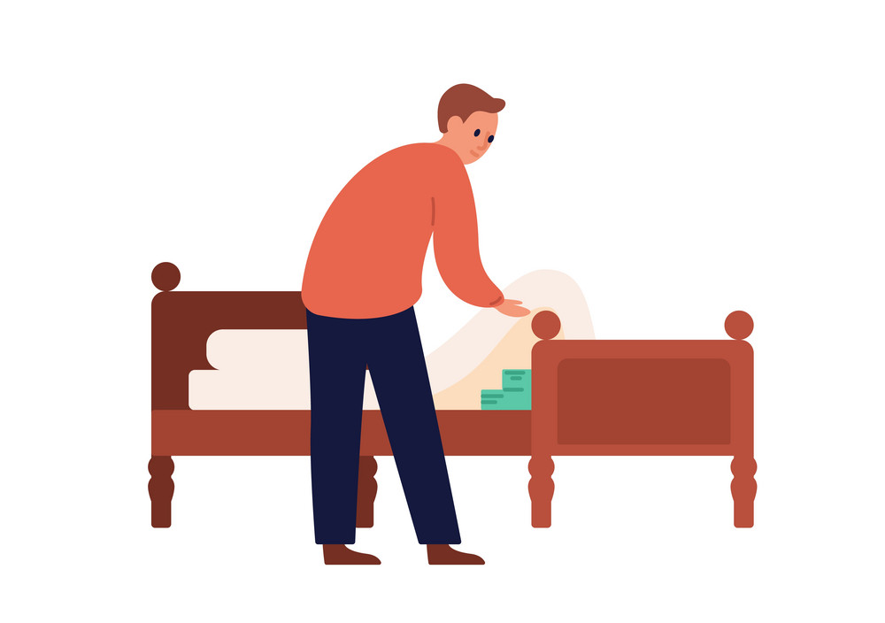
Starter activity
Where do people keep their money?
Discuss in pairs the different possible places
What are the main things someone might look for in a place to keep their money?
Notes:
Teacher instruction
Discussion activity – elicit idea of wanting to keep it safe

Slide 8
Piggy banks fact
These got their name because in the Middle Ages people used to keep their money in pots made of ‘pygg’, which meant clay.
As the English language evolved, this became pig, which is also the name of the animal hence why the shape of the pot changed as well!

Slide 9
What does a bank do?
Interest
What is meant by the following terms?
Customer
Deposits
Loans
Interest
Bank account
Current account
Profit
Identification
Economy
Deposits
Customers
Bank
Loans
Interest
Notes:
Teacher instruction
Use the diagram to walk and talk through the relationship between the key terms.
Students can be instructed to discuss or write down their own definitions.

Slide 10
Term | Definition
Customer | A person or business that buys goods or services from a company or bank.
Deposits | Money that a customer places in a bank or financial institution for safekeeping.
Loans | Money borrowed from a bank or financial institution that must be paid back with interest over time.
Interest | A fee paid for borrowing money, or earned from keeping money in a bank account.
Bank account | A secure place where a person or business can store their money and access it when needed.
Current account | A type of bank account used for everyday transactions like paying bills or withdrawing cash.
Profit | The money a business earns after subtracting its costs and expenses.
Identification | A document or proof used to show who you are, such as a driver's license or passport.
Economy | The system of production, distribution, and consumption of goods and services in a country or region.
Notes:
Use these detailed answers to support further discussion if needed

Slide 11
What does a bank do?
Interest
Banks accept money (deposits) from customers and they also make loans (lend money) to customers.
They pay interest on deposits and charge interest loans. That helps them make a profit.
Deposits
Customers
Bank
Loans
Interest

Slide 12
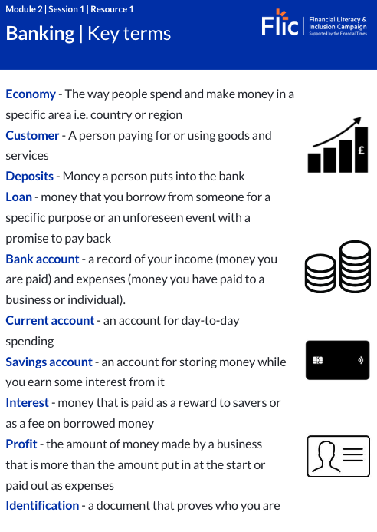
Keywords: banking
Read the key terms on the worksheet provided.
Resource 1: Key terms

Slide 13
Why do people need a bank account?
Copy the mind map
Fill in reasons why people might need a bank account
Why do people need a bank account?
Notes:
Teacher instruction
Give students 3-5 minutes to list or call out reasons for having a bank account.
Workbook
Please refer to page 8 of Student Workbook for printed copy of mindmap. Otherwise students can create a mindmap of their own

Slide 14
Why do people need a bank account?
Keeps money safe
(Up to £85,000 is kept safe in the bank)
Build up a record with the bank so it will be easier to borrow later
Don’t have to carry around large amounts of money
Why do people need a bank account?
Pay bills
Make online purchases.
Important when spending money in places that don’t accept cash
Can link apps to a bank account so payments can be made using mobile phone devices
Notes:
Teacher instruction
Ask students to read out the reasons. All students to make a note of reasons.
Additional points:
Spend money in places that don’t accept cash (an increasingly relevant thing)
An important proof of identity if you want to sign up for a mobile phone contract, take out a car loan etc when you’re older

Slide 15
Complete the conversation
Why should I open a bank account?
Things to include in the conversation:
What a bank account is
Why someone might not want to have a bank account
Two reasons why it’s a good idea to have a bank account
Stretch: What does a person need to open a bank account?
Notes:
Delivery instruction
Students can be given creative freedom to present this activity as a text dialogue or using imagery.
Teacher explanation
A bank account is…a place to keep money that records money that is deposited (put into the bank) and withdrawn (taken out of the account)
Someone might not want to have a bank account because:
If they’ve set up direct debits and there’s not enough money to pay for it, they might be charged for it
They don’t trust banks. They think that banks sell products to customers that they don’t need. Nevertheless, even if a person doesn’t trust a bank they should consider trusting the systems in place that hold banks accountable for their actions. In the banking industry there are lots of regulations and rules and consequences if a bank breaks those rules. The customer is usually well protected.
There are fees attached to using a bank. However, paying for a prepaid card or check cashing service is likely to be even more expensive.
It’s a good idea to have a bank account because…
Please see the previous slide
Adaptive teaching suggestion
Use role play

Slide 16
By the end of the session, I will be able to:
Explain why it’s important to have a bank account
Identify the steps to setting up a bank account
Analyse the advantages and disadvantages of different bank accounts

Slide 17
What do you need to open a bank account?
Find six examples of identification that a person could use to open a bank account. List them in your books.
Two answers contain 2 words.
Use these clues to help you:
U | Y | T | R | E | W | S | A | O | G | I
O | E | W | P | X | R | N | Z | K | N | D
I | H | Z | A | D | D | R | E | S | S | E
P | Y | F | S | U | S | B | E | G | K | N
L | J | U | S | O | S | X | R | H | Q | T
I | I | B | P | A | P | C | D | F | T | I
D | F | I | O | S | O | V | F | K | U | F
C | E | R | R | I | R | I | C | A | F | I
A | L | T | T | U | T | N | M | G | Y | C
R | Y | H | T | Q | P | T | C | L | K | A
D | E | V | Y | W | G | R | V | H | F | T
K | R | C | U | E | Z | M | B | F | D | I
M | D | X | I | R | B | N | U | Y | E | O
P | H | O | N | E | B | I | L | L | E | N
T | G | G | F | E | J | Y | U | U | T | R
Stretch
What age does a person have to be to open a bank account?
What could a person use to show or prove where they live?
Why would a bank want a person to prove their nationality?
Notes:
Teacher instruction
Wordsearch words: Address, Passport, Birth Certificate, ID Card, Phone Bill, Identification
Find the 5 examples of identification you can use in the wordsearch
Stretch Answers
A child can open a bank account (with parental consent) from the age of 11.
Driving licence, utility bill.
To prevent money laundering, tax evasion and other fraudulent activities.

Slide 18
What do you need to open a bank account?
Items that a person could use to open a bank account:
U | Y | T | R | E | W | S | A | O | G | I
O | E | W | P | X | R | N | Z | K | N | D
I | H | Z | A | D | D | R | E | S | S | E
P | Y | F | S | U | S | B | E | G | K | N
L | J | U | S | O | S | X | R | H | Q | T
I | I | B | P | A | P | C | D | F | T | I
D | F | I | O | S | O | V | F | K | U | F
C | E | R | R | I | R | I | C | A | F | I
A | L | T | T | U | T | N | M | G | Y | C
R | Y | H | T | Q | P | T | C | L | K | A
D | E | V | Y | W | G | R | V | H | F | T
K | R | C | U | E | Z | M | B | F | D | I
M | D | X | I | R | B | N | U | Y | E | O
P | H | O | N | E | B | I | L | L | E | N
T | G | G | F | E | J | Y | U | U | T | R
Birth certificate
Address
Passport
Phone bill
ID Card
Identification
Stretch
What age does a person have to be to open a bank account?
What could a person use to show or prove where they live?
Why would a bank want a person to prove their nationality?
Notes:
STRETCH
What age does a person have to be to open a bank account? At least 11 years old
What could a person use to show or prove where they live? Utility bill, entitlement to benefits letter
Why would a bank want a person to prove their nationality? To see if you pay tax elsewhere

Slide 19
How do you open a bank account?
Bank accounts can be opened online or in a bank
Proof of identity is needed. This means providing a document that shows the following:
Name
Date of birth
Address
The minimum age is usually 11 years old
If a young person is under 16 they will need a parent or guardian with them

Slide 20
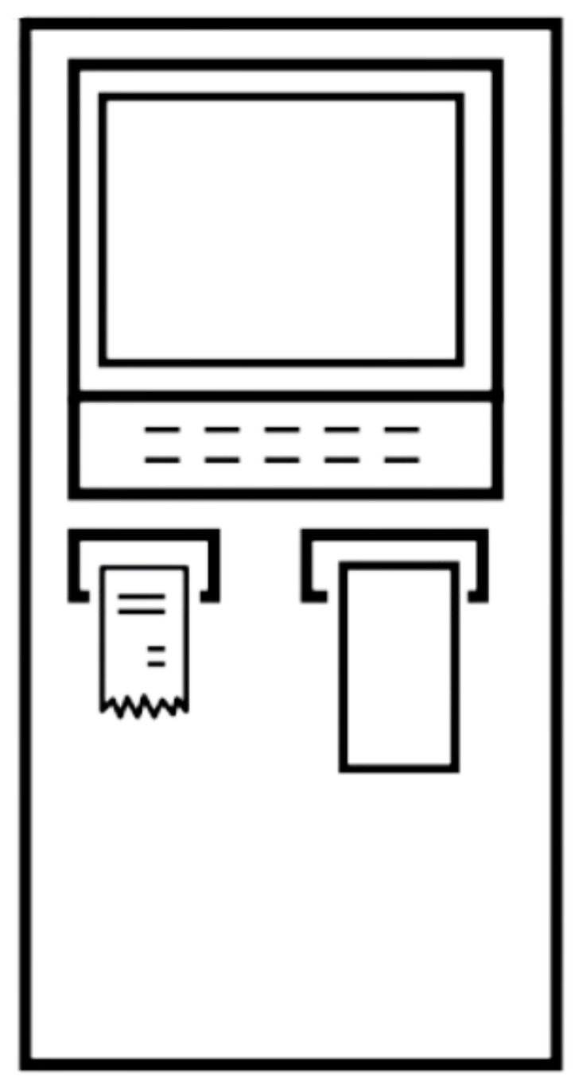
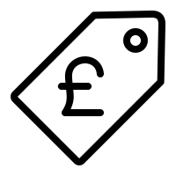
Questions to consider:
When choosing a bank account
Is there a local branch to talk about money queries? If so, check what banks are near and what their opening hours are.
Does it offer telephone or online banking?
Can a person withdraw money for free (without charges) at an ATM?
Does the bank give cash back on spending or paying your bills?
Does it offer any freebies e.g. money for opening an account, mobile phone insurance or a railcard?
Does the account have any overdraft fees? If you spend more money than you have in your account the bank will provide you with some extra money known as your overdraft, however they charge a fee for using this – it’s not free!

Slide 21
By the end of the session, I will be able to:
Explain why it’s important to have a bank account
Identify the steps to setting up a bank account
Analyse the advantages and disadvantages of different bank accounts

Slide 22
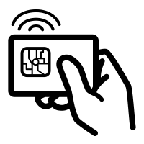
Bank account
What is a bank account?
A record of income (money that is paid to a person) and expenses (money that has been paid to a business or individual)
Just like a fingerprint, a bank account number is unique to each individual.
Stretch: Does anyone know what types of bank account you can open??

Slide 23
Bank account
What is a bank account?
A bank account is like a safe place to keep your money, but instead of being a box in your house, it’s in a bank. When you have a bank account, you can put money in (called “depositing”) and take money out (called “withdrawing”) when you need it.
Banks help keep your money secure, so you don’t have to worry about it being lost or stolen. They also help you track how much money you have.
Most bank accounts come with tools, like a debit card or an app, that let you easily pay for things or check your balance.
Stretch: Does anyone know what types of bank account you can open?

Slide 24
Three main types of accounts
Current account - instant access and regular use but it usually has no or very low interest rewards
Savings account - money is saved and interest is received on it as a reward. With online banking, a regular savings account is almost as accessible as a current account minus the card
Individual Savings Account (ISA) - money is saved and the interest received is tax-free. People can save up to £20,000 in an ISA

Slide 25
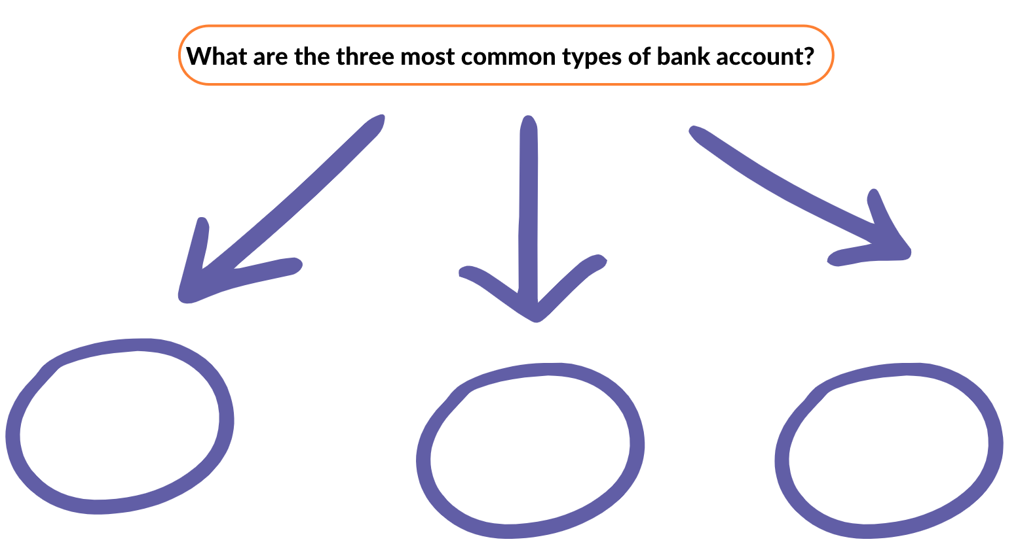
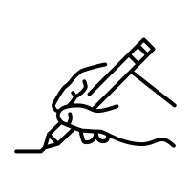
Types of bank account
Name the three types of bank account
Write down the key function of each
Notes:
Delivery instructions
Quick recap: what is the key takeaway from each bank account mentioned in the previous slide
Current: instant access, no/low rewards
Savings: interest received as reward, less accessible
ISA: money is saved, interest is tax free

Slide 26
Current, savings or both?
Create a table to sort the statements below into current account or savings account
Current account | Savings account
Instant access to your money
Keeps your money safe
Guaranteed interest reward
Helps your manage your day-to-day spending
Use it to pay bills
Use it to save up for something
Stretch:
What are the advantages and disadvantages of having instant access to your money?
What are the advantages and disadvantages of using a bank account to pay bills?

Slide 27
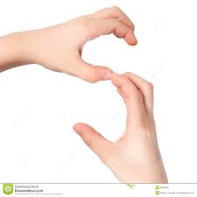
Current, savings or both?
Using 1 hand to make the letter C for Current account, and 2 hands to make the letter S for Savings account, make the letter to show which each statement applies to
Instant access to your money
Keeps your money safe
Guaranteed interest reward
Mostly used for day to day spending
Use it to pay bills
Use it to save up for something

Slide 28
Current, savings or both?
Using 1 hand to make the letter C for Current account, and 2 hands to make the letter S for Savings account, make the letter to show which each statement applies to
Instant access to your money
Keeps your money safe
Guaranteed interest reward
Mostly used for day to day spending
Use it to pay bills
Use it to save up for something
Stretch: What are the advantages and disadvantages of having instant access to your money

Slide 29
Current, savings or both?
Using 1 hand to make the letter C for Current account, and 2 hands to make the letter S for Savings account, make the letter to show which each statement applies to
Instant access to your money
Keeps your money safe
Guaranteed interest reward
Mostly used for day to day spending
Use it to pay bills
Use it to save up for something
Stretch: Are there any instances where your money would not be safe in a bank account?

Slide 30
Current, savings or both?
Using 1 hand to make the letter C for Current account, and 2 hands to make the letter S for Savings account, make the letter to show which each statement applies to
Instant access to your money
Keeps your money safe
Guaranteed interest reward
Mostly used for day to day spending
Use it to pay bills
Use it to save up for something
Stretch: How are banks able to provide interest, where does this money come from?

Slide 31
Current, savings or both?
Using 1 hand to make the letter C for Current account, and 2 hands to make the letter S for Savings account, make the letter to show which each statement applies to
Instant access to your money
Keeps your money safe
Guaranteed interest reward
Mostly used for day to day spending
Use it to pay bills
Use it to save up for something
Stretch: How do bank accounts help to manage day to day spending? Why would some people argue it’s better to use cash instead of a bank card.

Slide 32
Current, savings or both?
Using 1 hand to make the letter C for Current account, and 2 hands to make the letter S for Savings account, make the letter to show which each statement applies to
Instant access to your money
Keeps your money safe
Guaranteed interest reward
Mostly used for day to day spending
Use it to pay bills
Use it to save up for something
Stretch: What are the advantages and disadvantages of using a bank account to pay bills

Slide 33
Current, savings or both?
Using 1 hand to make the letter C for Current account, and 2 hands to make the letter S for Savings account, make the letter to show which each statement applies to
Instant access to your money
Keeps your money safe
Guaranteed interest reward
Mostly used for day to day spending
Use it to pay bills
Use it to save up for something
Stretch: Which statement does this link to that adds benefit to using this type of account?

Slide 34
Current, savings or both?
Create a table to sort the statements below into current account or savings account
Current account | Savings account
Keeps your money safe Can use for day to day spending Instant access to your money Use it to pay bills | Keeps your money safe Guaranteed interest reward Use it to save up for something
Stretch:
What are the advantages and disadvantages of having instant access to your money
What are the advantages and disadvantages of using a bank account to pay bills
Notes:
Teacher instruction
Allow students time to correct their answers
Question students on the possible advantages and disadvantages for each point

Slide 35
By the end of the session, I will be able to:
Explain why it’s important to have a bank account
Identify the steps to setting up a bank account
Analyse the advantages and disadvantages of different bank accounts

Slide 36
Current account switching quotes from MoneySavingExpert.com – would you switch?
New customers to a bank might receive a reward or deal for opening a new account.
What concerns might a person have when switching accounts?
Notes:
Teacher instruction
How easy is it/ how long does it take to switch current accounts?
A full switch will usually take up to 7 working days, and all of your details and payments from the old account will be transferred over as long as your bank is part of the UK switching scheme. If your bank isn’t part of the switching scheme, you’ll have to cancel your direct debits and standing orders and set them up again. You can find out which banks are in the switching scheme by clicking on this link.
If a person switches current account, will this affect their ability to open an account with that bank in the future?
No, people move around all the time and they’re encouraged to move by offers from the banks. If you’re moving back to a bank you’ve already been with, you might not qualify for their new opening deals. Check the small print.

Slide 37
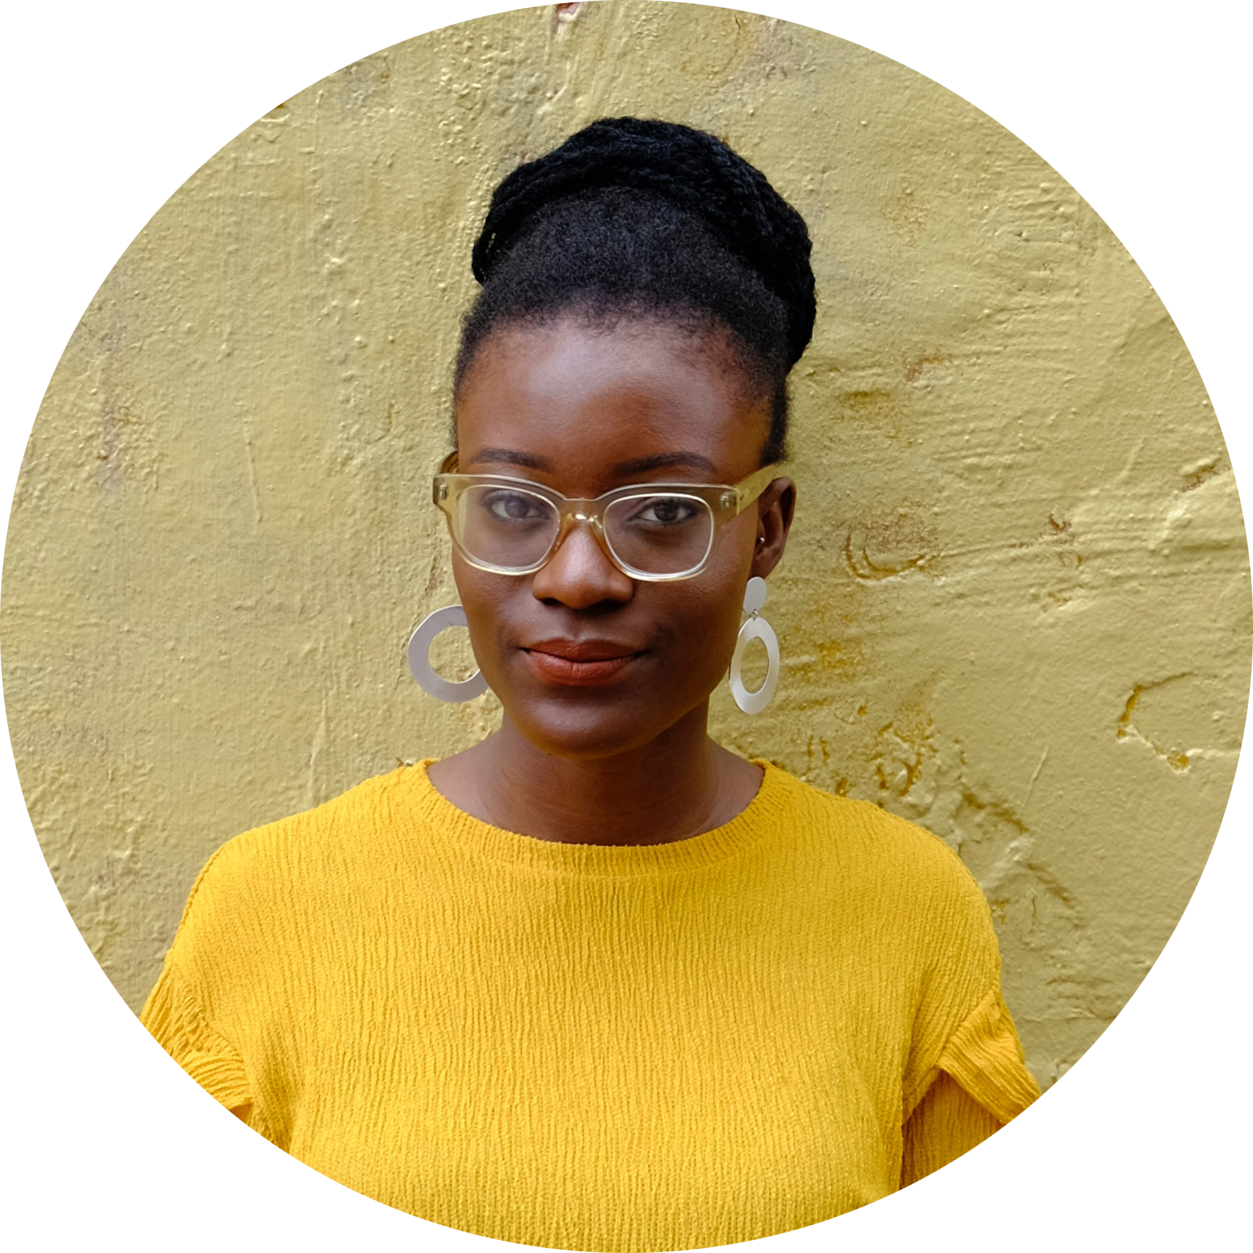
Reflection
This is Zara.
She works and is responsible for looking after her household.
Zara has a 15-year old daughter who would like to go to university when she is 18.
Write a paragraph explaining how Zara might use different types of banking.
Personal reflection: Which type of account do you prefer and why?
Notes:
Teacher explanation
Ideas to elicit from students
Current account can be used for managing the week to week budget e.g. money going out for food, household bills
Savings account can be used to put extra savings away for the future. Zara may try and savings in an account for several years to earn higher interest to support her daughter when she goes to university
Discussion points:
Zara may make the most money by putting her money in a savings account. These have higher interest rates than current accounts.
Her bank may offer savings accounts, or she could shop around: is there another bank that offers a higher interest rate, so she could save more?
Zara could also invest time into switching multiple times: some banks offer as much as £175 sign-up bonus for switching current accounts.
She could open a Junior ISA in her daughter’s name.

Slide 38
Reflection: Model Answer
Consider these possible answers:
Zara may make the most money by putting her money in a savings account. These have higher interest rates than current accounts.
Her bank may offer savings accounts, or she could shop around: is there another bank that offers a higher interest rate, so she could save more?
Zara could also invest time into switching multiple times: some banks offer as much as £175 sign-up bonus for switching current accounts.
She could open a Junior ISA in her daughter’s name.
Notes:
Teacher explanation
Ideas to elicit from students
Current account can be used for managing the week to week budget e.g. money going out for food, household bills
Savings account can be used to put extra savings away for the future. Zara may try and savings in an account for several years to earn higher interest to support her daughter when she goes to university
Discussion points:
Zara may make the most money by putting her money in a savings account. These have higher interest rates than current accounts.
Her bank may offer savings accounts, or she could shop around: is there another bank that offers a higher interest rate, so she could save more?
Zara could also invest time into switching multiple times: some banks offer as much as £175 sign-up bonus for switching current accounts.
She could open a Junior ISA in her daughter’s name.

Slide 39
Make your money work harder for you
Shop around for a bank account
You can change the bank your current account is with whenever you want to
Some people keep track of the freebies and perks, and change their account when they find one they like
The Current Account Switch Guarantee makes it easy to change accounts

Slide 40
By the end of the session, I will be able to:
Explain why it’s important to have a bank account
Identify the steps to setting up a bank account
Analyse the advantages and disadvantages of different bank accounts

Slide 41
Services available for people who have concerns about their personal finances
Martin Lewis’ MoneySavingExpert site has a section devoted to ‘banking and saving’ .
Money Helper’s ‘Saving’ section provides advice on a range of areas around saving habits and saving accounts.
Which offers guidance and advice banking and saving for children
At school, you can speak with an adult you trust.
This could be your form tutor, head of year or the school’s safeguarding officer.

Slide 42
Any questions?
?

Slide 43
Links to learn more!
Articles to extend learning
Please visit the FLIC learning hub for further resources
Citizens Advice - How to open a bank account
Money Supermarket - Opening a bank account
The ‘unbanked’ deserve as much attention as the ‘debanked’ (Financial Times, August 2023)

