Slide 1
How to manage
financial risk
This session is aimed at Year 9 and is also appropriate for KS4 and KS5

Slide 2
Unit outline
Session 1 | Session 2 | Session 3 | Session 4 | Session 5 | Session 6
Mobile phone products | Cryptocurrency | Financial exploitation | Online gaming | Online safety | Pocket money debate

Slide 3
Having a respectful learning environment
We will listen to each other respectfully
We will avoid making judgements or assumptions about others
We will comment on what has been said, not the person who has said it
We won’t put anyone on the spot and we have the right to pass
We will not share personal stories or ask personal questions
If there is a question that you do not wish to ask aloud, you can write it on a post-it note which will be collected throughout the session and answered at the end
Notes:
Teacher delivery
Students should be invited to ask questions and they should be provided with an opportunity to ask questions anonymously. It is useful to have a question box or allocated space on the whiteboard for students to share questions.
It is suggested that students are provided with post-its or slips to write their questions on and as the teacher circulates throughout the lesson these questions can be collected and answers throughout the session or using an allocated ‘question time’ at the end of the session.
Students can be invited to respond to questions asked by their peers. If responses to questions are based on personal preference or opinion, the teacher should be clear to preface any answers with this.

Slide 4
Session 2:
Cryptocurrency

Slide 5
By the end of the session, I will be able to:
Explain what cryptocurrency is and how it compares with traditional money
Assess the factors that influence financial decisions
Suggest ways to engage with crypto assets while managing risk

Slide 6








What is cryptocurrency?
Describe what you know about cryptocurrency using the words below: money coins digital investment risk bank speculative
Currencies - A medium of exchange for goods and services.
A currency usually comes in the form of coins and notes, but now there are also digital currencies, such as cryptocurrency.
Notes:
Suggested timing: 4 minutes on task | 4 minutes feedback

Slide 7
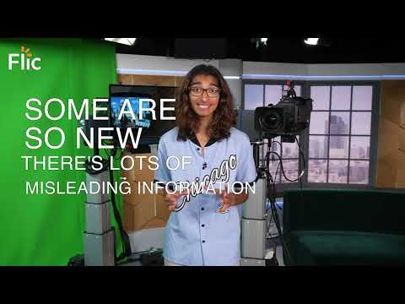
What is cryptocurrency?
5 facts about cryptocurrency
Video | https://youtu.be/PFKke1jDX78
Additional video resource: https://youtu.be/f7iXTyHGYX4 - play to 02:45

Slide 8
Summary | What is cryptocurrency?
1.Cryptocurrencies have a limited number of coins. This limited supply gives them value. Bitcoin is limited to 21 million bitcoins. The amount of coins that exist need to be ‘mined’ by massive computers solving complicated maths problems.
2. The value of crypto is mostly based on what people believe the value of the cryptocurrency is or will be. It is not issued by the government, like the British pound or US dollar. This is why it can be very volatile - often changing in value.
3. Cryptocurrency is speculative. This means that people buy or trade crypto because they have heard it may rise in value, not because they have evidence to support a potential rise in its value. Unlike online games, like Fortnite, investments in cryptocurrency can lead to real big losses.
4. Cryptocurrencies, at the moment, are not widely accepted so can’t be used to buy a lot of items.
5. Any investment should only be made after an emergency fund has been set aside. This is an amount of money, usually 3 months worth of spending, saved in case of unforeseen events.
Notes:
Different sets of students to be given different sections to read and summarise. Students then feedback to the class.

Slide 9
Cryptocurrency v.s money overview
Why some are wary of cryptocurrency…
It doesn’t have the backing of a government or central bank and usually isn’t regulated
It isn't stable
It isn't accepted for buying most shopping items
…can be exactly why others prefer it
Its instability (also called volatility) allows some people to make huge gains in a short space of time, but also huge losses!
It is sometimes decentralised, meaning peer to peer trades can take place without an organisation in the middle
Notes:
An institutional body includes organisations such as banks or insurance companies.

Slide 10
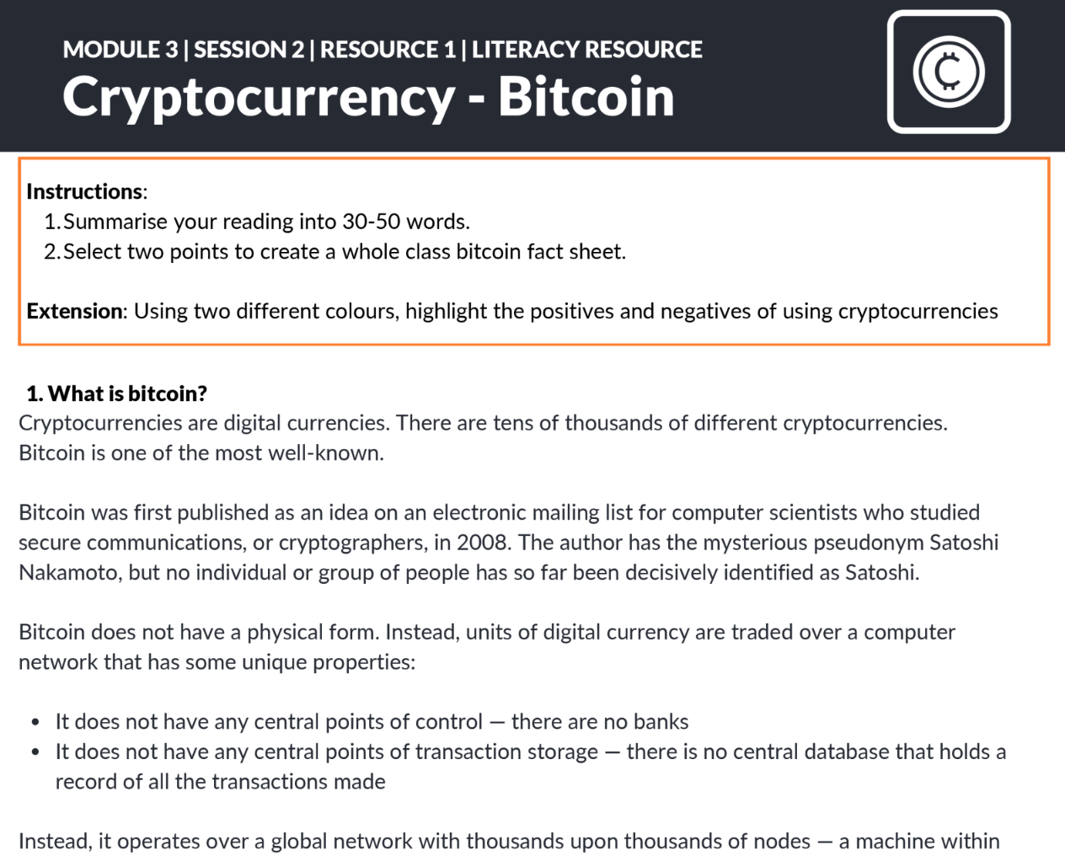
What is cryptocurrency?
Literacy resource: Cryptocurrency and bitcoin
Summarise your reading in 30-50 words
Select two points to create a whole class bitcoin fact sheet
Extension - Using two different colours, highlight the positives and negatives of using cryptocurrency.
Resource 1 | Literacy Resource
Notes:
Suggested timing: 10 minutes on task | 6 minutes feedback
Students can be given one part of the reading or all parts. (Print two per page)
For lower ability groups or students, focus on one section of the reading or use a whole class reading strategy.
Note key summary points on the whiteboard. Students can make notes from class feedback

Slide 11
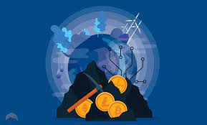
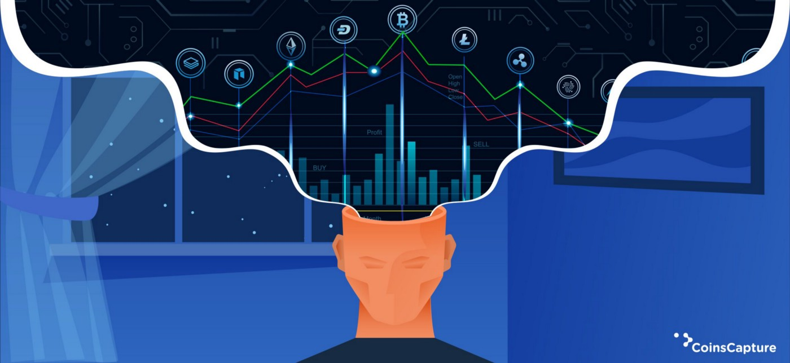
Ethical considerations
Environmental
Cryptocurrencies can be environmentally unfriendly because it takes a large amount of energy to power the technology they require. Bitcoin alone uses more energy than some entire countries!
There are increasing efforts to try to make cryptocurrencies greener.
Social
Some people get short-term happiness from their cryptocurrencies going up and down, but others can end up suffering from severe anxiety.
Some people have ended up treating it like gambling or committing crimes to fund it.
Watch the video 3:30 [optional] - https://www.ft.com/video/ce61990f-ba96-4759-8979-139dd6ccd8d9
Notes:
Further example
That is what happened to a man called Jake, who told the BBC that he had lost millions after becoming addicted to trading cryptocurrencies. Jake did not have millions to lose — he was charged with stealing £1.5mn from his employer.

Slide 12
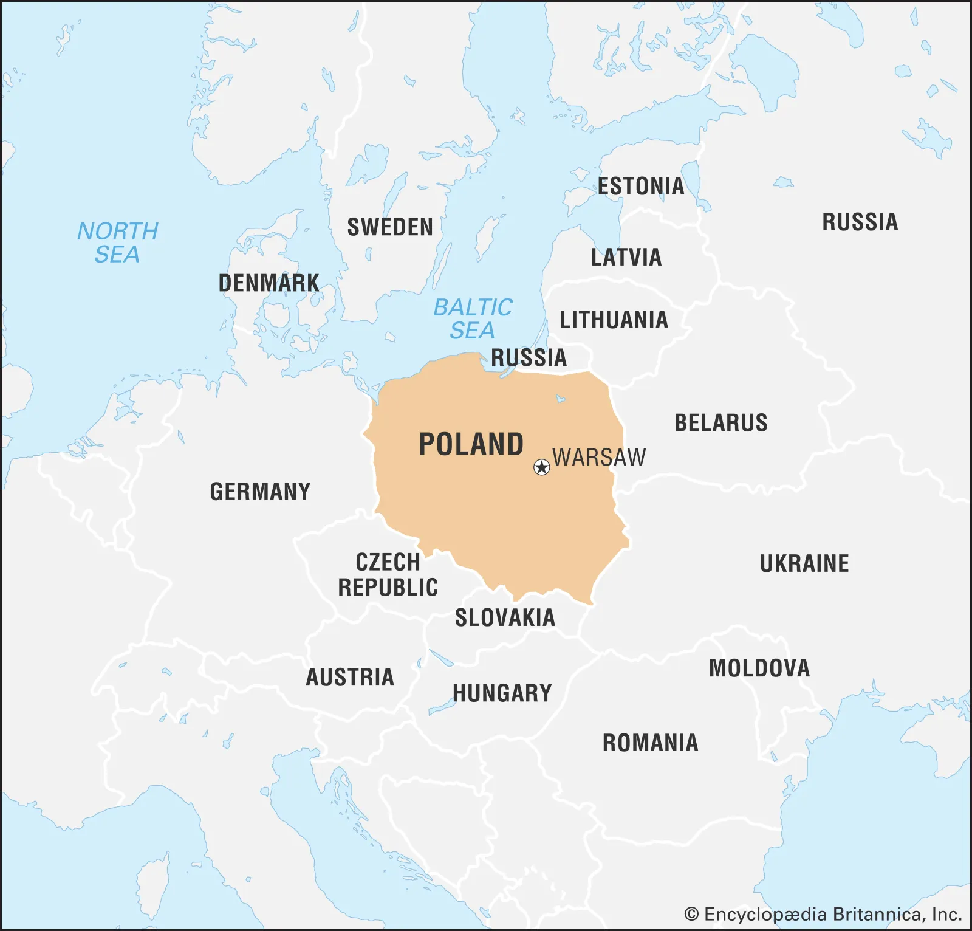
Did you know?
Bitcoin's energy consumption is similar to the whole country of Poland.
Notes:
https://www.bbc.co.uk/news/technology-56012952
Source: https://ccaf.io/cbnsi/cbeci/comparisons

Slide 13



Cryptocurrency - the good and the bad
What are some of the positives and negatives about bitcoin?
Notes:
Suggested timing: 8 minutes class discussion
Teacher delivery
Encourage students to consider all points from a range of perspectives i.e. a disadvantage for one, could be an advantage for another.

Slide 14
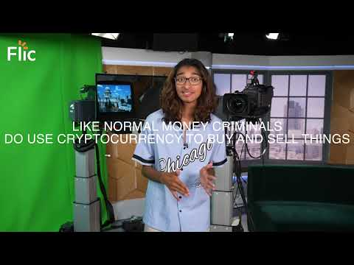
5 myths about cryptocurrency
Video | https://youtu.be/J-xEhaUxCy4
Notes:
Suggested timing: 1 minute video | 6 minutes AfL quiz

Slide 15
Multiple choice
There are about ……………..cryptocurrencies worldwide
A | B | C
750 | 7,200 | 10,000
Notes:
Source: https://www.statista.com/statistics/863917/number-crypto-coins-tokens/

Slide 16
Multiple choice
There are about ……………..cryptocurrencies worldwide
A | B | C
750 | 7,200 | 10,000
Notes:
Source: https://www.statista.com/statistics/863917/number-crypto-coins-tokens/

Slide 17
Multiple choice
2. Who can own a cryptocurrency?
A | B | C
Anyone | People over the age of 16 | People that have been financially trained

Slide 18

Multiple choice
2. Who can own a cryptocurrency?
A | B | C
Anyone | People over the age of 16 | People that have been financially trained
Note that this is different to opening an account or trading. Most popular cryptocurrency exchanges, such as traditional brokerage firms, prevent anyone under 18 years of age from opening a trading account.

Slide 19
Multiple choice
3. Which of these sets of words accurately define Bitcoin?
A | B | C
High-risk and stable | Low-risk and volatile | High-risk and volatile

Slide 20
Multiple choice
3. Which of these sets of words accurately define Bitcoin?
A | B | C
High-risk and stable | Low-risk and volatile | High-risk and volatile

Slide 21
Multiple choice
4. The supply of bitcoin is…
A | B | C
Changeable because more can be created or issued | Carefully controlled and limited | Controlled by governments or banks

Slide 22
Multiple choice
4. The supply of bitcoin is…
A | B | C
Changeable because more can be created or issued | Carefully controlled and limited | Controlled by governments or banks

Slide 23
Multiple choice
5. Which of these statements is TRUE?
A | B | C
Cryptocurrencies will always make a person rich quickly | Cryptocurrencies are mostly used by thieves | There’s never a guarantee that any cryptocurrency or other investment will make someone money

Slide 24
Multiple choice
5. Which of these statements is TRUE?
A | B | C
Cryptocurrencies will always make a person rich quickly | Cryptocurrencies are mostly used by thieves | There’s never a guarantee that any cryptocurrency or other investment will make someone money

Slide 25
By the end of the session, I will be able to:
Explain what cryptocurrency is and how it compares with traditional money
Assess the factors that influence financial decisions
Suggest ways to engage with crypto assets while managing risk

Slide 26

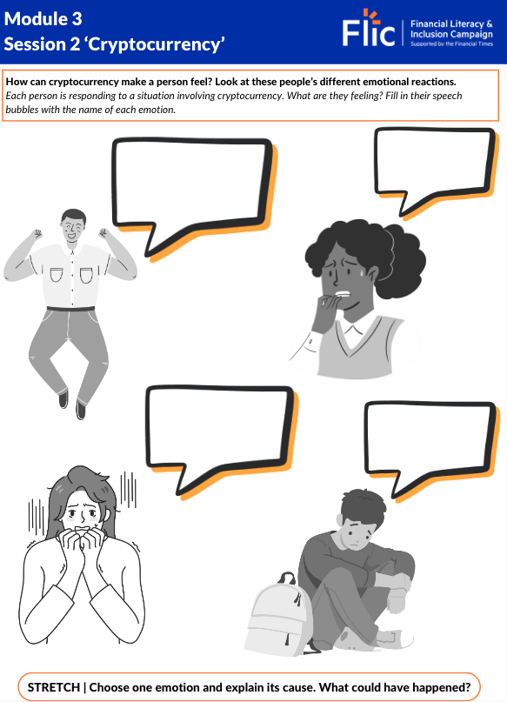
Cash or crypto?
How can cryptocurrency make a person feel?
Discussion: Think of positive and negative emotions that crypto could cause
Excited
Anxious
Powerful
Disappointed
Relevant
Frustrated
Notes:
Teacher explanation
It may be that young people might think about crypto as ‘empowering’ ‘revolutionary’ or ‘exciting’ – if this is the case, explain reasons why, although these might be feelings associated with investing in crypto, there is also a lot of anxiety, disappointment, confusion and frustration that can also be generated.

Slide 27

Who does cryptocurrency appeal to?
What are the factors that would influence this person’s decision to use cryptocurrency?
This is Zak.
Zak is 20 years old and is about to complete his last year at university studying software design. He will be living with his dad, who is a carer for his mum. He will not be able to leave home as he has not saved enough money for his own place. Zak is really interested in cryptocurrency, especially since some of his favourite influencers have recently invested. It is all his friends at university talk about.
How many factors can you identify?
Notes:
Suggested timing: 4 minutes on task
Teacher prompt questions
Is there a difference between genders?
Is there a difference between classes?
Does level of education matter?
Are there any reservations based on religious beliefs?
How might race be a factor when considering money and cryptocurrency?

Slide 28
Who does cryptocurrency appeal to?
How might the highlighted factors influence this person’s decision to use cryptocurrency?
This is Zak.
Zak is 20 years old and is about to complete his last year at university studying software design. He will be living with his dad, who is a carer for his mum. He will not be able to leave home as he has not saved enough money for his own place. Zak is really interested in cryptocurrency, especially since some of his favourite influencers have recently invested. It is all his friends at university talk about.
Task: Explain two factors that could influence Zak to invest in cryptocurrency
Notes:
Suggested timing: 4 minutes feedback | 8 minutes on task
The discussion is based on likelihood to engage in risk, reflect back on who is likely to invest and why?
Highlight the discussion is largely based on stereotypes and does not apply to all people in a specified group.

Slide 29

Who does cryptocurrency appeal to?
Lots of factors will determine who might engage with cryptocurrency.
Some personal circumstances lead to people having a more positive relationship with money. They then may invest in things such as cryptocurrency which could improve their standard of living.
However, some influencing factors such as information from friends and the media could encourage a lot of risk-taking behaviour.

Slide 30
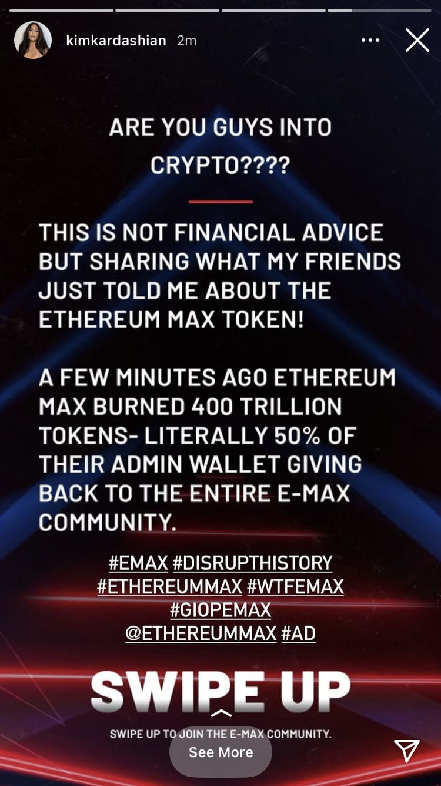

How does social media impact decision making?
Kim Kardashian promoted a cryptocurrency on her Instagram
What did her followers do?
What do you think happened to the value of the coin?
Notes:
Teacher prompt questions
Why did the value of the coin decrease?
Why is that a bad thing?
Who would have been able to benefit in this scenario?
How might someone protect themselves or make the best out of this situation?

Slide 31
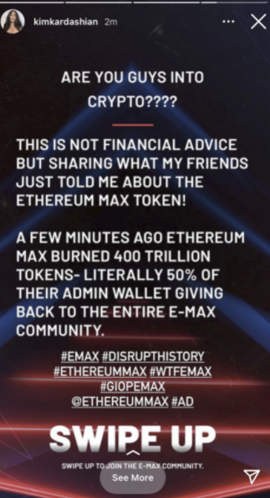
How does social media impact decision making?
Influencers promote everything from fashion to sport, and also cryptocurrencies.
Companies pay them to do this because seeing someone popular endorse a product can be really encouraging. But influencers are not always right!
Reality star Kim Kardashian and boxer Floyd Mayweather promoted the Ethereum Max coin to their followers in 2021. But then, the value of the coin fell sharply. If you had put $100 into the coins when she posted in May 2021, it would have been worth just $3
by the end of the year.
The celebrities, along with the executives from EthereumMax, hit the headlines
when investors sued, accusing them of allegedly making “false and misleading”
statements to their fans.
What is 1 thing you have learnt from this story?
Notes:
Influencers promote everything from fashion to sport, and also cryptocurrencies. Companies pay them to do this because seeing someone popular endorse a product can be really encouraging. But influencers are not always right!
Reality star Kim Kardashian and boxer Floyd Mayweather promoted the Ethereum Max coin to their followers in 2021. But then, the value of the coin fell sharply. If you had put $100 into the coins when she posted in May 2021, it would have been worth just $3 by the end of the year.
The celebrities, along with the executives from EthereumMax, hit the headlines when investors sued, accusing them of allegedly making “false and misleading” statements to their fans.
Investors sue Kim Kardashian and Floyd Mayweather Jr over crypto scheme | Cryptocurrencies | The Guardian

Slide 32
What happened next?
Kim Kardashian had to pay a $1.26 million fine for promotion of the token without disclosing that she was paid for the promotion.
The value of the company’s EthereumMax tokens increased by as much as 1,370% after the social media posts before crashing to an all-time low.
What is 1 thing you have learnt from this story?
Notes:
Guardian article
SEC Fine

Slide 33

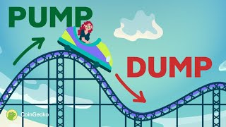
Other red flags! ‘Pump and dump’
Unknown coins rising rapidly in value
Paid ads
Lots of social media activity
Play until 1:00
https://www.youtube.com/watch?v=CakdQBB5QnQ
Notes:
Alternative video: https://www.youtube.com/watch?v=YJVtgv6Zmq4

Slide 34
By the end of the session, I will be able to:
Explain what cryptocurrency is and how it compares with traditional money
Assess the factors that influence financial decisions
Suggest ways to engage with crypto assets while managing risk

Slide 35
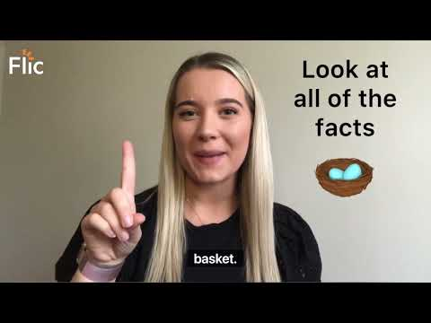
What does good research involve?
https://youtu.be/3xVMpSI1GfE
Video | https://youtu.be/3xVMpSI1GfE

Slide 36
What does good research involve?
Trusted sources
Check for red flags
Financial advice
Data and trends
Who has endorsed this coin?
Celebrity endorsement can impact how valuable a coin is perceived to be, especially if there has been hype created on social media for example.

Slide 37

Did you know?
Most cryptocurrencies are not regulated by the FCA (Financial Conduct Authority), even if the firm providing the crypto is. This means people aren’t protected by the UK’s Financial Compensation Scheme.
Long story short:
Cryptocurrencies are not regulated like normal banks.
If you are scammed, you are unlikely to get your money back.
Notes:
Teacher explanation
- You can check the crypto company's registration number on Companies House to check it is a legitimate company (only applies for UK firms). You can also check the Financial Conduct Authority register.
- Most cryptocurrencies are not regulated by the FCA (even if the firm providing the crypto is) which means you won't be protected by the UK's Financial Compensation Scheme. This means that if you're scammed it is unlikely you will recover your money.

Slide 38

How to manage influences
You receive this message from a friend:
“Hey! Have you seen the price of Kattacoin?!
It’s 15% cheaper than it has been.
You should buy. I have!!!”
Use the worksheet to create a conversation in response to the message
Resource 2: Text conversation template
Notes:
Suggested timing: 8 minutes on task

Slide 39
Any questions?
?

Slide 40



Services available for people who have concerns about their personal finances
Citizens Advice – Debt and Money – This resource contains links to advice on a number of topics, including financial difficulties, cost of living and communicating with creditors.
National Debtline – Debt and Money – a debt advice charity run by the Money Advice Trust, offering a free and confidential debt advice service.
Childline Helpline
0800 1111
At school, you can speak with an adult you trust.
This could be your form tutor, head of year or the school’s safeguarding officer.

Slide 41
Links to learn more
ARTICLES TO EXTEND LEARNING
Please visit the FLIC learning hub - Learning Hub FT FLIC for further resources
Blockchain: a clickable guide (Financial Times, 2021)
Going for Broke in Cryptoland (NY Times, 2021)
What are digital assets? (Financial Times, October 2012)

