Slide 1
How to manage
financial risk
This session is aimed at Year 9 and is also appropriate for KS4 and KS5

Slide 2
Unit outline
Session 1 | Session 2 | Session 3 | Session 4 | Session 5 | Session 6
Mobile phone products | Cryptocurrency | Financial exploitation | Online gaming | Online safety | Pocket money debate

Slide 3
Having a respectful learning environment
We will listen to each other respectfully
We will avoid making judgements or assumptions about others
We will comment on what has been said, not the person who has said it
We won’t put anyone on the spot and we have the right to pass
We will not share personal stories or ask personal questions
If there is a question that you do not wish to ask aloud, you can write it on a post-it note which will be collected throughout the session and answered at the end
Notes:
Teacher delivery
Students should be invited to ask questions and they should be provided with an opportunity to ask questions anonymously. It is useful to have a question box or allocated space on the whiteboard for students to share questions.
It is suggested that students are provided with post-its or slips to write their questions on and as the teacher circulates throughout the lesson these questions can be collected and answers throughout the session or using an allocated ‘question time’ at the end of the session.
Students can be invited to respond to questions asked by their peers. If responses to questions are based on personal preference or opinion, the teacher should be clear to preface any answers with this.

Slide 4
‹#›
Session 4:
Online gaming

Slide 5
By the end of the session, I will be able to:
Identify and calculate the cost of online gaming
Explain what can be done to manage spending when gaming
Evaluate recommendations made to help young people manage their spending when gaming

Slide 6
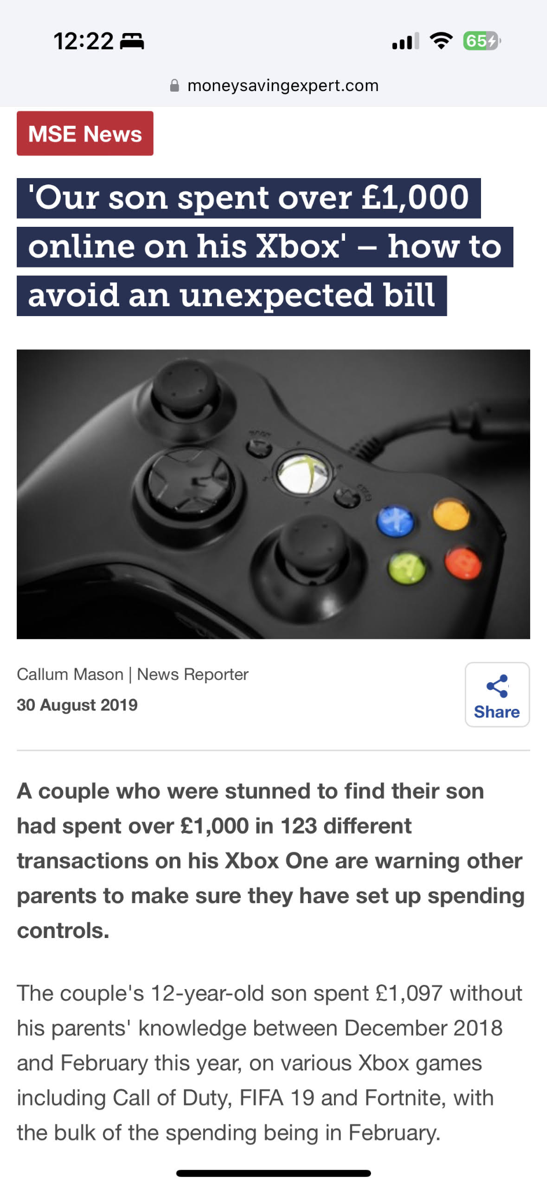
The cost of gaming
How has this young person spent £1,000 on a game?
Has a crime been committed?
Who should take responsibility for this bill?
It is likely that the young person made in-app purchases.
Using anyone’s bank card or account details without permission is fraud.
In many cases like this the parent has to deal with the financial consequences.
Notes:
Optional print for Do Now

Slide 7
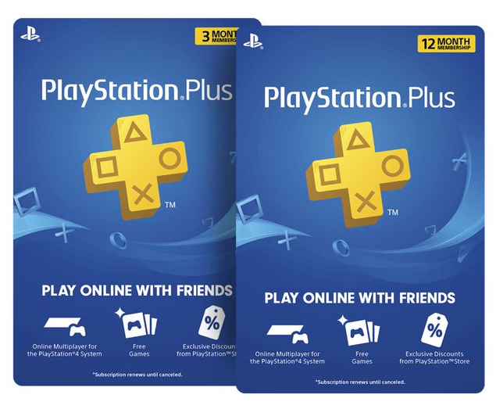
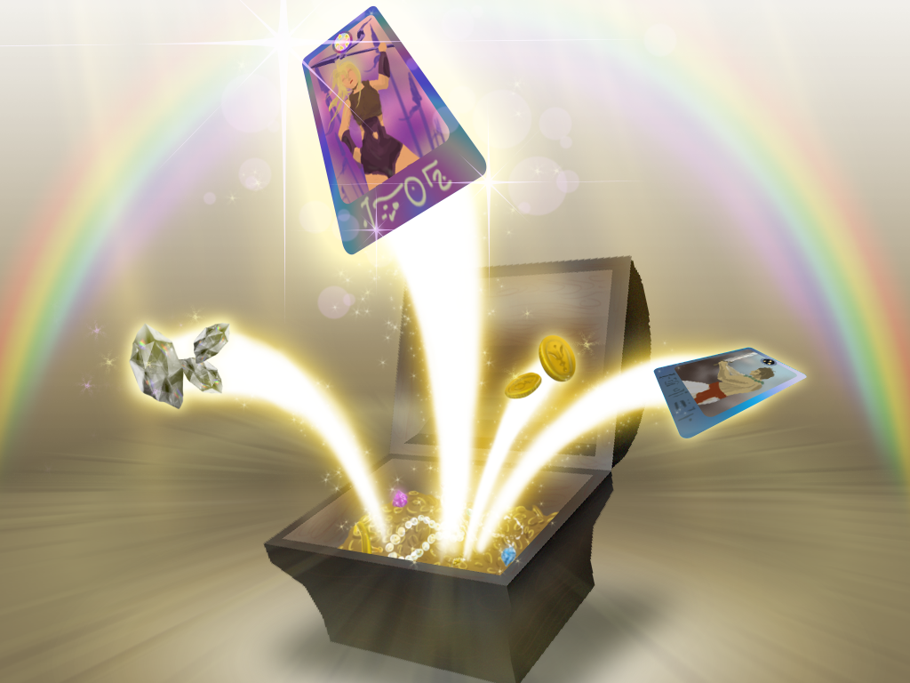
The cost of gaming
Examples of in-app purchases
Additional subscriptions
Gaming currency
Loot boxes
Unless the card owner has explicitly granted a person permission to use their card, then even a small purchase on the card is illegal.
This is a type of fraud and the person who has used the card may be subject to criminal and financial liability even for a small transaction.

Slide 8
How Games Encourage Spending
Activity
Using the information from the video, identify the ways in which video games encourage spending
Video: How free games are designed to make money
Notes:
Delivery Instructions
Teacher Explanation
Prompt Questions
Additional Context

Slide 9
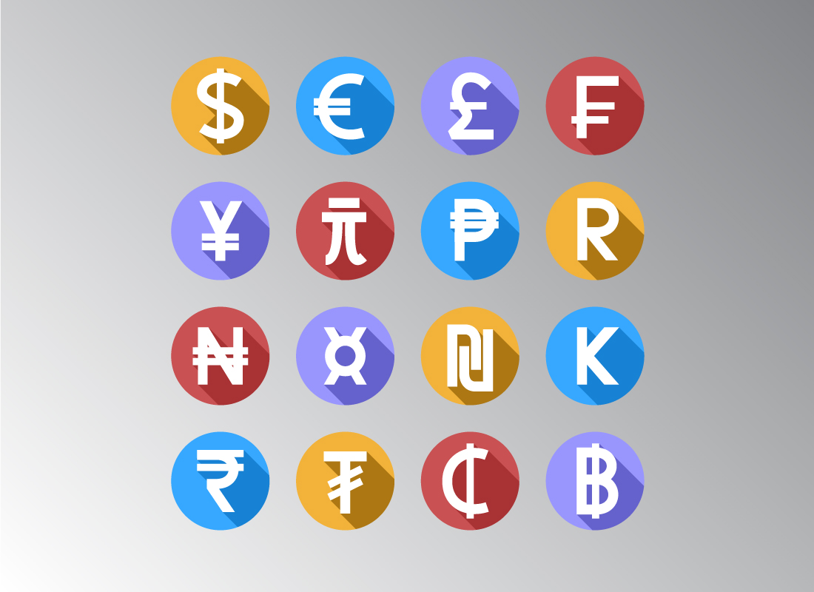
Did you get these?
Can you explain how these strategies work?
Use virtual currencies
Use strange exchange rates
Easy payment process
Embed inconvenience into the game
Dynamic pricing, especially when quitting
Notes:
Additional Context
Use Virtual Currencies: This psychologically dissociates in game spending from spending actual money. Means people are more likely to spend, as it feels less like they are spending their own money
Strange Exchange Rates: Makes it tricker to calculate exactly how much of your own money you are spending.
Easy Payment Process: Simple methods of payment reduces barriers to purchases.
Embedded Inconvenience: Encourages people to pay for items that improve convenience
Dynamic Pricing: Captures people who may not be willing to pay higher prices, but might be more willing to pay lower prices.

Slide 10
What are loot boxes?
Loot boxes are virtual treasure chests contained inside video games, where the contents are randomly selected. Players acquire the loot boxes, often paying for them with ‘real-world’ money. It is a gamble because they have no idea whether the box contains an item which they want (to improve or customise their experience of the game), or the odds of it doing so.
Loot boxes are big money for major games publishers, accounting for between 11% and one third of the annual sales of publishers. At the end of 2020, it was estimated that over £700 million was spent each year on loot boxes.
Source Gov.uk
Notes:
Government response to the call for evidence on loot boxes in video games - GOV.UK. Research here
Predicted global spending on loot boxes in 2025 is over $20 billion. Source

Slide 11
Optional literacy activity: Loot Boxes

Slide 12
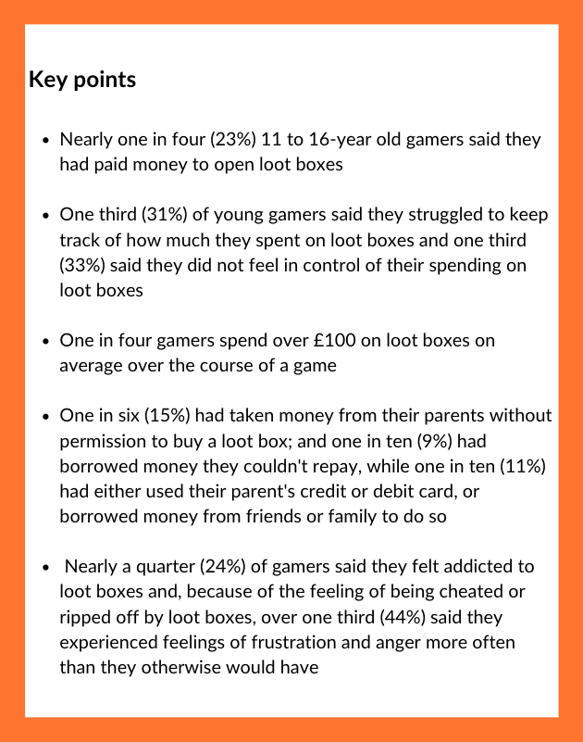
What are loot boxes?
Let’s read through some information on loot boxes and young people’s spending behaviour.
Make a list of 5 -10 number facts from the text.
For example, ‘almost one in four (22%) reported spending over £100’.
Resource 1 - Loot boxes
Source: Gambling Health Alliance | pg 2-3 | 2018

Slide 13
End of optional literacy activity

Slide 14
The cost of gaming
23%
15%
33%
What percentage of young people
said they had paid money to open loot boxes?
Notes:
Source: WHAT IS THE FINANCIAL IMPACT OF LOOT BOXES ON CHILDREN AND YOUNG PEOPLE?

Slide 15
The cost of gaming
23%
15%
33%
Nearly one in four (23%) 11 to 16-year old gamers
said they had paid money to open loot boxes

Slide 16
The cost of gaming
23%
15%
33%
What percentage of young people said they did not feel in control of their spending on loot boxes and did not keep track of spending?

Slide 17
The cost of gaming
23%
15%
33%
One third (33%) of young people said they did not feel in control of their spending on loot boxes and did not keep track of spending

Slide 18
The cost of gaming
23%
15%
33%
What percentage of young people have taken money from their parents without permission to buy a loot box

Slide 19
The cost of gaming
23%
15%
33%
One in six (15%) of young people have taken money from their parents without permission to buy a loot box

Slide 20
By the end of the session, I will be able to:
Identify and calculate how the cost of online gaming can escalate
Explain what can be done to manage spending when gaming
Evaluate recommendations made to help young people manage their spending when gaming

Slide 21
Calculating the cost of gaming
We’re going to see how much in-game purchases cost in pounds
In Game Currency:
FIFA Points
Cost:
£10.00 for 2,000
In-game Purchases:
Silver Pack: 150 FIFA points
Silver Premium Pack:
200 FIFA points
Gold Pack: 100 FIFA points
Gold Premium Pack:
350 FIFA points
How do we calculate the exchange rate between the pound (£) and an in-game currency?
We need to work out the ratio
Notes:
Delivery Instructions
A worked example is on the next slide
Teacher Explanation
Stretch: Exchange rate is not enough, due to the different pricing structures of in game purchases in the different game. An example of this is comparing Roblux to V-Bucks. £1 acquired roughly 100 Robux, but 200 V-Bucks. However most paid games in Roblox are only 25 Robux, whereas the cheapest pickaxe in Fortnite is 500. To use economic language, the purchasing power within these different games is quite different.
Prompt Questions
How can you change these numbers to make the calculation easier?
Additional Context
For some of these game, students may cite other in game currencies. FIFA also has FIFA Coins, and League of Legends has Blue Essence. The difference is that those currencies are accumulated by completing in game milestones, and cannot be bought.

Slide 22
Calculating the cost of gaming
We’re going to see how much in-game purchases cost in pounds. It might be useful to copy the example as we watch the video:

Slide 23
Calculating the cost of gaming
We’re going to see how much in-game purchases cost in pounds
How can we work out the total cost in pounds (£) for the in-game purchases listed?
In Game Currency:
FIFA Points
Cost:
£10.00 for 2,000
In-game Purchases:
Player cards: 150 FIFA points
Jersey kits: 200 FIFA points
Badges: 100 FIFA points
Fitness cards: 350 FIFA points
Step 1: The total points is worked out by adding up all of the in-game purchase points.
Total points = 150 + 200 + 100 + 350 = 800
Notes:
Delivery Instructions
A worked example is on the next slide
Teacher Explanation
Stretch: Exchange rate is not enough, due to the different pricing structures of in game purchases in the different game. An example of this is comparing Roblux to V-Bucks. £1 acquired roughly 100 Robux, but 200 V-Bucks. However most paid games in Roblox are only 25 Robux, whereas the cheapest pickaxe in Fortnite is 500. To use economic language, the purchasing power within these different games is quite different.
Prompt Questions
How can you change these numbers to make the calculation easier?
Additional Context
For some of these game, students may cite other in game currencies. FIFA also has FIFA Coins, and League of Legends has Blue Essence. The difference is that those currencies are accumulated by completing in game milestones, and cannot be bought.

Slide 24
Calculating the cost of gaming
We’re going to see how much in-game purchases cost in pounds
£
:
Points
Set up the ratio
£ : Points
10
:
2,000
In Game Currency:
FIFA Points
Cost:
£10.00 for 2,000
In-game Purchases:
Player cards: 150 FIFA points
Jersey kits: 200 FIFA points
Badges: 100 FIFA points
Fitness cards: 350 FIFA points
÷
÷
Divide both sides by 10 to find how many FIFA points £1 is worth 200 FIFA points.
i.e. divide the points by the £ cost
10
10
1
:
200
The exchange rate is
£1 : 200 FIFA points,
meaning £1 will buy 200 FIFA points
Notes:
Delivery Instructions
A worked example is on the next slide
Teacher Explanation
Stretch: Exchange rate is not enough, due to the different pricing structures of in game purchases in the different game. An example of this is comparing Roblux to V-Bucks. £1 acquired roughly 100 Robux, but 200 V-Bucks. However most paid games in Roblox are only 25 Robux, whereas the cheapest pickaxe in Fortnite is 500. To use economic language, the purchasing power within these different games is quite different.
Prompt Questions
How can you change these numbers to make the calculation easier?
Additional Context
For some of these game, students may cite other in game currencies. FIFA also has FIFA Coins, and League of Legends has Blue Essence. The difference is that those currencies are accumulated by completing in game milestones, and cannot be bought.

Slide 25
Calculating the cost of gaming
We’re going to see how much in-game purchases cost in pounds
x 4
x 4
We are working out the value of 800 FIFA Points → multiply our ratio of 1:200 by 4 to get 4:800
4
:
800
In Game Currency:
FIFA Points
Cost:
£10.00 for 2,000
In-game Purchases:
Player cards: 150 FIFA points
Jersey kits: 200 FIFA points
Badges: 100 FIFA points
Fitness cards: 350 FIFA points
£
:
Points
Set up the ratio again:
£ : Points
10
:
2,000
÷
÷
800 ÷ 200 = 4, so we can see that 800 is 4 times bigger than 200.
We therefore multiply 1 by 4 so we can see that Charlie spent £4 in the game.
10
10
1
:
200
Notes:
Delivery Instructions
A worked example is on the next slide
Teacher Explanation
Stretch: Exchange rate is not enough, due to the different pricing structures of in game purchases in the different game. An example of this is comparing Roblux to V-Bucks. £1 acquired roughly 100 Robux, but 200 V-Bucks. However most paid games in Roblox are only 25 Robux, whereas the cheapest pickaxe in Fortnite is 500. To use economic language, the purchasing power within these different games is quite different.
Prompt Questions
How can you change these numbers to make the calculation easier?
Additional Context
For some of these games, students may cite other in-game currencies. FIFA also has FIFA Coins, and League of Legends has Blue Essence. The difference is that those currencies are accumulated by completing in game milestones, and cannot be bought.

Slide 26
How much in-game currency will £1 buy you?
Activity: In groups, each person choose one game and;
Calculate the exchange rate between the pound and an in-game currency of your choice
Calculate the total cost in pounds of the in-game purchases for your game of choice
In-Game Currency:
Minecoins
Cost:
£8.00 for 1,600
In-game Purchases:
Skin Packs:
325 Minecoins
Texture Packs:
1,000 Minecoins
Maps: 900 Minecoins
In-Game Currency:
Riot Points (RP)
Cost:
£10.00 for 1,450
In-game Purchases:
Champions: 500 RPs
Champion skins:
1,770 RPs
Chromas: 300 RPs
Bundles: 2,000 RPs
In-Game Currency:
V-Bucks
Cost:
£25.00 for 5,000
In-game Purchases:
Pickaxes: 1,600 V-Bucks
Wraps: 500 V-Bucks
Emotes: 2,500 V-Bucks
Battle Passes:
950 V-Bucks for a monthly battle pass
In-Game Currency:
Robux
Cost:
£45.00 for 4,500
In-game Purchases:
Games: Most are free.
Premium skins: 800 Robux
Speed boats: 400 Robux
Avatar customisation:
1,200 Robux
Avatar strength skill:
350 Robux
Please note the in-game purchase points are illustrative, not accurate.
Notes:
Teacher Explanation
Stretch: Exchange rate is not enough, due to the different pricing structures of in game purchases in the different game. An example of this is comparing Roblux to V-Bucks. £1 acquired roughly 100 Robux, but 200 V-Bucks. However most paid games in Roblox are only 25 Robux, whereas the cheapest pickaxe in Fortnite is 500. To use economic language, the purchasing power within these different games is quite different.
Prompt Questions
How can you change these numbers to make the calculation easier?
Additional Context
For some of these games, students may cite other in-game currencies. FIFA also has FIFA Coins, and League of Legends has Blue Essence. The difference is that those currencies are accumulated by completing in game milestones, and cannot be bought.

Slide 27
ANSWERS
Game | Total cost (In-game points) | Total cost (£)
FIFA | 375 FIFA points | 375 ÷ 125 = £3
Minecraft | 2,225 Minecoins | 2,225 ÷ 200 = £11.13
League of Legends | 4,570 Riot points | 4,570 ÷ 145 = £31.52
Fortnite | 5,550 V-Bucks | 5,550 ÷ 200 = £27.75
Roblox | 2,750 Roblox points | 2,750 ÷ 100 = £27.50

Slide 28
By the end of the session, I will be able to:
Identify and calculate how the cost of online gaming can escalate
Explain what can be done to manage spending when gaming
Evaluate recommendations made to help young people manage their spending when gaming

Slide 29
Managing the cost of gaming
As you watch, we will pause to respond to the following questions;
Why did the young person say they purchased the loot boxes while playing?
How did the young person feel when they realised how much money they had spent?
What did the parents do to respond to their child’s spending?
What are the recommendations to prevent young people from overspending when gaming?
Video: Report: Gaming loot boxes cause financial and emotional harm to children

Slide 30
By the end of the session, I will be able to:
Identify and calculate how the cost of online gaming can escalate
Explain what can be done to manage spending when gaming
Evaluate recommendations made to help young people manage their spending when gaming

Slide 31
Managing the cost of gaming
What is the recommendation to manage online spending? | What are the advantages of this recommendation? | What are the disadvantages of this recommendation?
Better regulation or checks of how games include and promote in-game purchases
Using real currency to show the cost
Better access and promotion of parent controls
Stricter age requirements for making in-game purchases
What ideas do you have?

Slide 32
Managing the cost of gaming
Which recommendation is most useful is tackling the risk of overspending when gaming?
Which recommendation is least useful is tackling the risk of overspending when gaming?
Least effective recommendation
Most effective recommendation

Slide 33
Practices that encourage spending | Ways to combat practice
Virtual Currencies | Estimate actual costs of in game purchases Keep an eye on your bank account to see the actual amount spent in game
Strange Exchange Rates | Estimate exchange rates
Easy Payment Process | Create barriers to spending online Android and Apple phones can block in-game purchases altogether
Inconveniences embedded in-game | View these inconveniences as extra challenges that can make the game more satisfying as you complete them
Dynamic Pricing | Think carefully about whether you are happy with each spending decision

Slide 34
Reflection
Summarise your 3 main takeaways from the session.
Write these down.

Slide 35
By the end of the session, I will be able to:
Identify and calculate how the cost of online gaming can escalate
Explain what can be done to manage spending when gaming
Evaluate recommendations made to help young people manage their spending when gaming

Slide 36
Services available for people who have concerns about their personal finances
Citizens Advice – Debt and Money – This resource contains links to advice on a number of topics, including financial difficulties, cost of living and communicating with creditors.
National Debtline – Debt and Money – a debt advice charity run by the Money Advice Trust, offering a free and confidential debt advice service.
Childline Helpline 0800 1111
At school, you can speak with an adult you trust.
This could be your form tutor, head of year or the school’s safeguarding officer.

Slide 37
Any questions?
?

Slide 38
Links to learn more!
ARTICLES TO EXTEND LEARNING
The real cost of gaming - Safer Internet
Loot boxes - Parent Zone
Loot boxes - Gambling Health Alliance
In-game spending tips - Internet matters
Hidden cost of games - Breck Foundation
Between gaming and gambling - Research
Regulating loot boxes - Games industry
Online gaming statistics - U Switch

