Slide 1
How to manage
financial risk
This session is aimed at Year 9 and is also appropriate for KS4 and KS5

Slide 2
Unit outline
Session 1 | Session 2 | Session 3 | Session 4 | Session 5 | Session 6
Mobile phone products | Cryptocurrency | Financial exploitation | Online gaming | Online safety | Pocket money debate

Slide 3
Having a respectful learning environment
We will listen to each other respectfully
We will avoid making judgements or assumptions about others
We will comment on what has been said, not the person who has said it
We won’t put anyone on the spot and we have the right to pass
We will not share personal stories or ask personal questions
If there is a question that you do not wish to ask aloud, you can write it on a post-it note which will be collected throughout the session and answered at the end
Notes:
Teacher delivery
Students should be invited to ask questions and they should be provided with an opportunity to ask questions anonymously. It is useful to have a question box or allocated space on the whiteboard for students to share questions.
It is suggested that students are provided with post-its or slips to write their questions on and as the teacher circulates throughout the lesson these questions can be collected and answers throughout the session or using an allocated ‘question time’ at the end of the session.
Students can be invited to respond to questions asked by their peers. If responses to questions are based on personal preference or opinion, the teacher should be clear to preface any answers with this.

Slide 4
Session 5:
Online safety

Slide 5
By the end of the session, I will be able to:
Describe reasons for changes to the rate in online scams
State the impact that online scams have
Identify online scams and ways to avoid them

Slide 6







What are we learning about?
What is the link between these images?
Notes:
Teacher instruction
Online shopping - a rise in shopping online
Covid-19 - use of technology increased during 2020
Lockdown - people are at home a lot more
Online scams - have increased
Online dating - an example where people are likely to get scammed
Energy prices/energy scams - an example where people are likely to get scammed

Slide 7
Online Scams
In July 2022, ‘Which?’ reported that there were 413,553 reports made to Action Fraud, the fraud and cybercrime reporting centre for England, Wales and Northern Ireland, between April 2020 and March 2021 – up 33% year on year. More than £2.3bn was lost by victims as a result.
Rise in online shopping due to the pandemic led phone fraud to rise by 83%
More than 1,500 reports have been made to the National Fraud Intelligence Bureau about scam emails purporting to be from Ofgem about energy rebates
Respond to the following questions using full sentences.
What has happened to the rate of online crime in the UK?
How much money was lost as a result of online scams?
Explain why there has been a change to the rate of online crime in the UK
Notes:
Fraudsters have taken advantage of our changing habits, most recently leading to a surge in texts alleging to be from courier and delivery firms asking recipients for admin fees to retrieve packages.
This includes phone calls or SMS messages from unknown numbers, which cost up to £15 to call or £1.50 to text back.

Slide 8

Online Scams: Statistics
Rise in online shopping due to the pandemic led phone fraud to rise by 83%
Estimated cost of cyber crime to UK individuals (not including businesses) is £3.1bn a year
Organisations reported 14.6k cyber attacks. This led to £773m of reported financial losses.
Types of online attack:
Data breaches
Phishing attacks
Ransomware attacks
Identity theft
Online fraud
There were 214k cyber crimes reported
Think, pair, share:
Why do you think online fraud is so common now?
Have you ever received a scam message online? How did you react?
What can you do to be safer online?
Notes:
Fraudsters have taken advantage of our changing habits, most recently leading to a surge in texts alleging to be from courier and delivery firms asking recipients for admin fees to retrieve packages.
This includes phone calls or SMS messages from unknown numbers, which cost up to £15 to call or £1.50 to text back.
Source: Latest Cyber Crime Statistics from the UK [2024]

Slide 9
By the end of the session, I will be able to:
Describe reasons for changes to the rate in online crime
State the impact that online scams have
Identify online scams

Slide 10
Online Scams
What is the impact of online crime?
Consider:
For an individual emotionally
For an individual financially
For businesses
What is the impact of online crime?

Slide 11
Online Scams
What is the impact of online crime?
Consider:
For an individual emotionally
For an individual financially
For businesses
Loss of money
Changes to the law
Anxiety
What is the impact of online crime?
Takes up police time
Debt
Reduce credit score

Slide 12
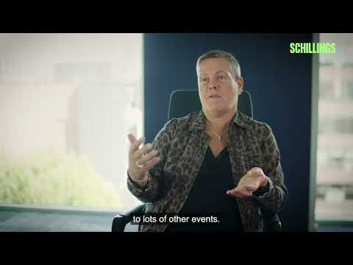
Online Scams
As you watch the clip, make a note of at least three emotional effects of online scams.
Video: https://youtu.be/PUKdk5r2xBU

Slide 13
By the end of the session, I will be able to:
Describe reasons for changes to the rate in online crime
State the impact that online scams have
Identify online scams

Slide 14
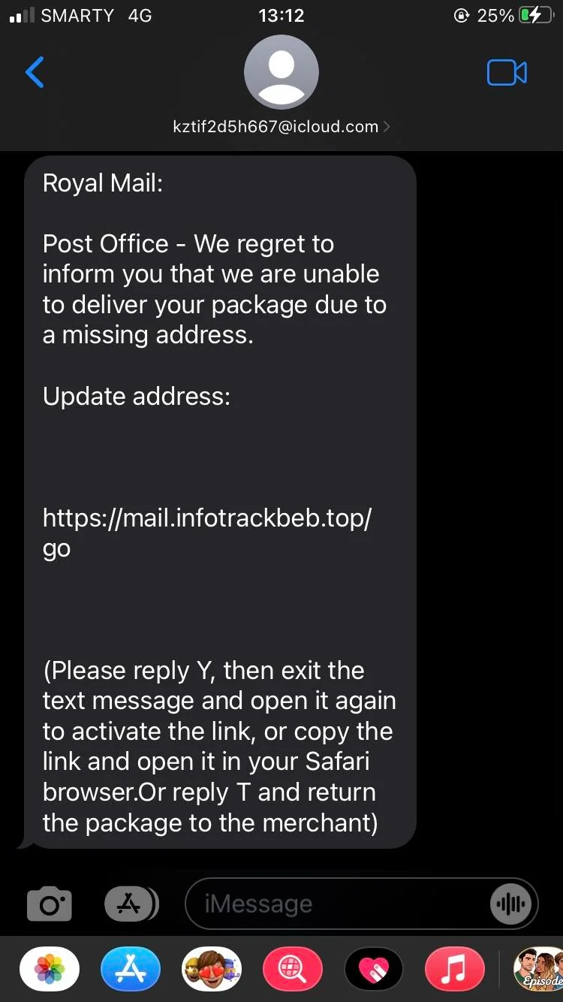

Identifying scams
Karim is feeling anxious about using his online accounts.
He recently got scammed after responding to this fake text message?
How can we tell this is not a genuine message?
Let’s help Karim learn how to spot an online scam.
Using your mini white-boards, respond ‘yes’ or ‘no’.
Source: Are you scam-savvy?
Notes:
Message sent during unsociable hours
Grammar - using a comma instead of decimal
Request for payment via a link - customer would be asked to log-in to their account
Bit.ly link rather than company

Slide 15
Identifying scams
Is there anything suspicious about this text?
Notes:
Message sent from an iCloud address over iMessage
Sending a link that isn’t Royal Mail
Odd instructions: reply to the text as well as open the link

Slide 16
Identifying scams
Let’s help Karim learn how to spot an online scam.
Is it a scam?
Using your mini white-boards, respond ‘yes’ or ‘no’
Source: Are you scam-savvy?

Slide 17
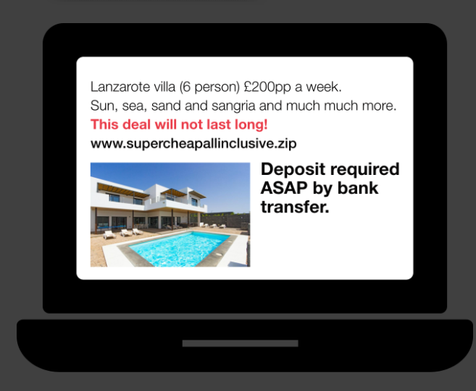
Is this a scam? Yes or No?
This brilliant all-inclusive deal online that’s significantly cheaper than others around. Should Karim buy it?
This could be a scam! Criminals use fake adverts, payment pages and websites to scam consumers. While many online platforms offer secure payment options, criminals will try to persuade a person to pay by bank transfer instead and rush them into making the payment. Read online reviews to check websites are legitimate and always use secure payment channels when booking. If the deal sounds too good to be true, it usually is.

Slide 18
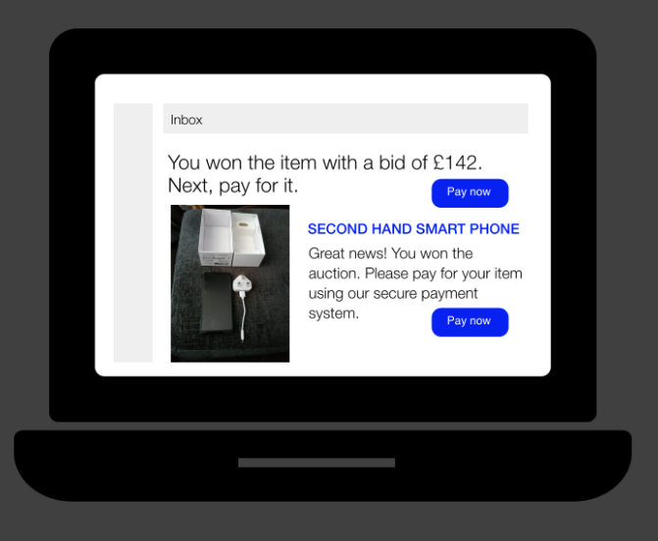
Is this a scam? Yes or No?
Karim has won an item in an online auction that you’ve bid on. Should he log in to his existing online auction account and make a payment?
This is genuine. Always log in to online auction accounts and make payments through the website’s secure payment channel.

Slide 19
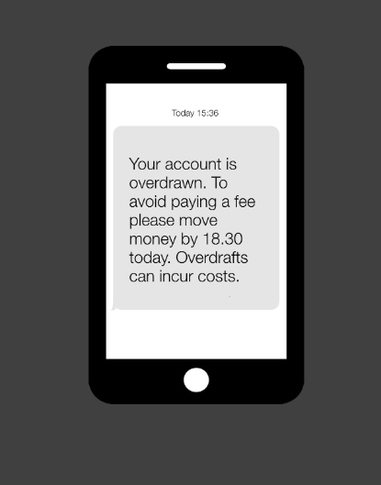
Is this a scam? Yes or No?
Karim receives this text message from his bank asking for prompt payment. Should he deposit some money into his account?
This is genuine. This text doesn't ask for any account details or ask Karim to make payment to someone else. Always use the official banking app or website to make any payments or transfers. If Karim was unsure, he should contact his bank using a known number to check.

Slide 20
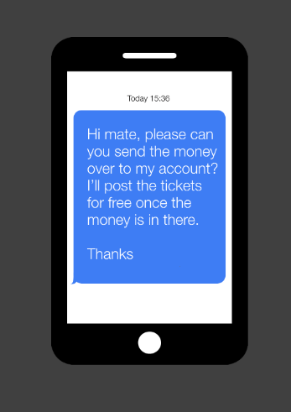
Is this a scam? Yes or No?
Karim is buying concert tickets on social media and he is asked to make payment by bank transfer.
Should he proceed with the payment?
This could be a scam! Always buy goods such as tickets from an authorised seller, not via individuals on social media as the tickets can be fake or not exist.

Slide 21
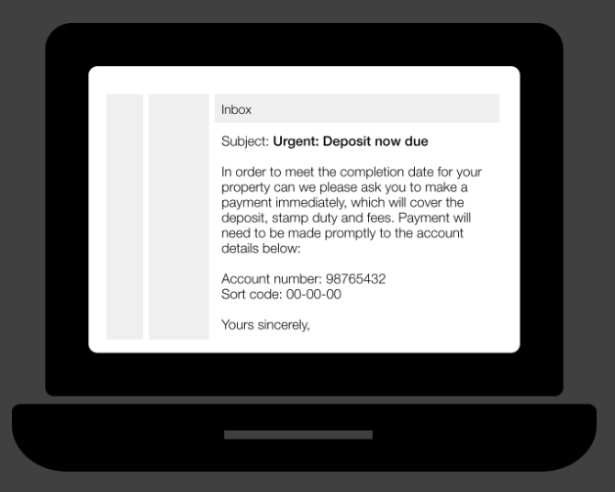
Is this a scam? Yes or No?
Karim is in the process of buying a house and receives an email from his solicitor with new bank details.
Should he transfer his deposit?
This could be a scam! Criminals can intercept emails and pretend to be your solicitor. Always call your solicitor using a known number before transferring any money to check requests are genuine.

Slide 22
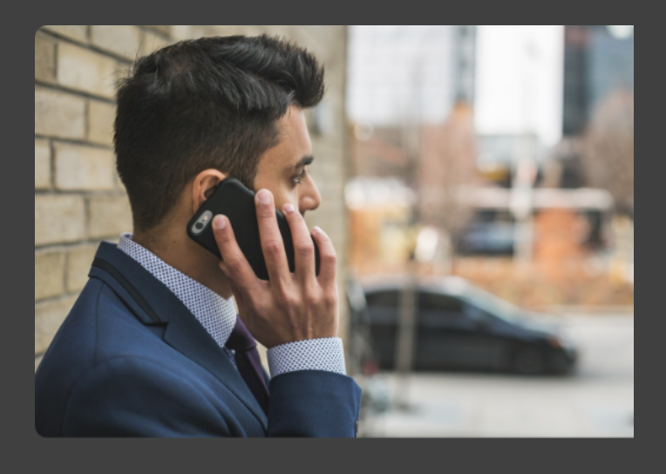
Is this a scam? Yes or No?
Someone calls Karim and states they are a police officer. They’re investigating a staff member at Karim’s bank. They need Karim to transfer some money to another account so they can monitor what happens.
Should Karim transfer the money?
This could be a scam! Criminals want money and will impersonate police officers to get it. The police will never ask Karim to withdraw or transfer money for safekeeping or for the purposes of an investigation.

Slide 23
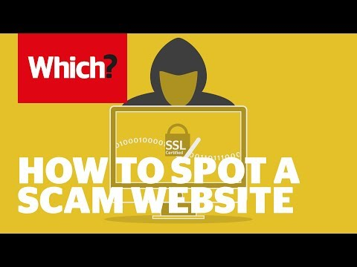
Avoiding other scams
Watch the video and identify ways in which you can protect yourself from scam websites
Then summarise your learning from the session by writing a short post (max 100 words) explaining:
The impact online scams can have
Top tips to identity and protect people from online scams.
Video: How to spot and avoid scam websites

Slide 24
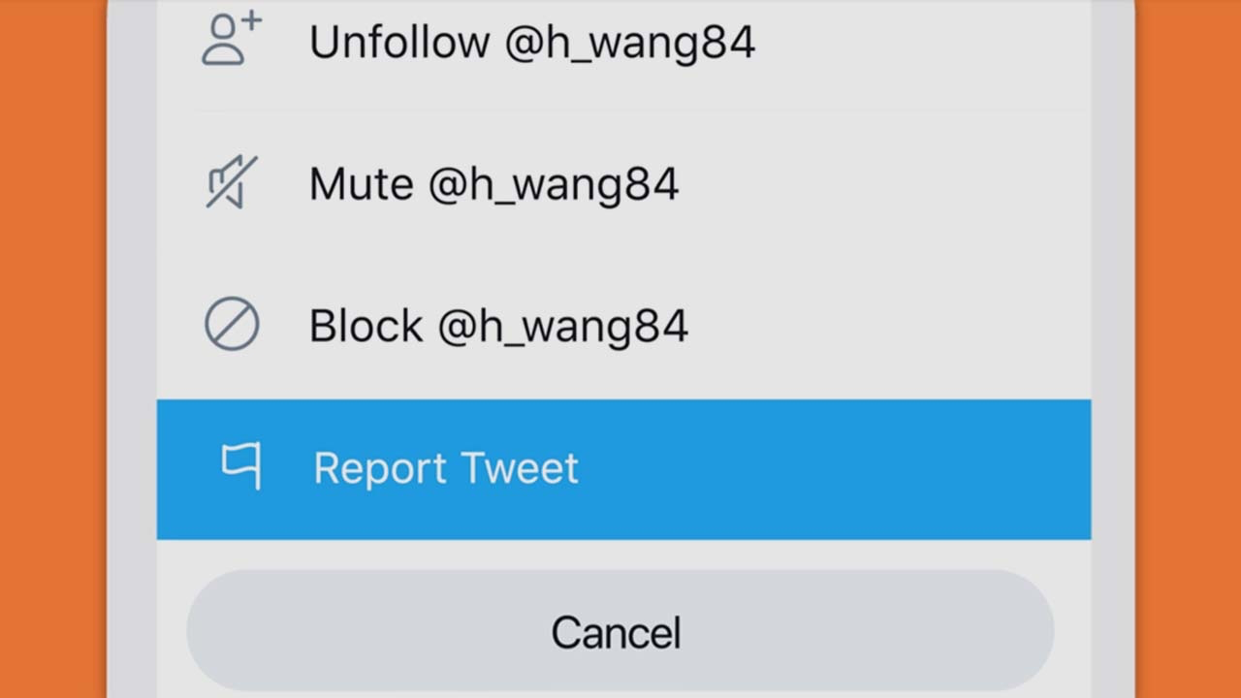
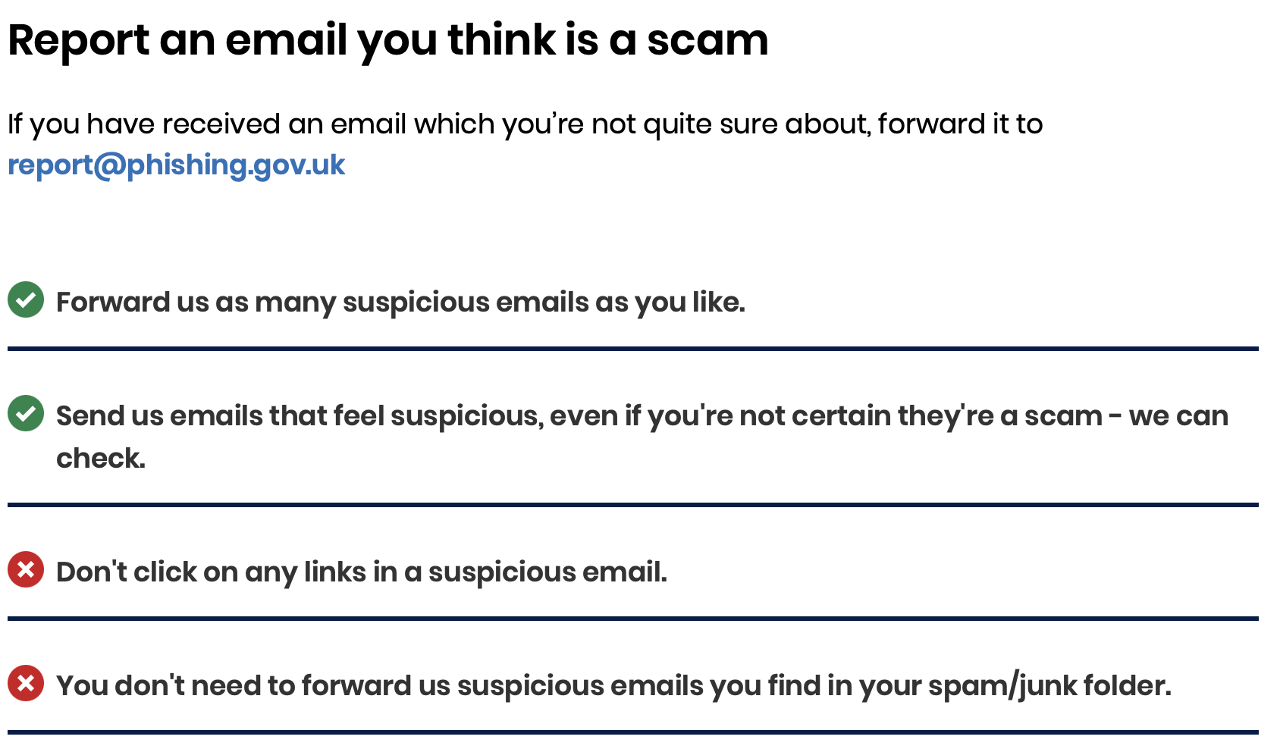
Reporting Scams
All major email provider and social media platforms have a way of reporting scams.
If you think someone is trying to scam you, don’t just ignore it. Reporting it may also help out multiple other people.
You can easily report people on most social media platforms via their profile.
You can also do this via your email provider, but to go a step further, you can also report scams directly to the National Cyber Security Centre.

Slide 25
Reporting Scams

Slide 26
By the end of the session, I will be able to:
Describe reasons for changes to the rate in online crime
State the impact that online scams have
Identify online scams

Slide 27
Any questions?
?

Slide 28



Services available for people who have concerns about their personal finances
Citizens Advice – Debt and Money – This resource contains links to advice on a number of topics, including financial difficulties, cost of living and communicating with creditors.
Action Fraud – UK's national reporting centre for fraud and cyber crime.
0300 123 2040
Childline Helpline
0800 1111
At school, you can speak with an adult you trust.
This could be your form tutor, head of year or the school’s safeguarding officer.
Notes:
https://www.ft.com/content/36d9263b-c492-445a-b7ca-da0595e07d57

Slide 29
Links to learn more!
ARTICLES TO EXTEND LEARNING
Please visit the FLIC learning hub for further resources: Learning Hub FT FLIC
Money Helper- Types of scam
Take five to stop fraud
The money drop -BBC iPlayer
Could your child be recruited as a money mule? (Financial Times, 2023)
Tackling the financial exploitation of students
National crime agency - #DontBeUsed

