Slide 1
How to manage
financial risk
This session is aimed at Year 9 and is also appropriate or KS4 and KS5

Slide 2
Unit outline
Session 1 | Session 2 | Session 3 | Session 4 | Session 5 | Session 6
Mobile phone products | Cryptocurrency | Financial exploitation | Online gaming | Online safety | Pocket money debate

Slide 3
Having a respectful learning environment
We will listen to each other respectfully
We will avoid making judgements or assumptions about others
We will comment on what has been said, not the person who has said it
We won’t put anyone on the spot and we have the right to pass
We will not share personal stories or ask personal questions

Slide 4
Session 6
Pocket money debate

Slide 5
By the end of the session, I will be able to:
Identify reasons for and against young people having pocket money
Assess the risks involved with young people managing their money
Suggest the best ways for young people to manage their money responsibly

Slide 6
Young people and money management
“All young people should have pocket money”
What is your first reaction to this statement?

Slide 7
Young people and money management
Thinking about what you have learnt over the last few weeks, describe 2-3 things that young people should be aware of when it comes to managing their own money.

Slide 8
Young people and money management
“All young people should have pocket money”
Create the table below in your book
No: young people should not have pocket money | Yes: all young people should have pocket money

Slide 9
Young people and money management
With your partner, discuss the questions below to give reasons why young people should not have pocket money
Now fill in your table with the information and arguments you have just discussed.
What are some of the ways people spend money while gaming?
 | No: young people should not have pocket money
 | When it comes to online gaming, in what ways might young people be irresponsible with money management?
 | What are some of the financial risks that young people are exposed to online?
 | Why might some parents and carers choose not to give their children pocket money?

Slide 10
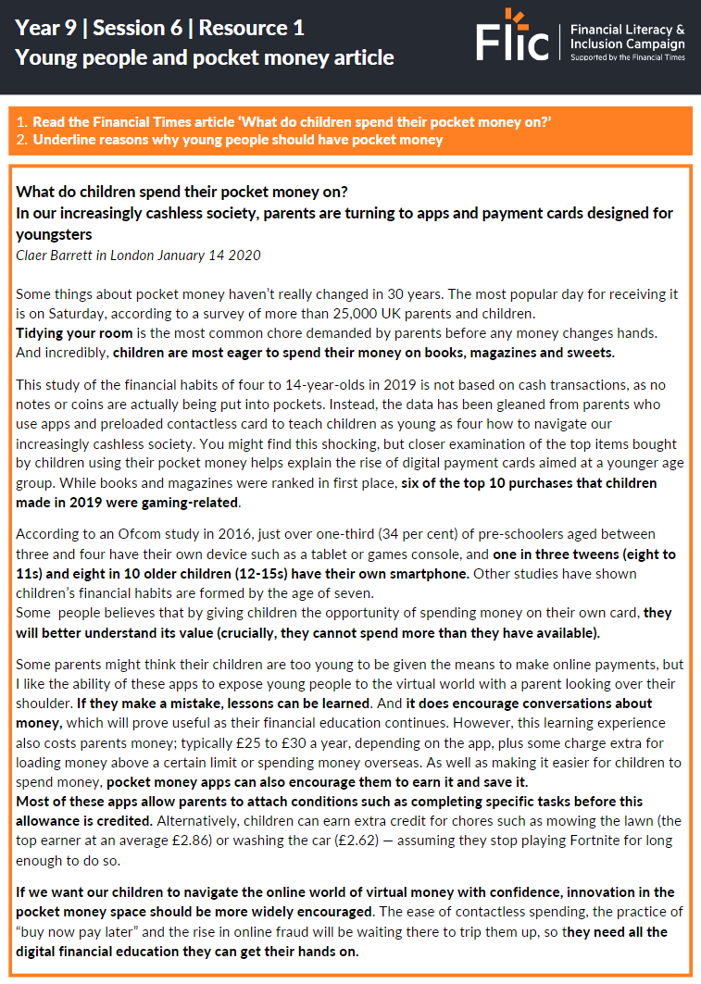
Young people and money management
Now let’s look at some of the reasons why young people should be given pocket money:
Read the Financial Times article ‘What do children spend their pocket money on?’
Highlight reasons why young people should have pocket money
Stretch | Underline reasons why children shouldn’t have pocket money
Notes:
Source: What do children spend their pocket money on?
Delivery Guidance: Use text-to-speech to provide access to article
Microsoft
MS edge has a read aloud function that is built in - these can be accessed by pressing F9
Accessibility features in Microsoft Edge - Microsoft Support
Full text to copy into TTS tool such as TTSReader is below. (Does not exceed daily free character limit)
What do children spend their pocket money on?
In our increasingly cashless society, parents are turning to apps and payment cards designed for youngsters
Claer Barrett in London January 14 2020
Some things about pocket money haven’t really changed in 30 years. The most popular day for receiving it is on Saturday, according to a survey of more than 25,000 UK parents and children. Tidying your room is the most common chore demanded by parents before any money changes hands. And incredibly, children are most eager to spend their money on books, magazines and sweets.
This study of the financial habits of four to 14-year-olds in 2019 is not based on cash transactions, as no notes or coins are actually being put into pockets. Instead, the data has been gleaned from parents who use apps and preloaded contactless card to teach children as young as four how to navigate our increasingly cashless society. You might find this shocking, but closer examination of the top items bought by children using their pocket money helps explain the rise of digital payment cards aimed at a younger age group. While books and magazines were ranked in first place, six of the top 10 purchases that children made in 2019 were gaming-related.
According to an Ofcom study in 2016, just over one-third (34 per cent) of pre-schoolers aged between three and four have their own device such as a tablet or games console, and one in three tweens (eight to 11s) and eight in 10 older children (12-15s) have their own smartphone. Other studies have shown children’s financial habits are formed by the age of seven.
Some people believes that by giving children the opportunity of spending money on their own card, they will better understand its value (crucially, they cannot spend more than they have available).
Some parents might think their children are too young to be given the means to make online payments, but I like the ability of these apps to expose young people to the virtual world with a parent looking over their shoulder. If they make a mistake, lessons can be learned. And it does encourage conversations about money, which will prove useful as their financial education continues. However, this learning experience also costs parents money; typically £25 to £30 a year, depending on the app, plus some charge extra for loading money above a certain limit or spending money overseas. As well as making it easier for children to spend money, pocket money apps can also encourage them to earn it and save it. Most of these apps allow parents to attach conditions such as completing specific tasks before this allowance is credited. Alternatively, children can earn extra credit for chores such as mowing the lawn (the top earner at an average £2.86) or washing the car (£2.62) — assuming they stop playing Fortnite for long enough to do so.
If we want our children to navigate the online world of virtual money with confidence, innovation in the pocket money space should be more widely encouraged. The ease of contactless spending, the practice of “buy now pay later” and the rise in online fraud will be waiting there to trip them up, so they need all the digital financial education they can get their hands on.

Slide 11
Young people and money management
 | Yes: all young people should have pocket money
 | What items do young people typically spend their pocket money on?
 | How are apps designed to help young people make positive money decisions?
 | How can parents and carers help young people to manage their pocket money?
Notes:
Relevant ‘yes’ arguments from article:
Children like to spend money on things like books and magazines: could be educational
By giving children the opportunity to spend money, they will better understand its value. And they can’t spend more than they have available
Pocket money apps for children can allow them to learn how to manage money, while being supervised by parents

Slide 12
Young people and money management
“All young people should have pocket money”

Slide 13
Debate
“All young people have pocket money”
Why do young people need access to their own money?
Other than spending, what are the benefits of young people having access to their own money?
What are some of the financial risks that young people are exposed to?
Stretch | What have you learned to help you make positive choices with money? Write these down for your own personal reflection.
Notes:
Delivery instructions
Possible delivery:
Write as essay: students write their debate responses, demonstrating arguments for and against the statement
Class debate or think/pair/share: students share their arguments verbally

Slide 14
Any questions?
?

Slide 15
Services available for people who have concerns about their personal finances
Citizens Advice – Debt and Money – This resource contains links to advice on a number of topics, including financial difficulties, cost of living and communicating with creditors.
National Debtline – Debt and Money – a debt advice charity run by the Money Advice Trust, offering a free and confidential debt advice service.
Childline Helpline 0800 1111
At school, you can speak with an adult you trust.
This could be your form tutor, head of year or the school’s safeguarding officer.

